Slide 1
Becoming a Critically Reflective Teacher
New Mexico State University, Las Cruces, June 8th 2022
Stephen Brookfield
Distinguished Scholar, Antioch University
http://www.stephenbrookfield.com/

Slide 2
My Web Site
My website is open access so if you want to find out more about any of the exercises or activities I mention go to the page and click on the ‘Resources’ link.
Scroll down & you will find multiple PDF files of workshop packets stuffed with activities or power point files.
Today’s power point is the first one listed: http://www.stephenbrookfield.com/powerpoints-pdfs
You do not need to ask my permission to use any of these resources. If they’re useful then please try them out and adapt them to your context.
www.stephenbrookfield.com

Slide 3
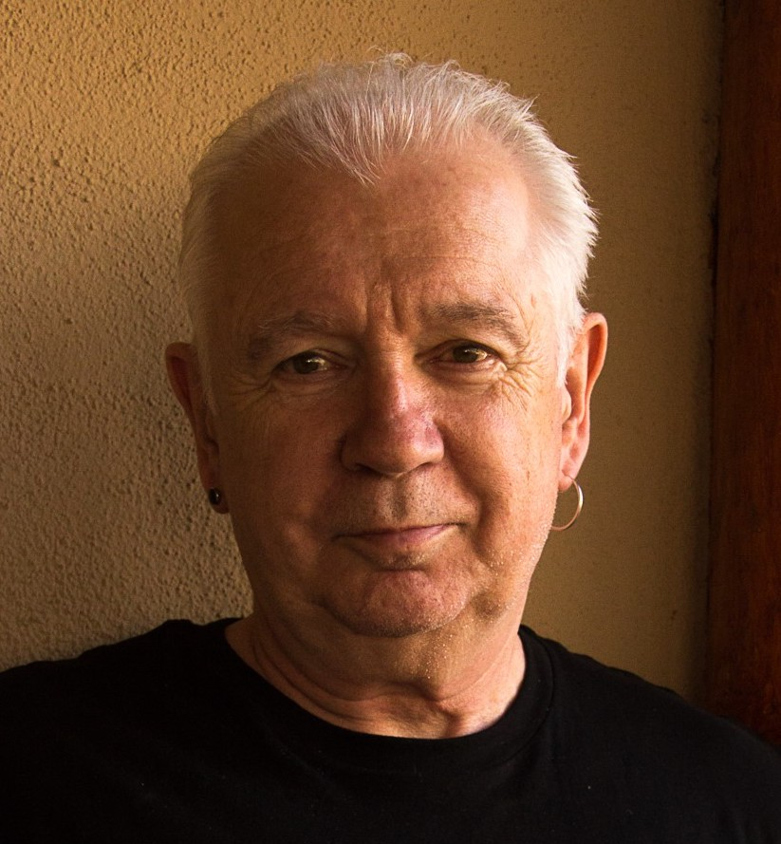

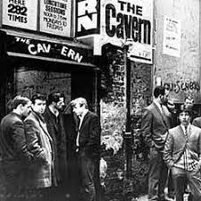

Slide 4
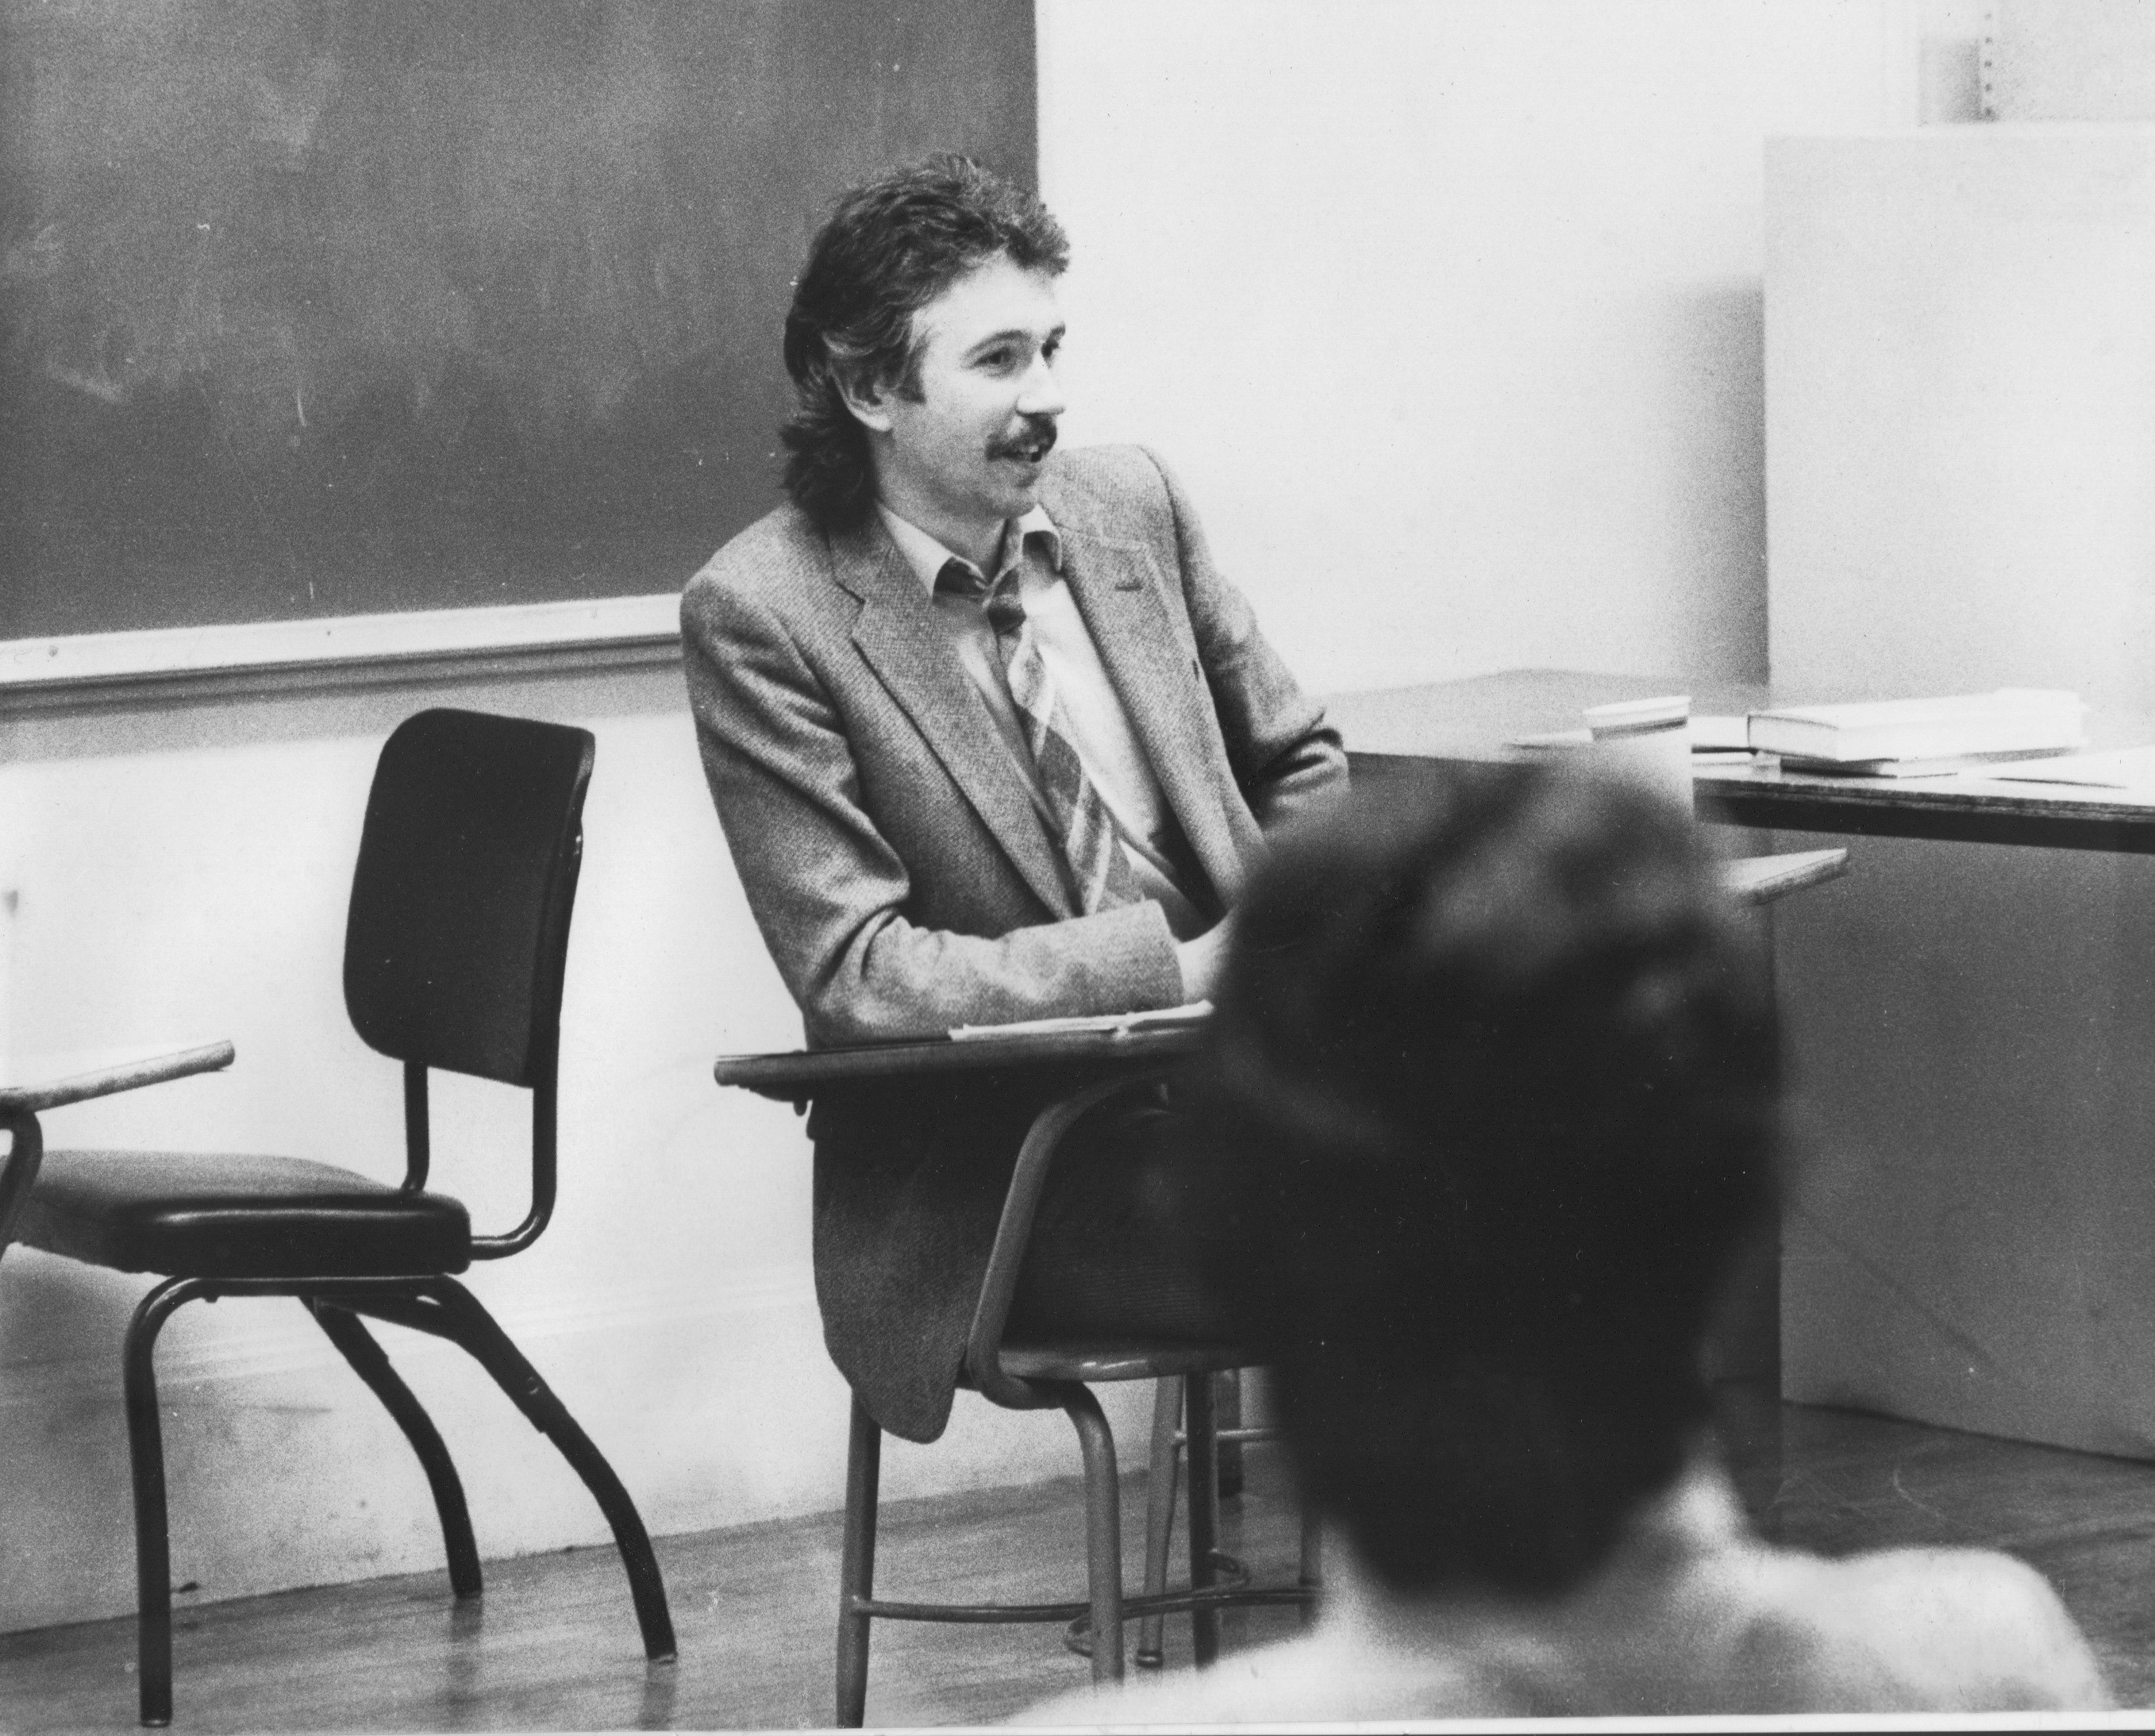
Who I am as a teacher is influenced by who I am as a learner….
History of academic mediocrity –failed high school leaving exams, university places cancelled, College of Technology, graduated in bottom half of my class, turned down for graduate study, failed my master’s degree exam – Broadening student-centered assessment measures
Watching my doctoral supervisor – giving me ‘bad’ inconvenient news in a way that I knew was in my own best interests
Ethical use of teacher power
Relational underpinnings to critical thinking
An authoritative ally

Slide 5
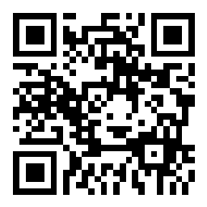
Go to sli.do
Enter Code: 6957287
Or, use the QR Code opposite
Reply to the question: When you have witnessed or enacted being a critically reflective teacher, what does it LOOK, SOUND or FEEL like?
Your responses will help form a word cloud

Slide 6
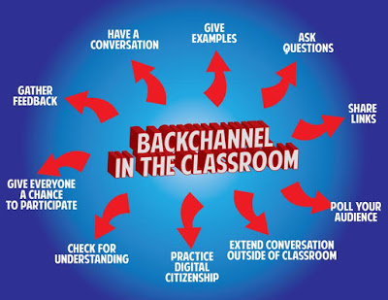
Sli.do backchannelchat.com tweedback.de
Interrupts the normal privileging of extroverts, dominant language speakers
Students can ask questions without fear
You can pose a question at start of class to assess knowledge, experience & preconceptions of students – but also to uncover ‘unsayables’: “what’s a recent example of structural racism you’ve witnessed, enacted or experienced at the school?”
You can pose quick questions during class to check for understanding, identify misconceptions
Students can critique your actions

Slide 7
Checking Assumptions - 4 Lenses on Practice
Students’ Eyes
Colleagues’ Perceptions
Autobiography
Theory/Research

Slide 8
Enacting Critical Reflection as a Leader
- Stephen’s Clinical Depression
Assumptions:
Clinical Depression is Caused by External Circumstances
Therefore I Shouldn’t Be Depressed
The Way to Deal With Depression Is To Reason Through It
I Must Tell Yourself To Snap Out of It
Medications Are For Those Too Weak To Deal With The World
Rooted in Ideology: PATRIARCHY
(Men are to be entrusted with making decisions
by virtue of their superior rationality & logic)

Slide 9
Re-Framed Assumptions
Depression is a chemical imbalance in the brain – not a flaw in character
Talk & cognitive behavior therapy is helpful against a background of medication
Patriarchy damages men by portraying toxic masculinity as the ideal – (“I can deal with this myself”, “I don’t need help”, “Women may need pills but I don’t”, “I need to be strong”)
My responsibility is to make appropriate public disclosure of my own response to my own depression

Slide 10
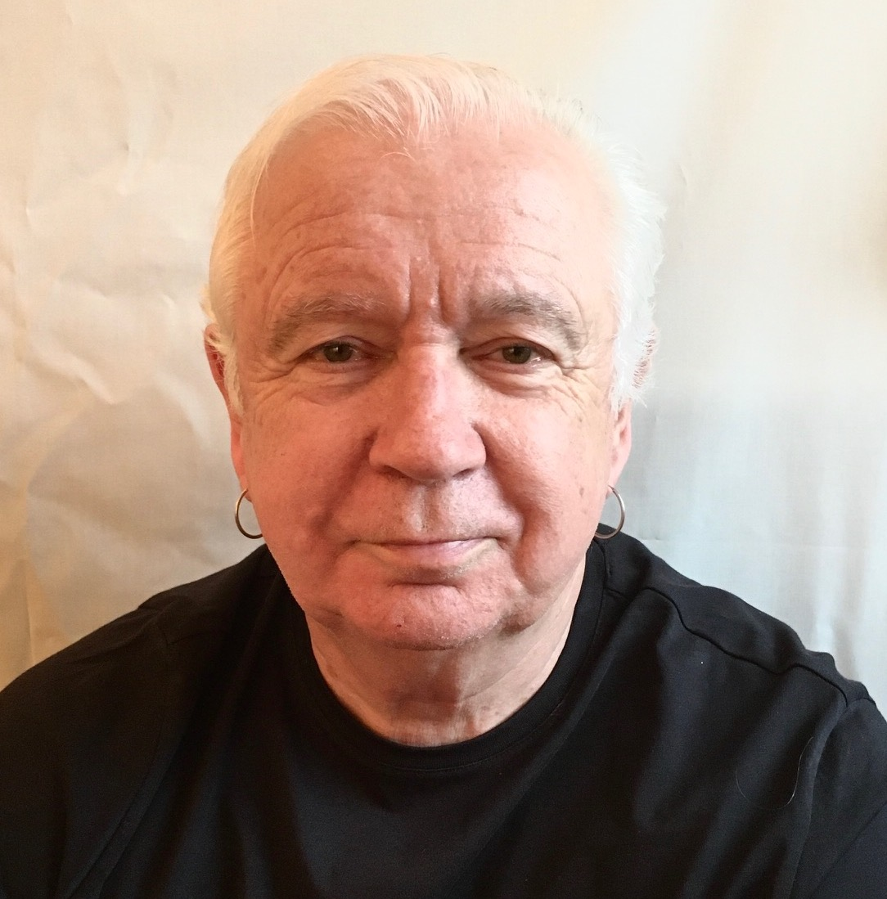
My racial identity – the ‘good White person’
I’ve escaped racist conditioning
I treat everyone the same
I don’t see color
I have nothing to contribute to racial discussions
I can monitor my own racism
I’m a good moral person
My heart is in the right place
My actions always have good intent
Good White People. Shannon Sullivan, 2014. (SUNY Press)

Slide 11
In fact…
I grew up bathed in the idea & practice of White supremacy
Whites act according to the ideals of the European Enlightenment – we use reason, logic & objectivity, we stay calm & should therefore be in charge of making decisions for ALL people. White supremacy positions Whites in superior contrast to people of color who are seen as emotional, unpredictable, volatile & unreliable & should be kept as far from the reigns of power as possible
I will NEVER lose that conditioning
I have a lot to contribute to racial discussions – because I know intimately at a deep level how White supremacy is learned & transmitted
The intent of my actions has no necessary connection to their effects
My responsibility is to talk about my struggle recognizing my own Whiteness, how that structures my life, & how I enact racism
My responsibility is NOT to wait for colleagues of color to raise questions of racism – but to be the first to do that as a normal expectation of professional behavior

Slide 12
The 1st Class Speech
Call me Stephen – friendly atmosphere
I look forward to teaching – I learn so much from my students
My job – help you realize what you know
Questions – encouraged but…
I don’t know all the answers
Questions are gifts for my learning
Mistakes – richest moment in learning
Unexpected Event – pool our wisdom
This speech…. Puts students at ease
Makes me relatable/approachable
Lets them know mistakes are normal
Honours & respects their experiences

Slide 13


Slide 14
What I’ve Learned - POWER IS ALWAYS IN THE ROOM
Student-student power dynamics
How teachers exercise their power ethically & responsibly to support students’ learning

Slide 15

I’ve Learned…
Students are ALWAYS watching you & reading meaning into your words & actions
I’ve Learned…
You can’t really ever be a ‘fly on the wall’ even in discussions where you don’t talk
Visiting Groups
Supportive?
Interfering?

Slide 16
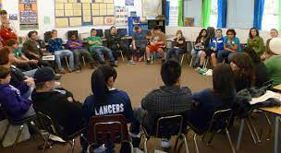
Circle of Voices Protocol
What has happened when an assumption about teaching has been challenged in your career?
Begin with 2 minutes silence for people to think about their response to the question & make written or mental notes
Go alphabetically around the group and have each person give their response to the question(s) they’ve just been thinking about. Each person tries to keep their comments to a minute or so. No interruptions of each other please.
Once everyone has spoken move into open conversation – anyone can speak at any time & there is no order of contribution. However, try to speak ONLY about what someone ELSE said in the opening round of comments.

Slide 17
BENEFITS
My actions are grounded in an accurate understanding of what’s going on with my students – this increases the chances of things working out as I hope they will
I can always articulate the rationale & assumptions for my actions & choices – this gives students a confidence-inducing belief in my teaching expertise
The complexity I uncover means I cease to believe that I can control everything that happens – this reduces my stress
The reality of diversity means I keep alternating pedagogic modalities – this increases students’ engagement
RISKS
Impostorship – I’m muddling through, when will people find me out & see I’m a fraud? How could I have missed this? How could my assumptions have been so wrong? Why didn’t I take that into account?
Lost innocence – the dawning realization that the world’s complexity means you’ll never get it “right” – your leadership will be an ever deepening inquiry into how context alters the dynamics of practice
Power – better understanding of how you are probably never in a ‘power free zone’: how does your exercise of power become em-power-ing?
Loss of control – much of what goes on is completely beyond your influence & control - losing the myth that “everything depends on me”

Slide 18
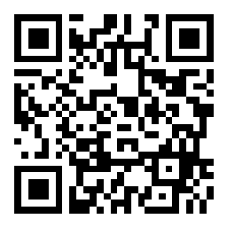
Go to sli.do
Enter code: 8340555
Or use the QR code opposite for smart phones
What is the most intractable teaching problem you face – the one that drains the most time & energy from your work?

Slide 19
Some of Stephen’s Resources
Books:
Becoming a White Antiracist (2021, w/ Mary Hess) Sterling, VA: Stylus
Teaching Race (2019) Wiley (Hoboken, NJ)
Becoming a Critically Reflective Teacher (2017, 2nd. Ed.) Jossey-Bass/Wiley (Hoboken, NJ)
The Discussion Book (2016 w/ Stephen Preskill) Wiley (Hoboken, NJ)
Learning as a Way of Leading (2008 w/ Stephen Preskill) (Wiley Hoboken, NJ)
Website:
www.stephenbrookfield.com

