Slide 1
Becoming a White Antiracist ITLC Lilly Conference, May 12th 2021
Stephen Brookfield
Distinguished Scholar, Antioch University
http://www.stephenbrookfield.com/

Slide 2
How to access this power point
Go to my home page: http://www.stephenbrookfield.com/
Click on the “Resources” link (top left, next to ‘Home’
Scroll down to power points & pdf’s http://www.stephenbrookfield.com/powerpoints-pdfs
This power point is the 1st one listed – Becoming a White Antiracist
Feel free to steal anything from my home page – it’s open access for free download

Slide 3
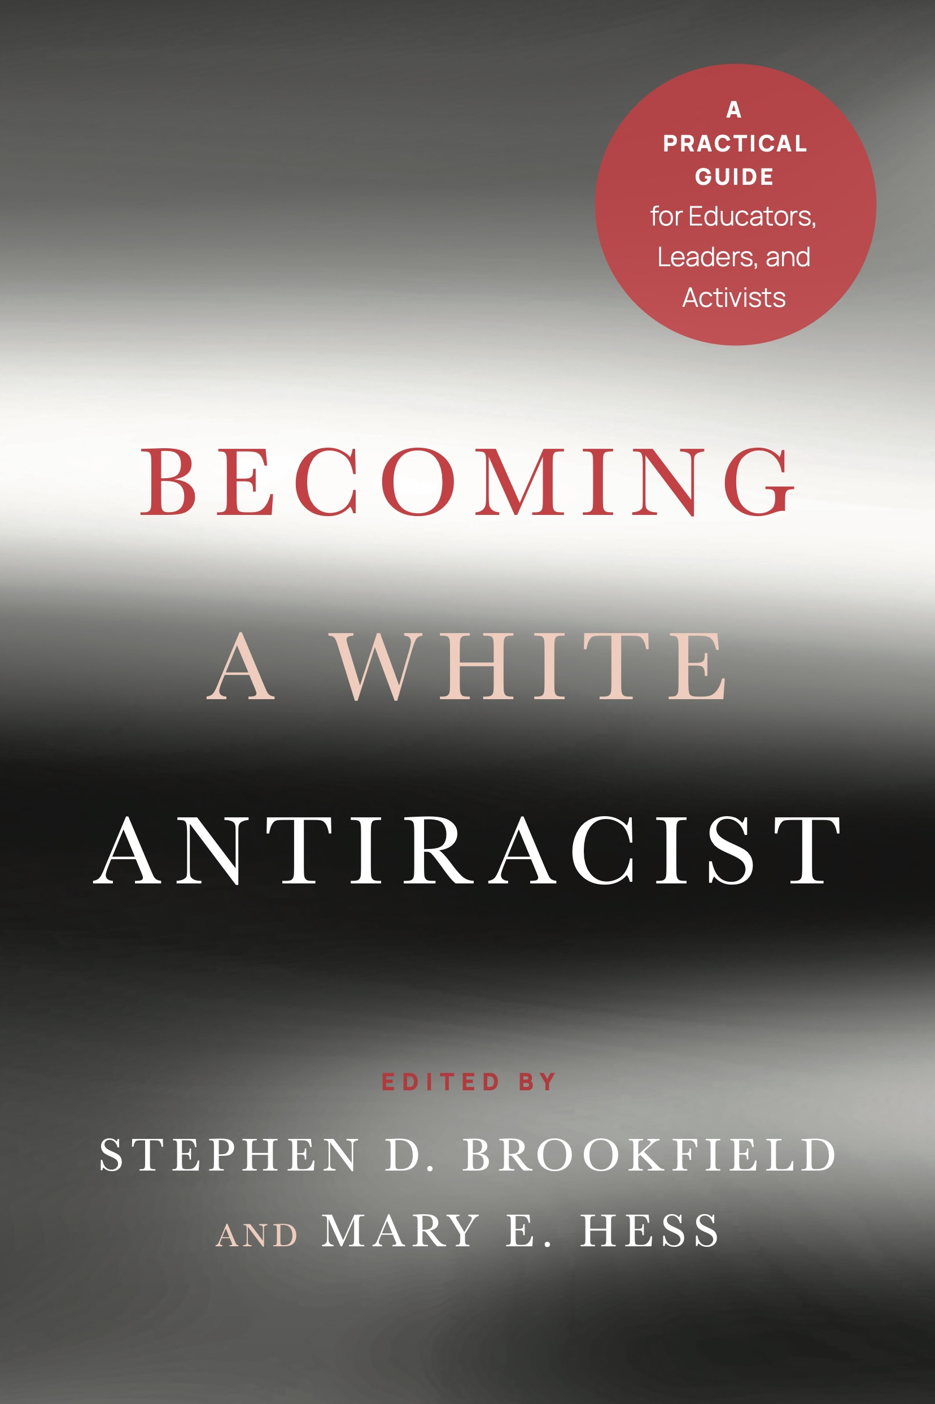
Becoming a White Antiracist: A Practical Guide for Educators, Leaders & Activists https://www.amazon.com/Becoming-White-Antiracist-Practical-Educators/dp/1620368595/ref=tmm_pap_swatch_0?_encoding=UTF8&qid=&sr= Gospel Beautiful Podcast: https://www.buzzsprout.com/680528/8460030-stephen-brookfield-and-mary-hess-becoming-a-white-antiracist

Slide 4
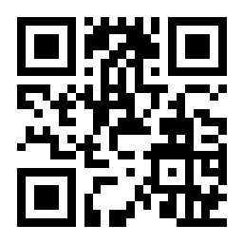
Go to: sli.do
Enter Code: 18670
Or use the QR code opposite
You’ll see a statement: “When I know we're going to talk about race I feel....”
Vote for the response that most closely matches your own

Slide 5
Why WHITE antiracism?
White people are often at an arithmetic level of understanding of the dynamics of racism compared to the calculus level of understanding of Black, Indigenous and People of Color (BIPOC)
BIPOC get tired of seeing white folks wake up to racism & discover white supremacy in front of them
White people often feel the need to confess to racism & seek absolution from BIPOC
White people don’t want to say much & come clean for fear of being called racist
White group members will strive to prove their ‘good white’* credentials & declare their ally-ship
This is why breaking up groups into racial affinity groups is often appropriate & helpful
Shannon Sullivan 2014. Good White People (SUNY)

Slide 6
The danger of performing ‘woke-ness’
“I honestly have been having a hard time being in predominately white classes lately as people in this country realize, again, the issues that exist in America for Black people.
While she was giving her long spiel on her good work, I couldn't figure out where to place my feelings. I could see it from a mile away; I even prepped myself for it before the class.
I prepared for THIS, but I still wasn’t ready. Her actions were soooo predictable, well, to me. It was something I knew was bound to happen in a class placed right in the heart of the world grappling with whether or not Black lives matter. But still I felt completely uncomfortable, sick.
Now, I am not one to dim anyone's light, but all I felt like saying was, "oh, okay. That's cute. You want a cookie?"
I couldn't help but think, "this is not something new, why is it new to you? Why are you just now having these conversations?"
I do not know this woman and may never have a class with her again; however, I will always remember what she did and how it made me feel.”
Carmina Maye 2020 I Really Wanted this to Be a Poem. (Dept. of Art & Art Education, Teachers College)

Slide 7
Racism The system that embeds and enacts the ideology of white supremacy in… The state (legal system, penal servitude, political organizations, policing, schooling, health discrepancies, local government etc.) Civil society (control of commerce, funding & participation in recreational sports, community organizations etc.) Culture (definitions of what constitutes ‘high’ & ‘low’ art & aesthetics, media representations, mainstream media control, social media control, funding for community creativity etc.) Systemic dominance often manifested in daily microaggressions that demean & dismiss BIPOC
White supremacy
An ideology sedimented in institutions, systems & structures which holds that whites, because of their supposedly superior intelligence, capacity to use reason & make calm, objective decisions, should naturally be in positions of power & authority
Correlated with anti-blackness & the criminalization & degradation of BIPOC as inherently volatile, uncontrollable, & possessing a propensity for violent criminality – this is why BIPOC need to be ‘controlled’ so as to keep them from holding the reigns of power & authority

Slide 8
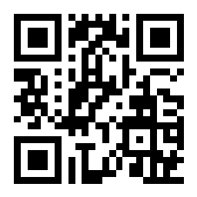
Let’s use sli.do for questions & reactions To ask questions, make comments, give reactions & post criticisms – all anonymously Go to sli.do Enter code 194074 Or use the QR code opposite

Slide 9
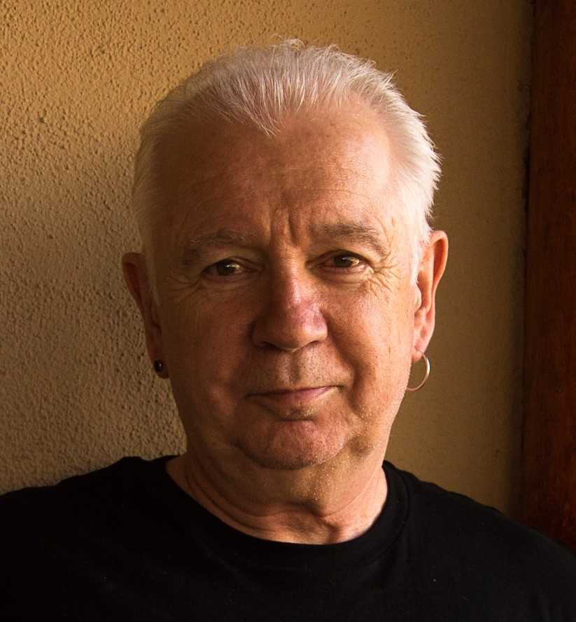
“Good Whites” – like me (Stephen)
Believe that we don’t see race
Believe everyone is a human being & we should treat everyone the same (colorblind ideology)
Believe we focus on actions & individual character, not racial identity
Choose when to engage in race and anti-racism
Can monitor our own racism
Believe we have a pure, anti-racist soul
Believe we are free of white supremacist conditioning
View racism as something committed by less enlightened whites
Regard ourselves as allies of people of color
Shannon Sullivann 2014. Good White People (SUNY)

Slide 10
“Good whites” - like me (Stephen)
Will vigorously deny any racist intent when confronted with examples of their learned racism & claim they have been misunderstood, are acting innocently, & are being unfairly accused
Will become defensive & immediately seek to explain to people of color the “real” meaning of their behavior
Will resist “sitting with” the reality that they have learned racism & white supremacy throughout their lives & carry those viruses
Will accuse people of color of imagining things, seeing racism where it doesn’t exist, & denying the validity of whites’ experience
Will come to each other’s defense in multi-racial discussions
I know this because these are all of my learned behaviors
(Robin DiAngelo White Fragility 2018)
(Shannon Sullivan Good White People 2014)

Slide 11
Hard Truths – What I Know as a White Instructor in a Multiracial Environment
I MUST call out racist behavior (including in myself) as soon as I see it. If I don’t I will have no credibility in the eyes of students and colleagues of color.
I MUST assume that for students and colleagues of color EVERYTHING is seen through the lens of race. For them, NOTHING is “race free”.
I MUST acknowledge my own racist behavior when it’s pointed out to me – not try to ‘explain’ it away, not protest my innocence: I must regard it as truth.
I MUST NEVER try to talk people of color “out of” their testimony of racism.
I MUST NEVER invoke “being respectful” or “seeing all sides of this” as a way of avoiding painful truths about my own socialization into, & learning of, racism.
I MUST NEVER claim to be an “ally” or anti-racist “friend”.
I MUST NEVER ask people of color to teach me about racism or to tell me what I should do – figuring out what whites should do is OUR responsibility.

Slide 12
So where do white educators go from here?
Understand that calling out racism is the responsibility of whites
Don’t wait for people of color to say they’re uncomfortable with something – if you have any unease, name it
Work on naming racism as LEARNED behavior – not individual soul flaw
Strive to model anti-racist awareness in your own contributions
Understand white privilege/power as an unconscious phenomenon – not worrying about how your race makes things difficult for you
Don’t expect gratitude or thanks – you’re just doing the right thing
Don’t preach at, or disdain, those you regard as “less enlightened”
Don’t set up people to “confess” & then grant absolution
Don’t stay silent in multiracial discussions
Do assume you’ll say the “wrong” thing & leave feeling you messed up
Don’t declare yourself an ally to BIPOC – but act as one

Slide 13
Preparing to Teach with Race in Mind
Lose Your Desire/Expectation to Be Perfect
Send Round Introductory Reading/Viewing*
Take the Emotional Temperature –sli.do, Mood Meter
Begin By Modeling Self-Disclosure
Introduce the Concept of Brave Space
Use Conversational Protocols to Engage Everyone
(Circle of Voices, Circular Response, Bohmian)
Check In Regularly via Anonymous Channels
(sli.do, backchannelchat.com)
* Letter to White America (George Yancy) https://opinionator.blogs.nytimes.com/2015/12/24/dear-white-america/
* What it Means to be American (Color of Fear) https://www.youtube.com/watch?time_continue=3&v=2nmhAJYxFT4&feature=emb_logo
* Conversations on Race (New York Times) https://www.nytimes.com/interactive/projects/your-stories/conversations-on-race
* How Can We Win (Kimberly Latrice Jones) https://www.youtube.com/watch?v=ZkedkvNn5V0

Slide 14
Some Resources from Stephen
Becoming a White Antiracist; A Practical Guide for Educators, Leaders and Activists (Stylus, 2021) w/Mary Hess
Gospel Beautiful Podcast: https://www.buzzsprout.com/680528/8460030-stephen-brookfield-and-mary-hess-becoming-a-white-antiracist
Teaching Race: Helping Students Unmask and Challenge Racism (Jossey-Bass, 2019)
The Discussion Book: 50 Great Ways to get People Talking (Jossey-Bass, 2016) w/ Stephen Preskill
Powerful Techniques for Teaching Adults (Jossey-Bass, 2013)
Teaching for Critical Thinking (Jossey-Bass 2012)
Handbook of Race and Adult Education (Jossey-Bass, 2010) w/ Vanessa Sheared, Juanita Johnson-Bailey, Scipio Colin Jr III, & Elizabeth Peterson
www.stephenbrookfield.com
(Go to “Resources”, “Creating an Anti-Racist White Identity” and “Recent Writings” links)

Slide 15
General Resources
Ijeama Oluo – So You Want to Talk About Race (2019) https://www.youtube.com/watch?v=TnybJZRWipg
George Yancy - Look! A White (2012), What White Looks Like (2004), White Self-Criticality beyond Anti-Racism (2016) https://www.youtube.com/watch?v=fyZNAAr8czE
Derald Wing Sue – Race Talk & the Conspiracy of Silence (2016) https://www.youtube.com/watch?v=Nrw6Bf5weTM&t=53s
Shannon Sullivan – Good White People (2014) https://www.youtube.com/watch?v=UZo06BjmbbE
Robin DiAngelo – White Fragility (2018) https://www.youtube.com/watch?v=45ey4jgoxeU
Ibram X. Kendi – How to Be an Anti-Racist (2019) https://www.youtube.com/watch?v=TzuOlyyQlug
Glenn Singleton – Courageous Conversations About Race (2014) https://www.youtube.com/watch?v=IwaOBXzJ3hs
Tim Wise – White Like Me (2011) https://www.youtube.com/watch?v=N4fbr1LlxEk

