Slide 1
Whiteness & Antiracism Carleton Class of 71/72 Committee Meeting
Stephen Brookfield
http://www.stephenbrookfield.com/
https://www.antiracisttraining.org/

Slide 2
Working Assumptions: Our Understanding of Racism
Ideological/
Cultural
Institutional/
Structural
Interpersonal/Relational
Individual/
Intrapersonal
Racism often seen as individual acts
We see racism as a SYSTEM that is created to maintain & enforce power and advantage
For Carleton to become an antiracist institution means uncovering the institutional racist practices
Antiracist training is not the same as diversity training.
Notes:
Racism often seen as individual acts of prejudice, individual biases, and acts of disparagement & exclusion. In this view you can become antiracist by resolving to have a better heart & greater resolution in monitoring one’s own behaviors
We see racism as a SYSTEM that is created to maintain & enforce the power and advantage of one particular racial group – in the USA this group is European-American Whites
So, for us, for Carleton to become an antiracist institution means uncovering the institutional practices, habits and systems that work to exclude BIPOC (Black, Indigenous & People of Color) communities
Antiracist training is not necessarily the same as diversity training. Diversity training promotes a valuable & necessary appreciation of the different talents, abilities & experiences present in a community & how these can be leveraged for the common good.
Antiracist training focuses on uncovering & changing institutional systems practices, patterns & habits that exclude BIPOC groups. At times these trainings intersect; at other times they have different emphases.
START WITH THE INDIVIDUAL AND INTERPERSONAL – NEXT PHASE IS THAT WE ENCOURAGE AN INSTITUTIONAL AND IDEOLOGICAL FOCUS

Slide 3
Antiracism Training at Carleton
Spring 2021:
Monthly Community-Wide Didactic Events
Monthly Discussions involving ALL Carleton community members in Racial Affinity Spaces
12 Affinity Group meetings per month – 7 white only groups, 3 BIPOC only groups, 1 biracial identity group and 1 open to all racial identities.
Date | Title
January 21 | Kick-Off: What Does It Mean for Carleton to Commit to Antiracism?
February 4 | What Racial Identity Means for How Life at Carleton Is Experienced
March 4 | What Is Racism?
April 1 | Implicit Bias and Microaggressions
April 29 | Bystander Interventions and Allyship

Slide 4
Today’s Focus
Many diversity efforts are understandable focused on making BIPOC folk feel acknowledged and included, and on learning about their experiences and cultural traditions. What often gets pushed to the side is the reality of white supremacy and how white racial identity & white epistemology construct our world at Carleton and elsewhere.
Many BIPOC have urged that the most important work whites can do is try to understand what it means to be white.
In this session we will explore as a group the connection between naming and challenging whiteness and white supremacy, and becoming antiracist.

Slide 5
DEFINING TERMS - RACISM
Racism is NOT individual acts of meanness, implicit bias, cultural blindness that come from a place of moral unfitness - though these all reflect a racist system
Racism is a SYSTEM constructed to maintain the power & supremacy of one group. In the US this is Euro-Americans. In other countries it’s ethnicity / religion
In the US this system perpetuates inequality and exclusion through the dissemination of an ideology of white supremacy. This ideology views all non-whites as less than fully human. Whiteness becomes the de-facto definition of humanity, of leadership.
A racist system ensures that communities of color are targeted & harmed but that this is accepted as the natural way of the world - school to prison pipeline, the criminalization of blackness, brownness and redness, the effects of Covid 19.
Whites LEARN racism in daily interactions with the system, in breathing the cultural air of stereotypes, & within white-only groups
So early on – establish that racism is a LEARNED BEHAVIOR, not a personal character flaw: a consciousness that structures how we move through the world

Slide 6
Remember – Racism is “Normal”
Racism is NORMAL & PERVASIVE (though obviously deeply harmful, dehumanizing, brutalizing, violent, destructive and immoral) (CRT)
It’s normal because we live in a racist system & have grown up under white supremacy – so acting in racist ways is not an example of your fundamentally flawed soul – IT’S WHAT YOU’VE BEEN TAUGHT TO DO! (often completely without your awareness)
So get past your “shame” and “guilt” at thinking of yourself as being racist – you didn’t set out intentionally and deliberately to become racist: RACISM HAPPENED TO YOU! (by dint of growing up in the USA)
We need to recognize racism for what it is: a LEARNED BEHAVIOR
Am I racist? Of course! I grew up in a racist world. How could I NOT be?

Slide 7
White Supremacy
Core Idea – because of their innately superior intelligence, ability to use reason & logic, & capacity for calm objective analysis, whites should be entrusted with the power & control to make decisions for everyone else. People of color are too unsophisticated, irrational & emotional to be entrusted with power. They have ‘soul’ and physical grace but are deemed not to possess intelligence & are driven by animalistic instinct.
An unacknowledged component of white identity – if you are white assume that you, like me, have this idea in your consciousness at an unacknowledged level. You may think you are past it, but it’s in you.
This core idea ‘normalizes’ racism for ‘good whites’ – we may deplore racism but we enact it because of learned white supremacy

Slide 8
Let’s start with an anonymous social media tool
Go to sli.do
Enter the code: 69649
Respond to the question there: Think about your own experiences as Carleton alumni and activists. What does it mean to be white for your time here and in the wider world?

Slide 9
Let’s try a 2nd sli.do question
Go to sli.do
Enter the code: 97374
Respond to the question: What do I see as my greatest challenge in becoming antiracist?

Slide 10
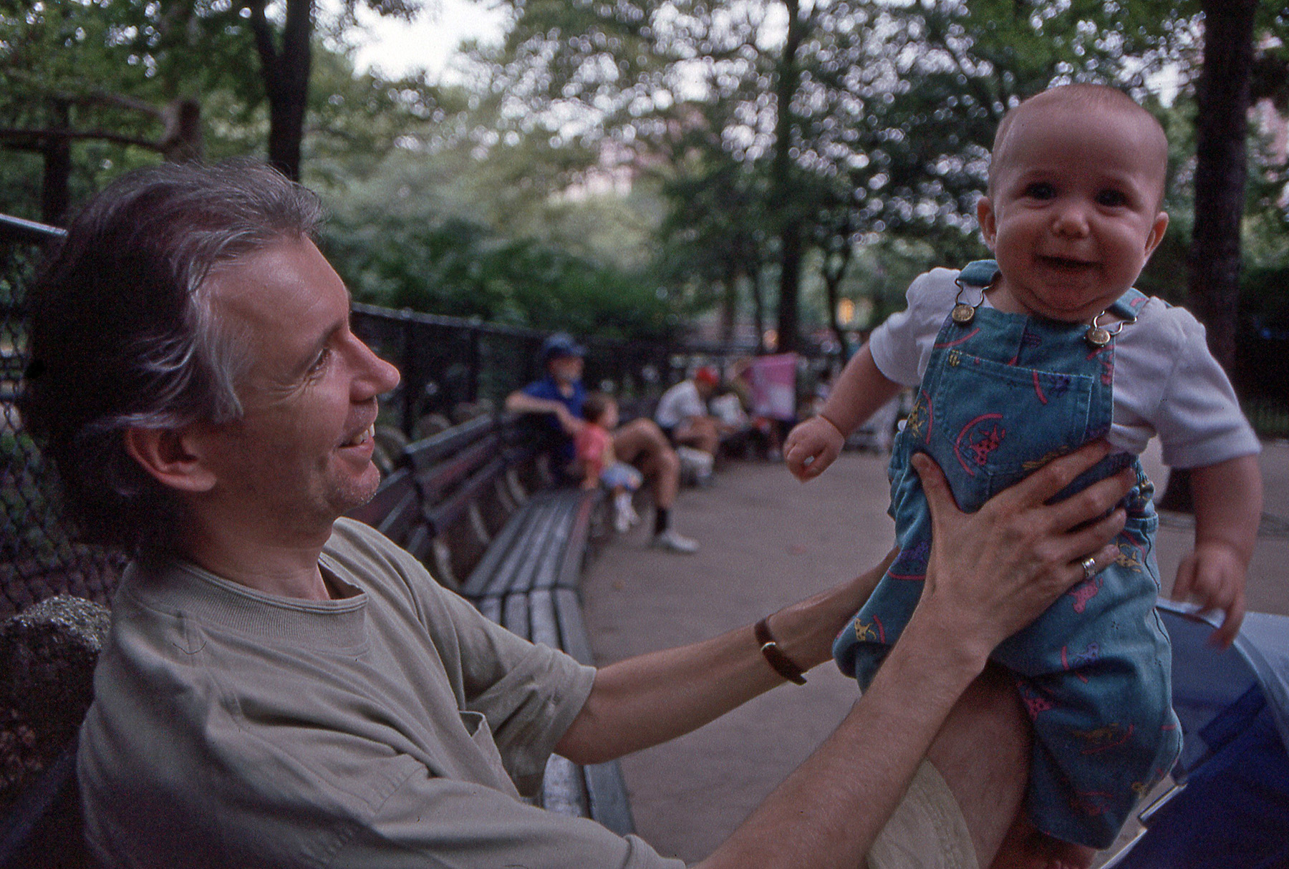
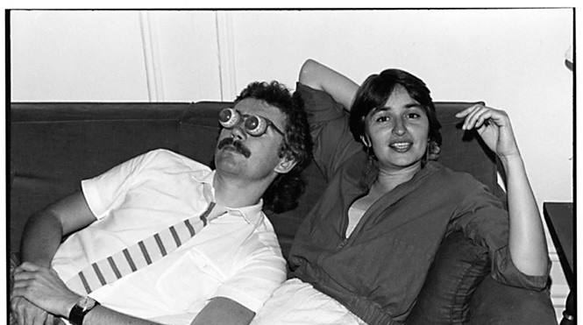
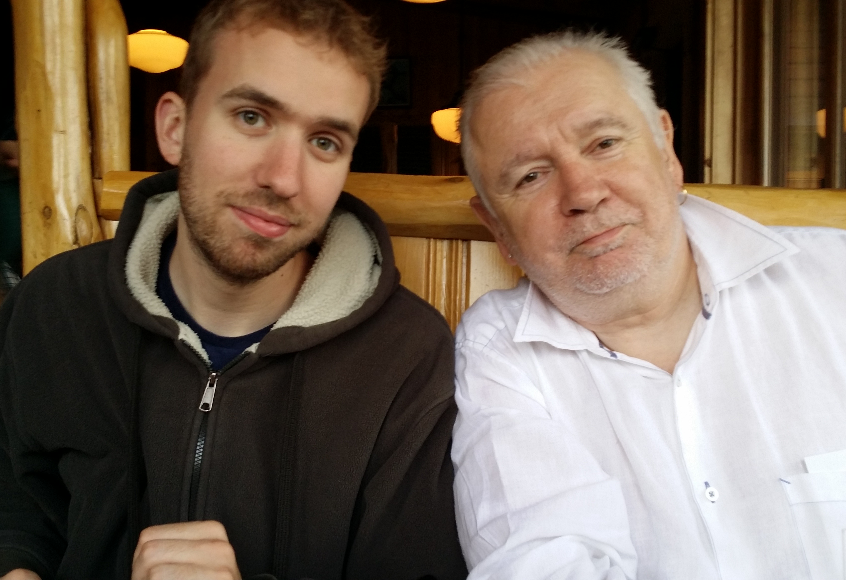
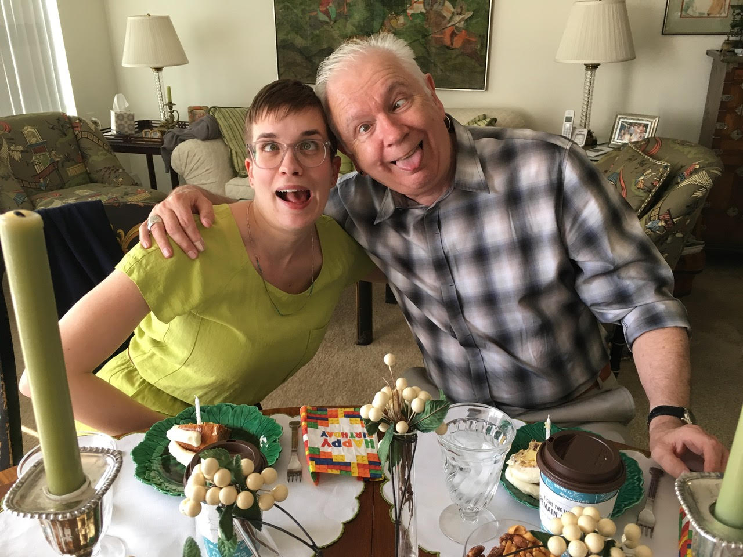
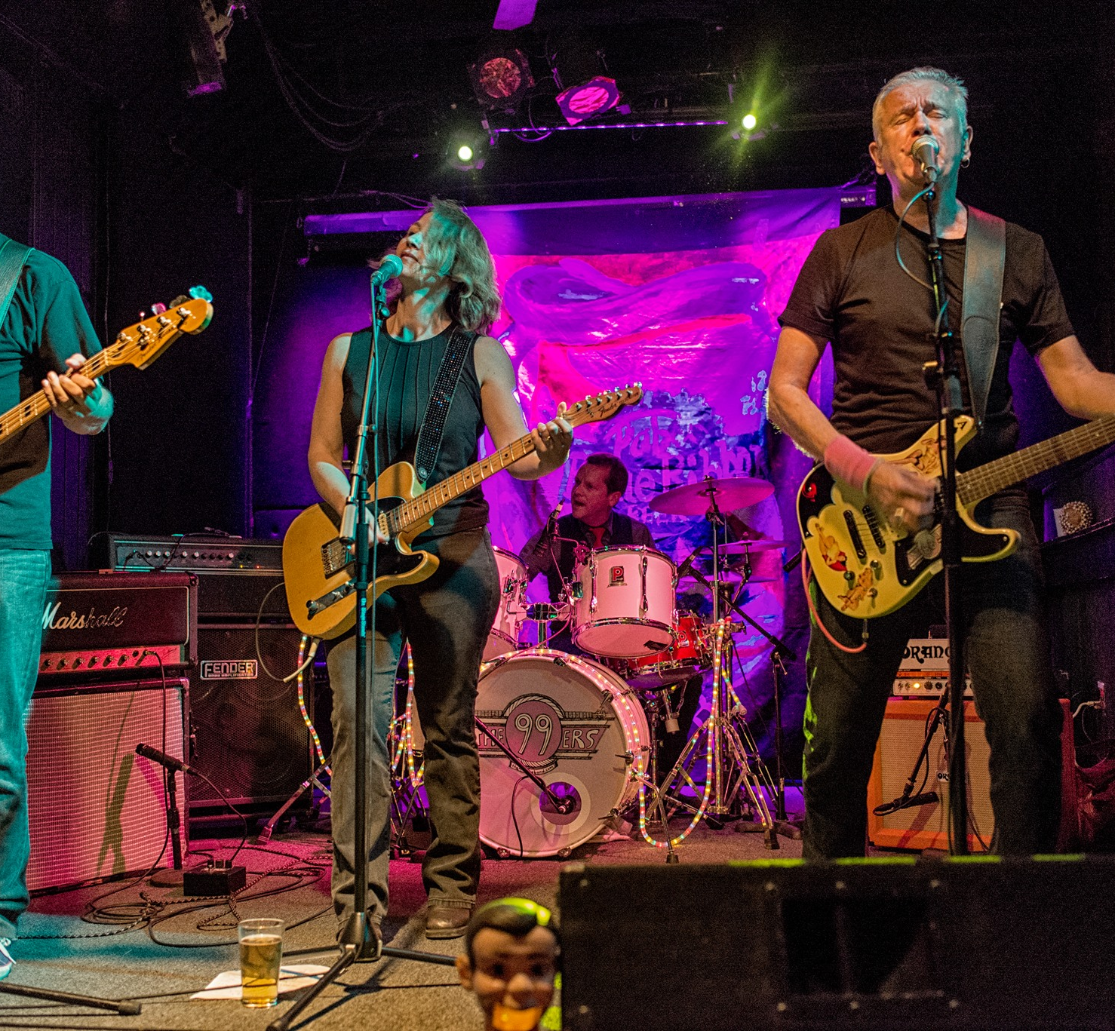
Who we are shapes how we experience the world
As a White man Stephen has….
Tried not to see color & treat everyone the same (color blindness)
Chosen when to focus on race
Assumed good intent on the part of authorities
Is used to seeing people who look like him in positions of leadership
Can walk around stores with no fear of surveillance (despite shoplifting)
Been rewarded for raising issues of race
Does not have to prepare his white children for racial profiling
Expects his expressions of ally-ship to be taken seriously
Has a visceral fear of blackness as dangerous & volatile
Can be publicly proud of who he is & where he comes from
Shannon Sullivan Good White People (SUNY, 2014)

Slide 11
Some Insights from Work on White Racial Identity
Good White People (like Stephen)
Assume they have escaped racist conditioning & socialization
Try to be colorblind & focus on the person’s actions, not their racial identity
View whiteness as the universal standard for what is human & what is normal, without being aware of that reality
Believe we can monitor our own racism & control how our actions are perceived
See racism as something committed by less educated, less enlightened whites
See racism as acts of individual behavior that can be eradicated by a good heart & the exercise of moral courage
Think that by resolving to be better we can quickly lose our learned biases
Shannon Sullivan: Revealing Whiteness (Indiana University Press, 2006) Good White People (SUNY Press, 2014)
Robin DiAngelo White Fragility (Beacon Press, 2018)
Notes:
George Yancy – Look, a White! (Temple University press, 2012)
Janet Helms –A race is a nice thing to have (Cognella Publishing, 2019, 3rd ed.)
Shannon Sullivan – Good White people (SUNY Press, 2014)
Tim Wise – White like me (Counterpoint, 2011)
Joe Feagin – The White racial frame (Routledge, 2020, 3rd ed.)

Slide 12
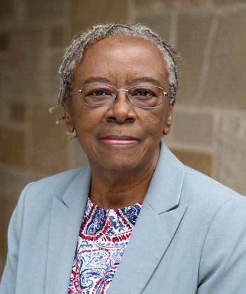
White Racial Identity Development
Status | Description
Contact | Obliviousness. Being White is viewed as a "normal" state of being which is rarely reflected upon, and the privileges associated with being White are simply taken for granted.
Disintegration | Increased interactions with people of color and/or exposure to new information about the reality of racism greater awareness is often accompanied by feelings of guilt, anger and sadness. These emotions can lead to denial and resistance to this new learning, but they can also be a catalyst for action.
Reintegration | Feelings of guilt and denial may be transformed into fear and anger toward people of color. Resentful "blaming the victim" may be used as a strategy to avoid dealing with the uncomfortable issue of racism, as well as avoiding the struggle to abandon racist assumptions and define a new, anti-racist identity
Pseudo-independence | Intellectual understanding of the unfairness of racism as a system of advantage and a recognition of the need to assume personal responsibility for dismantling it. The individual may seek to distance themselves from other Whites, and actively seek relationships with People of Color as a way of reducing the social isolation experienced earlier.
Immersion/ Emersion | Actively seeking answers to the questions, "Who am I racially? What does it really mean to be White in society?," the individual needs information about White allies, those Whites who have worked against racism, as role models and guides for a new way to thinking about White identity
Autonomy | The internalization of a positive White racial identity and is evidenced by a lived commitment to anti-racist activity, ongoing self-examination and increased interpersonal effectiveness in multiracial settings
Janet Helms, Ph.D.
A race is a nice thing to have Cognella Publishing (2013)
Notes:
BRYANA

Slide 13
Hard Truths – What I Know as a White Person
In multiracial settings I MUST call out racist behavior (including in myself) as soon as I see it. If I don’t I will have no credibility in the eyes of people of color.
I MUST assume that for Black, Indigenous and People of Color (BIPOC) EVERYTHING is seen through the lens of race. For them, NOTHING is “race free”.
I MUST acknowledge my own racist behavior when it’s pointed out to me – not try to ‘explain’ it away, not protest my innocence: I must regard it as truth.
I MUST NEVER try to talk people of color “out of” their testimony of racism.
I MUST NEVER invoke “being respectful” or “seeing all sides of this” as a way of avoiding painful truths about my own socialization into, & learning of, racism.
I MUST NEVER claim to be an “ally” or anti-racist “friend”.
I MUST NEVER ask people of color to teach me about racism or to tell me what I should do – figuring out what whites should do is OUR responsibility

Slide 14
So where do we go from here?
Understand that calling out racism is the responsibility of whites
Don’t wait for people of color to say they’re uncomfortable with something – if you have any unease, name it
Work on naming racism as LEARNED behavior – not individual soul flaw
Strive to model anti-racist awareness in your own contributions
Understand white privilege/power as an unconscious phenomenon – not worrying about how your race makes things difficult for you
Don’t expect gratitude or thanks – you’re just doing the right thing
Don’t preach at, or disdain, those you regard as “less enlightened”
Don’t set up people to “confess” & then grant absolution
Don’t stay silent in multiracial discussions
Do assume you’ll say the “wrong” thing & leave feeling you messed up

Slide 15
Let’s break into groups for a Circle of Voices
(1) Begin with a period of 1-2 minutes silence where you think about the different ways you could complete this sentence: “whenever I have witnessed or enacted effective antiracism, it looks, sounds or feels like…..”
(2) Go alphabetically around the group and have each person give their response to the prompt above. Each person tries to keep their comments to a minute or so. No interruptions in this round please – let each person have the floor.
(3) Once everyone has spoken move into open conversation – anyone can speak at any time & there is no order of contribution. However, try to speak ONLY about what someone ELSE said in the opening round of comments.
As themes, questions & issues arise please post them to Zoom Chat

