Slide 1
Leading as the Practice of Critical Reflection Wisconsin Technical College System 2022 Collaborative College Connections Conference
Stephen Brookfield
Distinguished Scholar, Antioch University
http://www.stephenbrookfield.com/

Slide 2
My Web Site
My website is open access so if you want to find out more about any of the exercises or activities I mention go to the page and click on the ‘Resources’ link.
Scroll down & you will find multiple PDF files of workshop packets stuffed with activities or power point files.
Today’s power point is the first one listed: http://www.stephenbrookfield.com/powerpoints-pdfs
You do not need to ask my permission to use any of these resources. If they’re useful then please try them out and adapt them to your context.
www.stephenbrookfield.com

Slide 3
Leadership A PROCESS in which individuals, groups and collectives seek to enact change… Helping communities & organizations to create & develop a vision of where we all want to be Modeling the process we seek to enact Establishing communicative systems that help people realize connections, experiences & agendas they have in common Finding ways to hold people to account Galvanizing & retaining enthusiasm
Critical Reflection is…………
Hunting & Checking Assumptions
Exploring Multiple Perspectives
Taking Informed Actions

Slide 4
Enacting Critical Reflection as a Leader - Stephen’s Clinical Depression
Assumptions:
Clinical Depression is Caused by External Circumstances
Therefore I Shouldn’t Be Depressed
The Way to Deal With Depression Is To Reason Through It
You Must Tell Yourself To Snap Out of It
Medications Are For Those Too Weak To Deal With The World
Rooted in Ideology: PATRIARCHY
(Men are to be entrusted with making decisions
by virtue of their superior rationality & logic)

Slide 5
Re-Framed Assumptions
Depression is a chemical imbalance in the brain – not a flaw in character
Talk & cognitive behavior therapy is helpful against a background of medication
Patriarchy damages men by portraying toxic masculinity as the ideal – (“I can deal with this myself”, “I don’t need help”, “Women may need pills but I don’t”, “I need to be strong”)
My responsibility is to make appropriate public disclosure of my own response to my own depression

Slide 6
The Meeting As a way of increasing energy and participation, and because of a commitment to extending democracy, I arranged all my meetings in circles

Slide 7
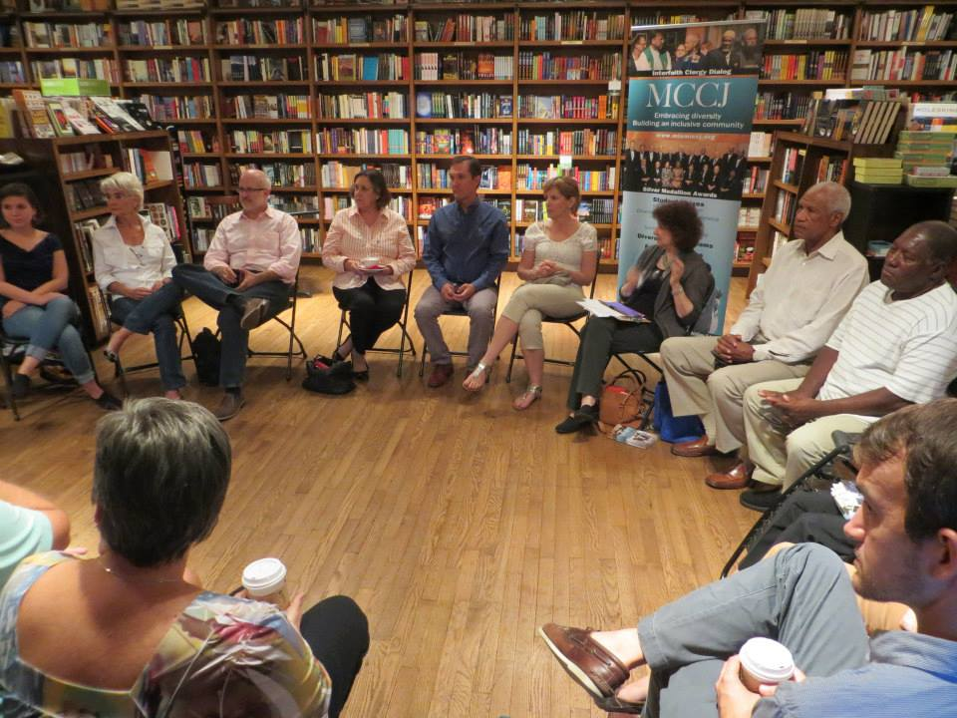

Slide 8
My Assumptions…
If I get to the meeting early & arrange the chairs in a circle…
Colleagues will feel their experience is respected & acknowledged when they walk in.
This will create a relaxed and congenial environment for learning
The distance between me as the leader, convener or chair & the participants will be reduced
They will see me as an ally in their work – someone they can trust
People will therefore be more likely to participate, contribute, ask questions etc.

Slide 9
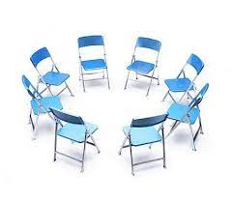
The Circle Through Participants’ Eyes
The circle is an arena of surveillance – everything I do will be seen, my mistakes will be noticed by everyone
The circle is alienating – if anything about me marks me out as different (how I look or sound) my discomfort is increased
The circle is coercion – you are coercing me into speech before you’ve earned the right to do that
The circle increases mistrust – I can’t sit back & judge your competence over time
The circle implicitly privileges speech - why don’t you let me process information & mull things over in my own time?

Slide 10
NOW…
I still use the circle but explain…
It’s to keep sight lines clear – so participants who wish to contribute or ask a question can do that easily
It’s so participants don’t have to talk to the back of other people’s heads
I won’t assume that those who are quiet are less diligent or intelligent
I must self-disclose before expecting students to do the same

Slide 11
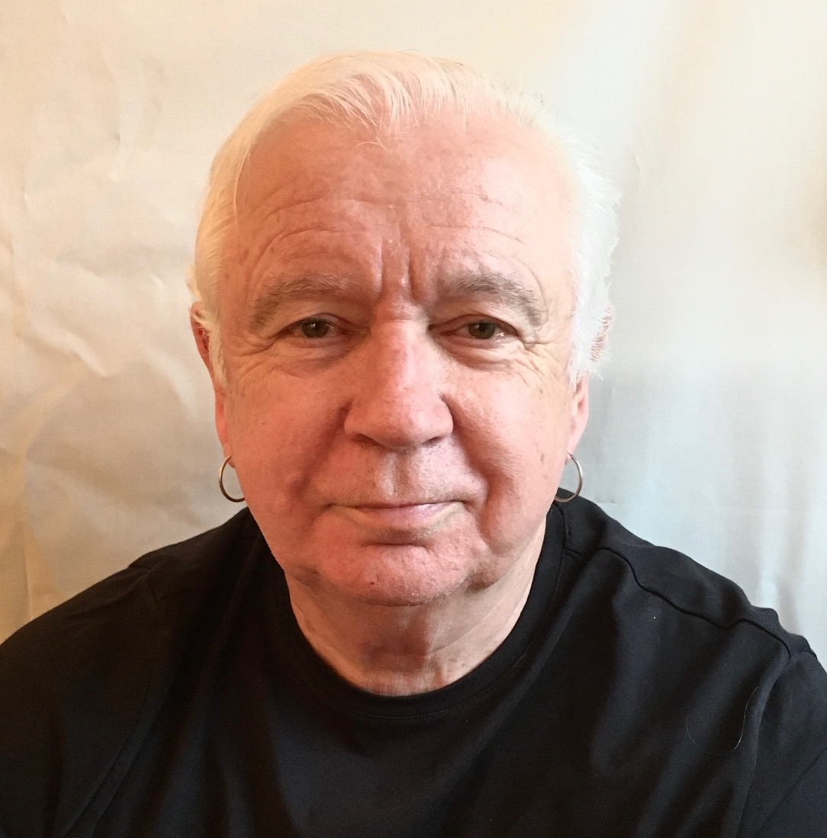
My Racial Identity – “The Good White”
I’ve escaped racist conditioning
I treat everyone the same
I don’t see color
I have nothing to contribute to racial discussions
I can monitor my own racism
I’m a good moral person
My heart is in the right place
My actions always have good intent
Good White People. Shannon Sullivan, 2014. (SUNY Pess)

Slide 12
In fact…
I grew up bathed in the idea & practice of White supremacy
Whites act according to the ideals of the European Enlightenment – we use reason, logic & objectivity, we stay calm & should therefore be in charge of making decisions for ALL people. WS positions Whites in superior contrast to people of color who are seen as emotional, unpredictable, volatile & unreliable & should be kept as far from the reigns of power as possible
I will NEVER lose that conditioning
I have a lot to contribute to racial discussions – because I know intimately at a deep level how White supremacy is learned & transmitted
The intent of my actions has no necessary connection to their effects
My responsibility is to talk about my struggle recognizing my own Whiteness, how that structures my life, & how I enact racism
My responsibility is NOT to wait for colleagues of color to raise questions of racism – but to be the first to do that as a normal expectation of professional behavior

Slide 13
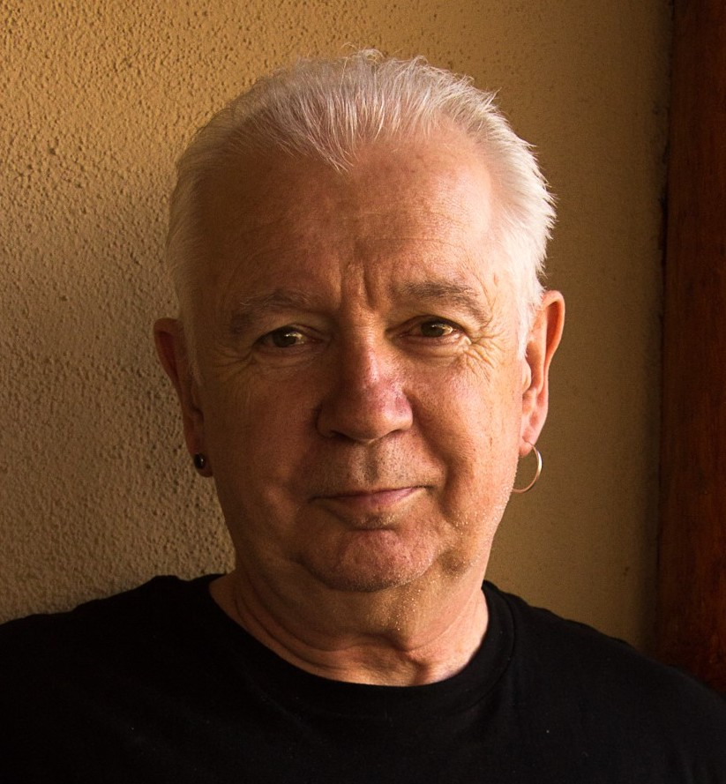
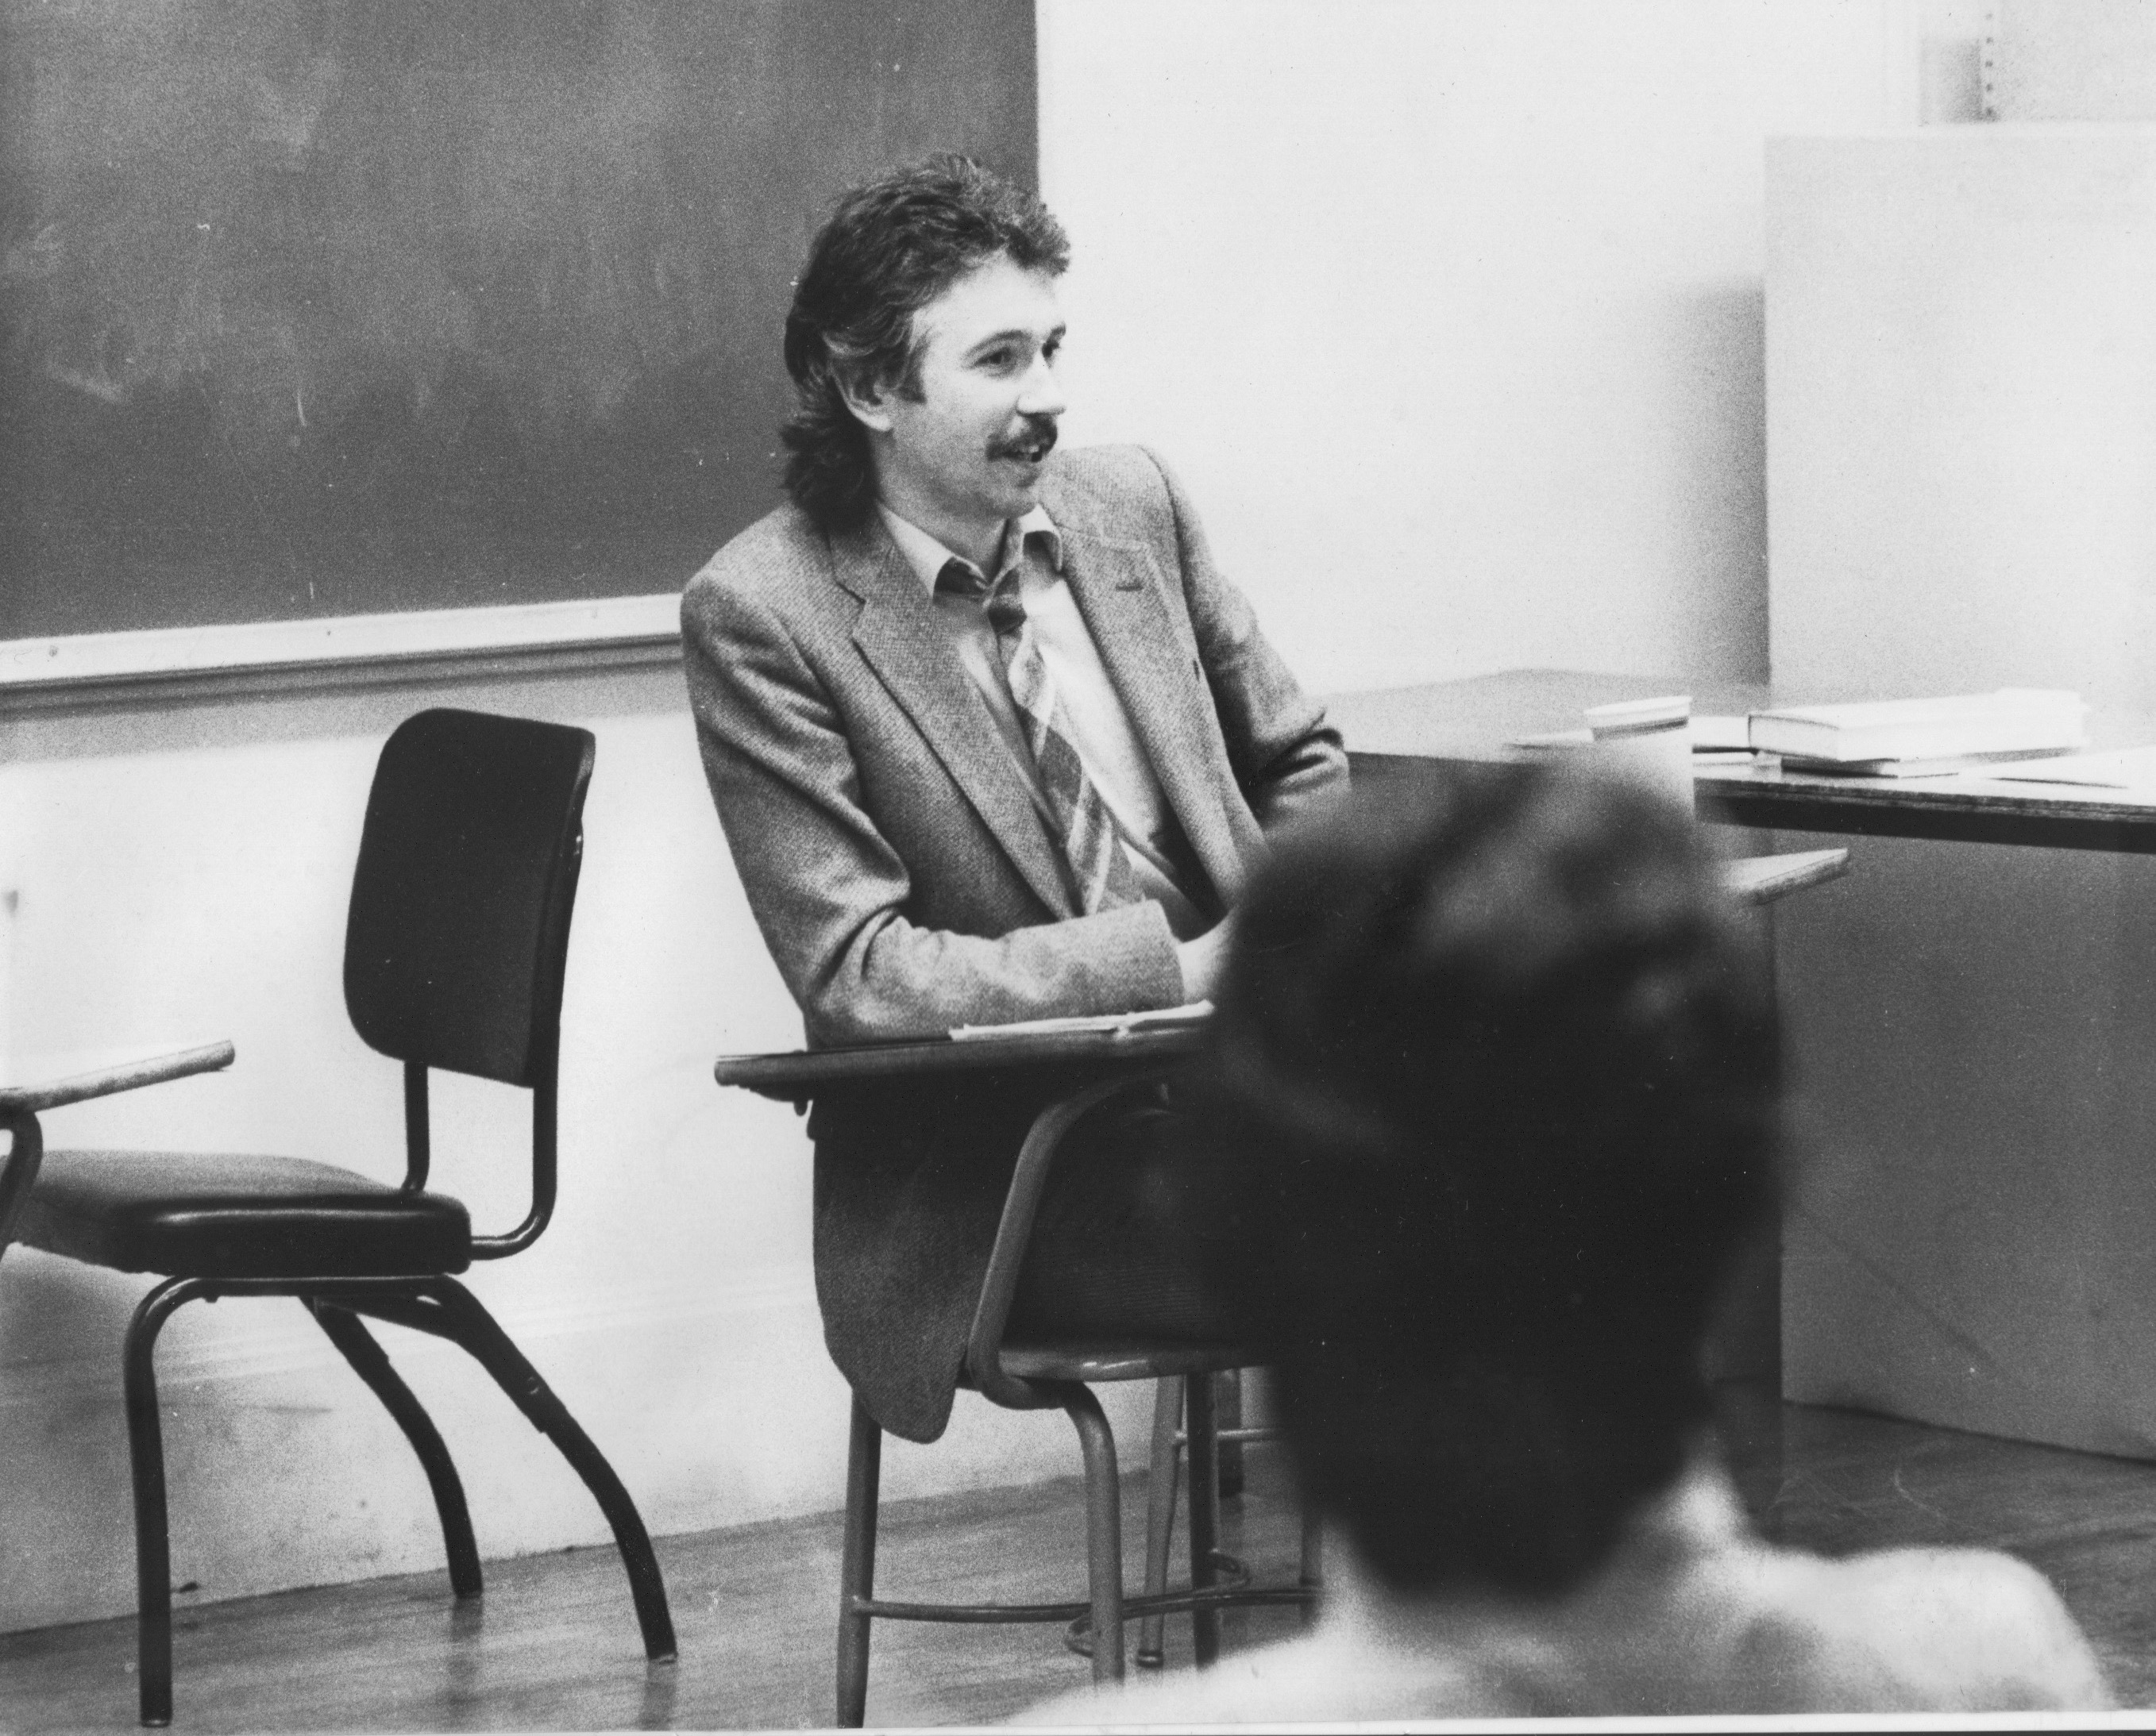
The Opening Speech
Call me Stephen – friendly atmosphere
I look forward to teaching – I learn so much from my students
My job – help you realize what you know
Questions – encouraged but…
I don’t know all the answers
Questions are gifts for my learning
Mistakes – richest moment in learning
Unexpected Event – pool our wisdom
This speech…. Puts students at ease
Makes me relatable/approachable
Lets them know mistakes are normal
Honours & respects their experiences

Slide 15
Critical reflection on leadership means….
Impostorship – I’m muddling through, when will people find me out & see I’m a fraud? How could I have missed this? How could my assumptions have been so wrong? Why didn’t I take that into account?
Lost innocence – the dawning realization that the world’s complexity means you’ll never get it “right” – your leadership will be an ever deepening inquiry into how context alters the dynamics of practice
Power – better understanding of how you are probably never in a ‘power free zone’: how does your exercise of power become em-power-ing?
Loss of control – much of what goes on is completely beyond your influence & control - losing the myth that “everything depends on me”

Slide 16
Some of Stephen’s Resources
Books:
Becoming a White Antiracist (2021, w/ Mary Hess) Sterling, VA: Stylus
Teaching Race (2019) Wiley (Hoboken, NJ)
Becoming a Critically Reflective Teacher (2017, 2nd. Ed.) Jossey-Bass/Wiley (Hoboken, NJ)
The Discussion Book (2016 w/ Stephen Preskill) Wiley (Hoboken, NJ)
Learning as a Way of Leading (2008 w/ Stephen Preskill) (Wiley Hoboken, NJ)
Website:
www.stephenbrookfield.com

