Slide 1
Becoming a Skillful Teacher New Mexico State University
Stephen Brookfield (he, him)
Distinguished Scholar, Antioch University
http://www.stephenbrookfield.com/

Slide 2
How to access this power point…
Go to my home page: http://www.stephenbrookfield.com/
Click on the “Resources” link (top left, next to ‘Home’
Scroll down to power points & pdf’s http://www.stephenbrookfield.com/powerpoints-pdfs
This power point is the 1st one listed – “You Can Teach Race Imperfectly or Not at All”
Feel free to steal anything from my home page – it’s open access for free download

Slide 3
I am from…*
the sound of seagulls crying over the north sea and merseybeat blasting at the Cavern club,
the smell of fish & chips, factory waste and coal burning fires,
the taste of grease, sour milk tea and dust at the back of my throat
the idea of community pride & the triumph of humor over pretentiousness
* Adapted from the poem Where I’m From by George Ella Lyon

Slide 4
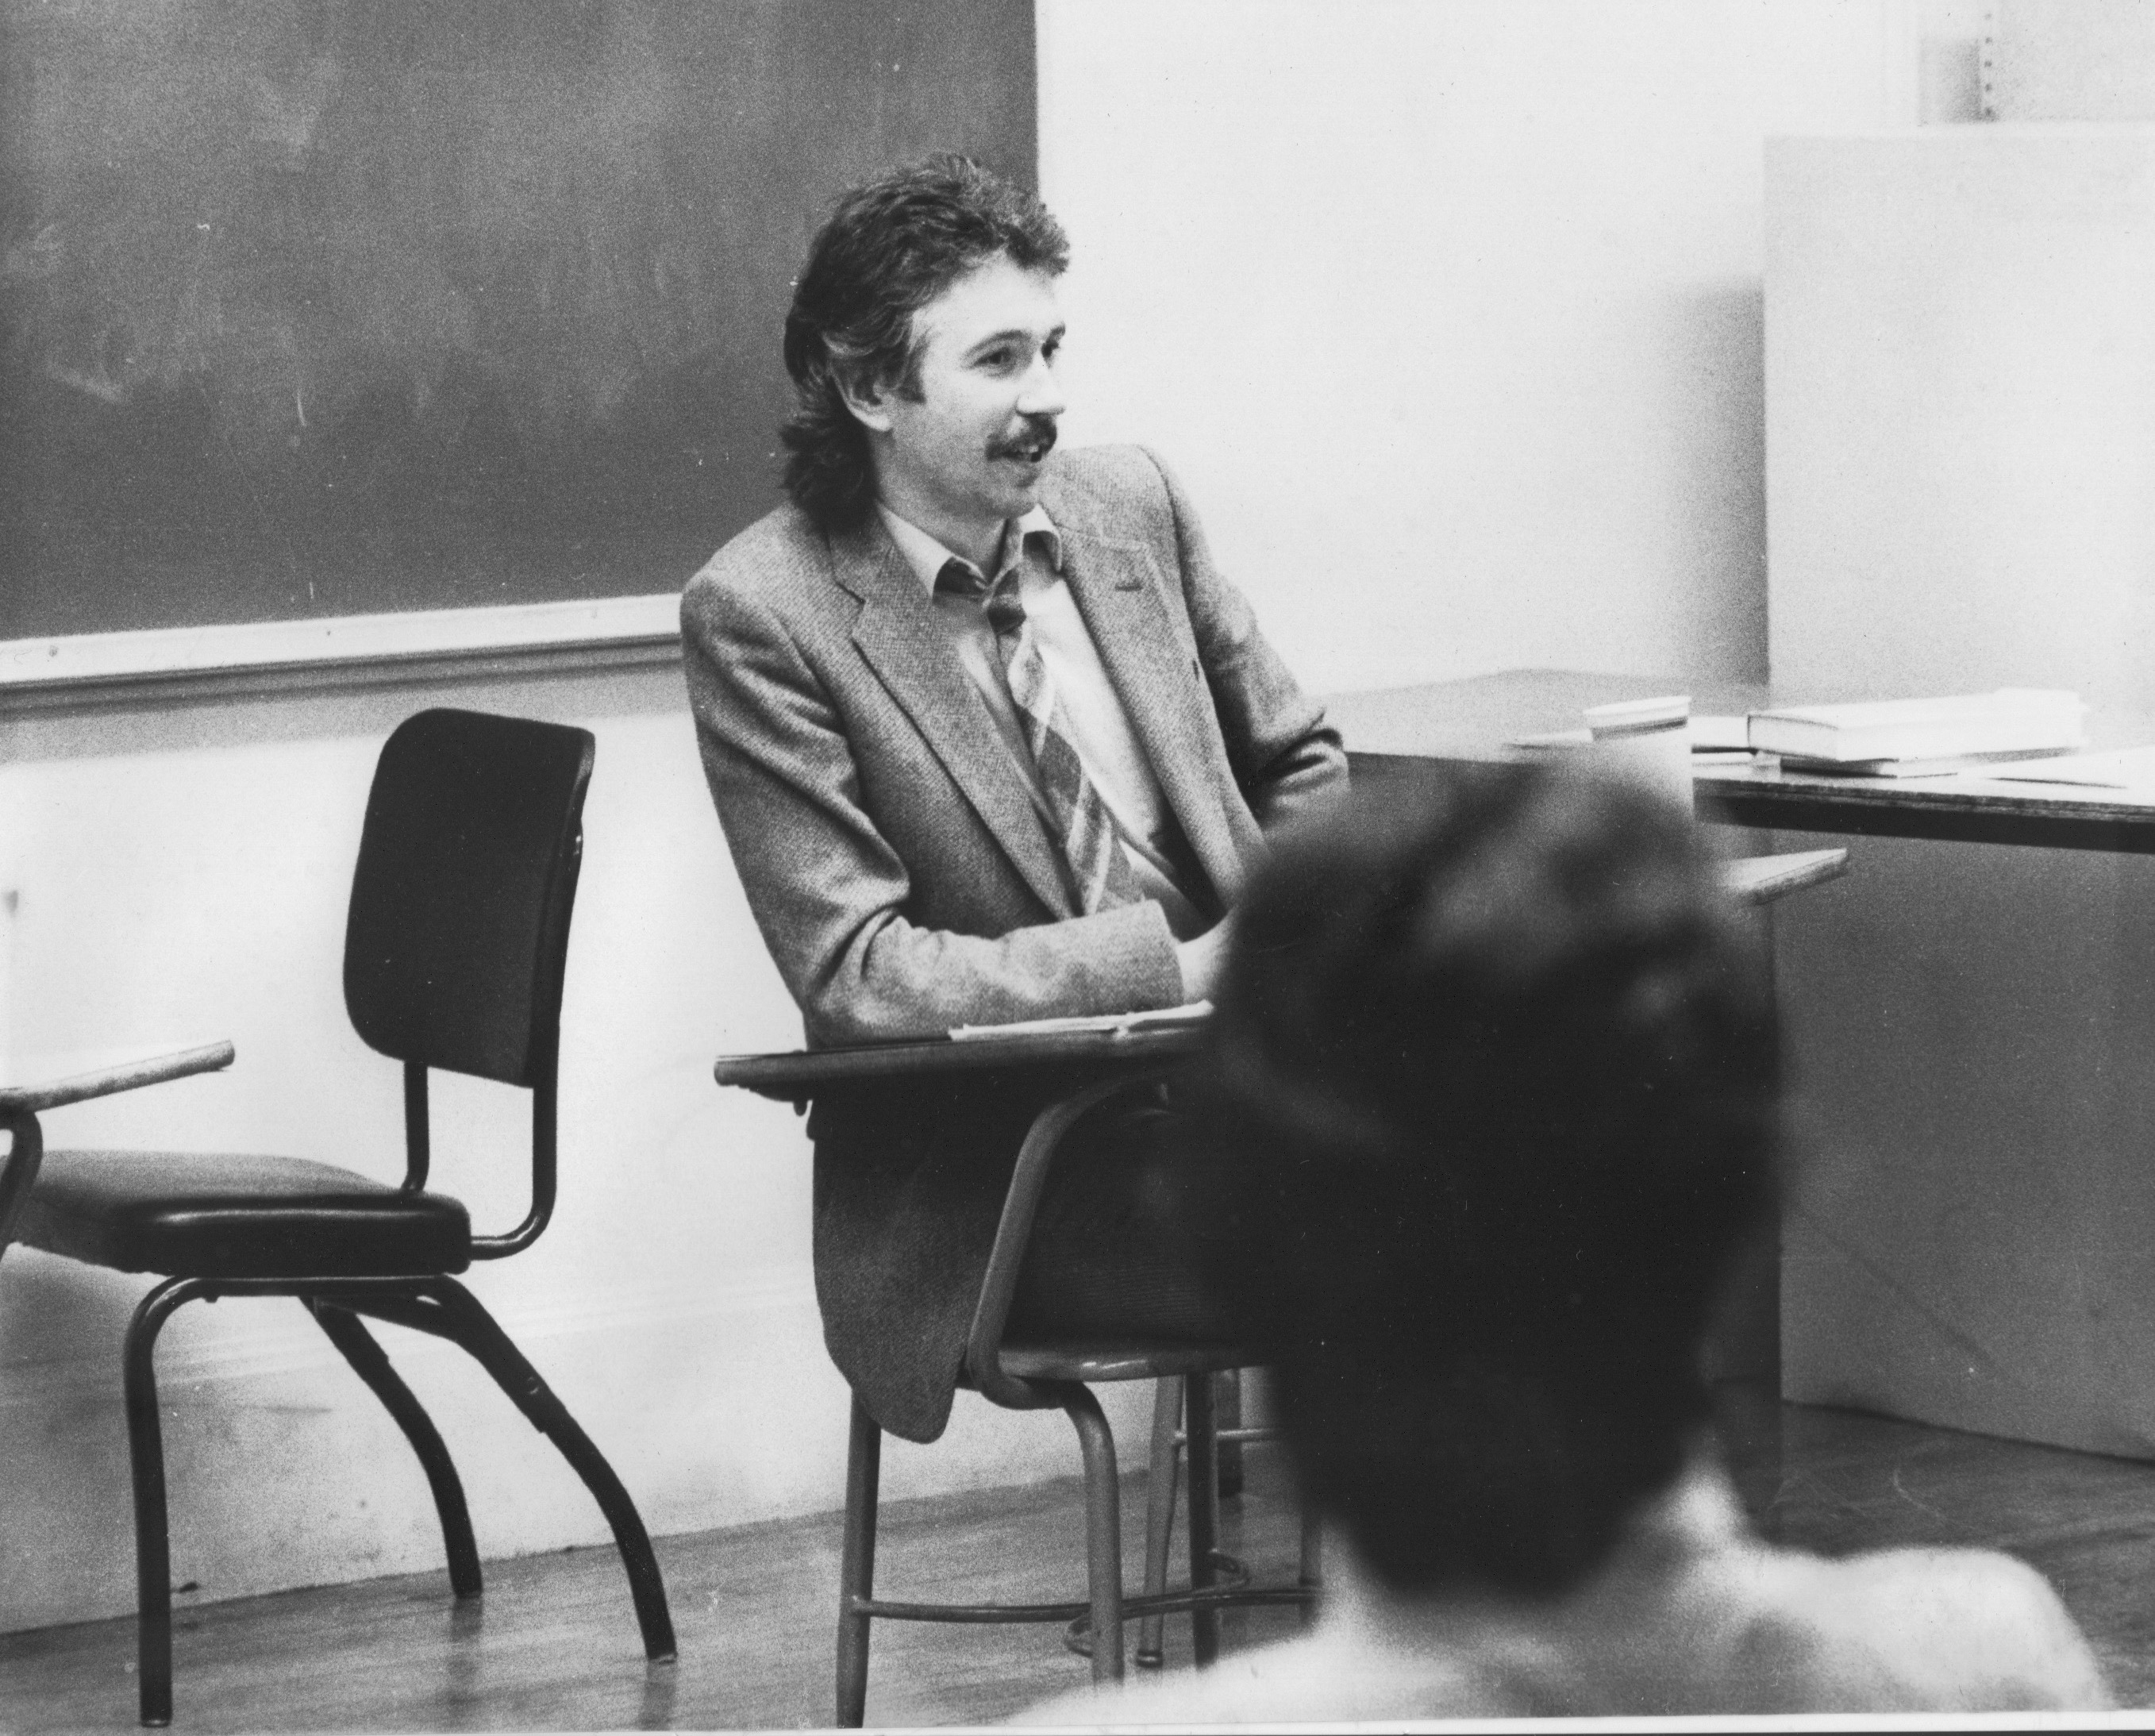
History of academic mediocrity –failed high school leaving exams, university places cancelled, College of Technology, graduated in bottom half of my class, turned down for graduate study, failed my master’s degree exam Broadening student-centered assessment measures
Watching my doctoral supervisor – giving me ‘bad’ inconvenient news in a way that I knew was in my own best interests
Ethical use of teacher power
Relational underpinnings to critical thinking
Balancing credibility & authenticity

Slide 5
Assumptions I’m Making About YOU
You want to do good work
You want students to be engaged and interested in the learning you’re arranging for them
You want students to learn to think and practice in ways you believe are valuable & that will benefit them
You’re happiest & most fulfilled when you are fully engaged in, & attentive to, the moments when you feel something important/significant is happening in your interactions with students

Slide 6
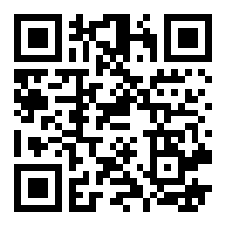
USING sli.do
Go to sli.do
Enter Code 8073141
Or use the QR code opposite if you’re on a smart phone
Respond to this question…
When you know you’re teaching skillfully, what does that LOOK, Sound, or FEEL like?
Your response is ANONYMOUS

Slide 7
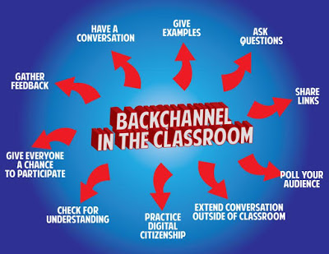
Pose a question at start of class to assess what knowledge, experience & preconceptions students bring Pose quick questions during class to check for understanding, identify misconceptions Invite students to raise questions or seek clarification anonymously Interrupts the normal privileging of speech, extroverts, dominant language speakers – no one can dominate Anonymity means students aren’t afraid to ask ‘dumb’ questions As with all activities, open to sabotage sli.do backchannelchat.com tweedback.de

Slide 8
Content Knowledge Content grammar – a comprehensive, deep & up to date knowledge of the building blocks of skill and information that students need to think and work as a mathematician, nurse, psychologist, art historian, entrepreneur, biologist, poet, environmental scientist, etc. Epistemological grammar – the multiple & contested ways people in your discipline judge intellectual / scholarly work to be important, significant, powerful, authentic & legitimate: what ways is ‘truth’ established
Pedagogic Knowledge
A continuous awareness of how students experience learning in your course in multiple ways – sli.do, the CIQ, backchannelchat.com
An ability to design learning in which you can adjust activities so that students are supported but also challenged to move beyond current levels of aesthetic skill, judgment & creativity
A readiness to explain your process to students, saying what your activities are trying to achieve and the experience or theory they’re based on
A willingness to model publicly learning activities & processes before asking students to engage in these – bringing in your own work for critique

Slide 9
4 Core Assumptions of Skillful Teaching
Good Teaching = Whatever Helps Students Learn
Best Teaching is Critically Reflective – Checking The Assumptions Informing Our Practice
Most Important Pedagogic Knowledge We Need is Information on How Students Experience Learning
Context Changes Everything

Slide 10
Good Teaching = Helping learning Leaving the Room - 1st Day Panel Clint Eastwood Chair
Classroom Geography. You don’t need to talk
What Do YOU Think?

Slide 11
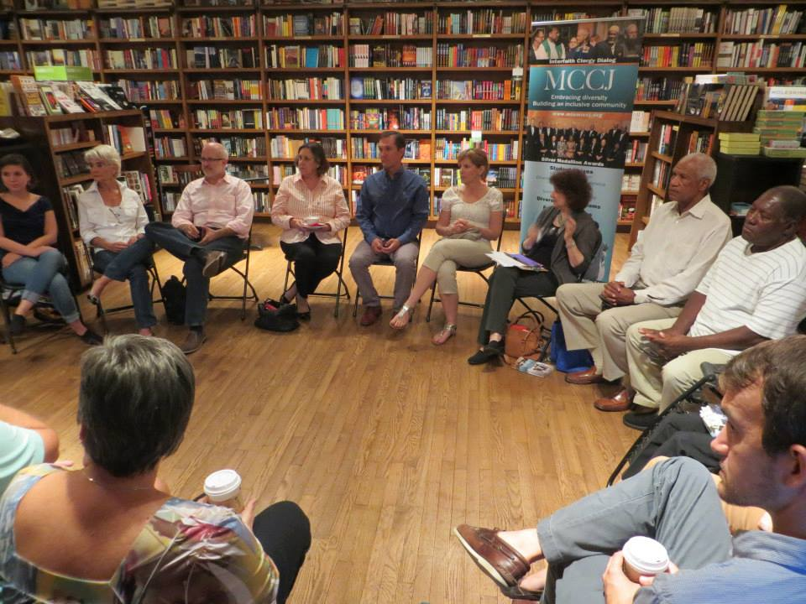
Best Teaching is Critically Reflective
If I get to class early & arrange the chairs in a circle…
Students will feel their experience is respected & acknowledged when they walk in.
This will create a relaxed and congenial environment for learning
The distance between me as the teacher & them as the students will be reduced
They will see me as an ally for their learning – someone they can trust
Students will therefore be more likely to participate, contribute, ask questions etc.

Slide 12
THROUGH STUDENTS’ EYES…
The circle is an arena of surveillance – everything I do will be seen, my mistakes will be noticed by everyone (peers & instructor)
The circle is alienating – if anything about me marks me out as different (how I look or sound) my discomfort is increased
The circle is coercion – you are coercing me into speech before you have earned the right to do that: what game are you playing here?
The circle increases mistrust – I can’t sit back & judge your competence or authenticity, just let me process by myself: when I’m ready I’ll join the circle

Slide 13
NOW…
I still use the circle but explain…
It’s to keep sight lines clear – so students who wish to contribute or ask a question can do that easily
It’s so students don’t have to talk to the back of other people’s heads
I won’t assume that those who are quiet are less diligent or intelligent
I must self-disclose before expecting students to do the same

Slide 14
Most Important Knowledge I Need – How Students Are Experiencing Learning Needed to build bridges to acquisition of new content, skill & understanding
Muddiest Point
Questions Raised
via….

Slide 15
How the CIQ is administered
Given out during the last 5 minutes of the last class of the week – students give their completed CIQ’s to a volunteer before they leave the room
It’s deliberately anonymous
You read the responses &, at the start of the next class, you report back the main themes, questions raised & commonalities/differences revealed
As you respond to the comments you talk about what they mean for your practices & actions – you explain calibrations you’re making in response, OR explain why you need to stick to your agenda, format, process etc.
Student-centered responsiveness is a process of negotiation NOT capitulation to majority wishes
Student-centeredness is finding out how students experience learning so you can build bridges to take them where they need to go

Slide 16
Context Constantly Changes EVERYTHING
Student Demographics
Communicative Options
Technology
Political Culture
Financial Pressures
Legislature
What Constitutes ‘Canon’
Organizational Priorities

Slide 17
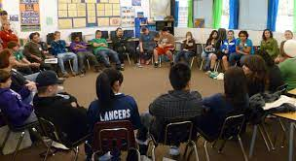
Circle of Voices Protocol
What would you like your students to say about your course or your teaching when they were out of your earshot?
(1) Declare a 1-2 minute silent period for people to think about their response to the question & make written or mental notes
(2) Go alphabetically around the group and have each person give their response to the question(s) they’ve just been thinking about. Each person tries to keep their comments to a minute or so. No interruptions of each other please.
(3) Once everyone has spoken move into open conversation – anyone can speak at any time & there is no order of contribution. However, try to speak ONLY about what someone ELSE said in the opening round of comments.

Slide 18
CREDIBILITY Expertise – We know our stuff, give multiple examples, & demonstrate our expertise by responding well to unexpected questions Experience – We’ve been around the block, know our area of practice Rationale – There’s a method to our madness, we explain why we do what we do in ways that are clear Conviction – We show students we want to make sure they’ve understood the material correctly by regular check-ins & individualized evaluation Brookfield, S.D. 2015 The skillful teacher. Hoboken, NJ: Wiley
AUTHENTICITY
CONGRUENCE – our words & actions match & are consistent
FULL DISCLOSURE – any expectations, criteria, & agendas we hold are regularly shared with students
RESPONSIVENESS – we seek out & respond to students’ concerns
PERSONHOOD – we use appropriate autobiographical disclosure to engage attention & support learning
Brookfield, S.D. 2015 The skillful teacher. Hoboken, NJ: Wiley

Slide 19
Go to sli.do Enter Code 4061364 Or use the QR code opposite if you’re on a smart phone Respond to this question… What factors most disrupt your attempts to teach skillfully? Your response is ANONYMOUS

Slide 20
Some of Stephen’s Resources
http://www.stephenbrookfield.com/ (CIQ, powerpoints, pdf’s, videos, writings, visuals
Books:
Engaging imagination: Helping students become creative & reflective thinkers (w/ Alison James) (2014)
The skillful teacher: on trust, technique & responsiveness in the classroom (3rd. Ed. 2015)
Becoming a critically reflective teacher (2nd Ed. 2017)
The discussion book: 50 great ways to get people talking (2016)

