Slide 1
The Dynamics of Teaching for Critical Thinking
CRITICAL THINKING IN HIGHER EDUCATION AND LABOUR MARKET INTERNATIONAL VIRTUAL SCIENTIFIC CONFERENCE
December 9-10, 2021, Mykolas Romeris University
Stephen Brookfield
Distinguished Scholar, Antioch University
http://www.stephenbrookfield.com/

Slide 2
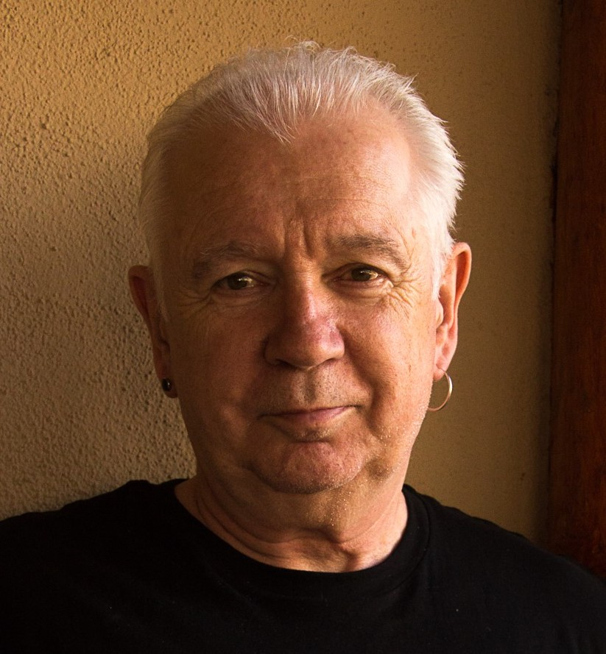

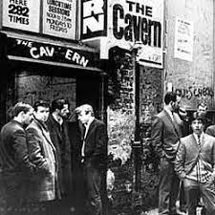

Slide 3
My Web Site
My website is open access so if you want to find out more about any of the exercises or activities I mention go to the page and click on the ‘Resources’ link.
Scroll down & you will find multiple PDF files of workshop packets stuffed with activities or power point files.
Today’s power point is the first one listed: http://www.stephenbrookfield.com/powerpoints-pdfs
You do not need to ask my permission to use any of these resources. If they’re useful then please try them out and adapt them to your context.
www.stephenbrookfield.com

Slide 4
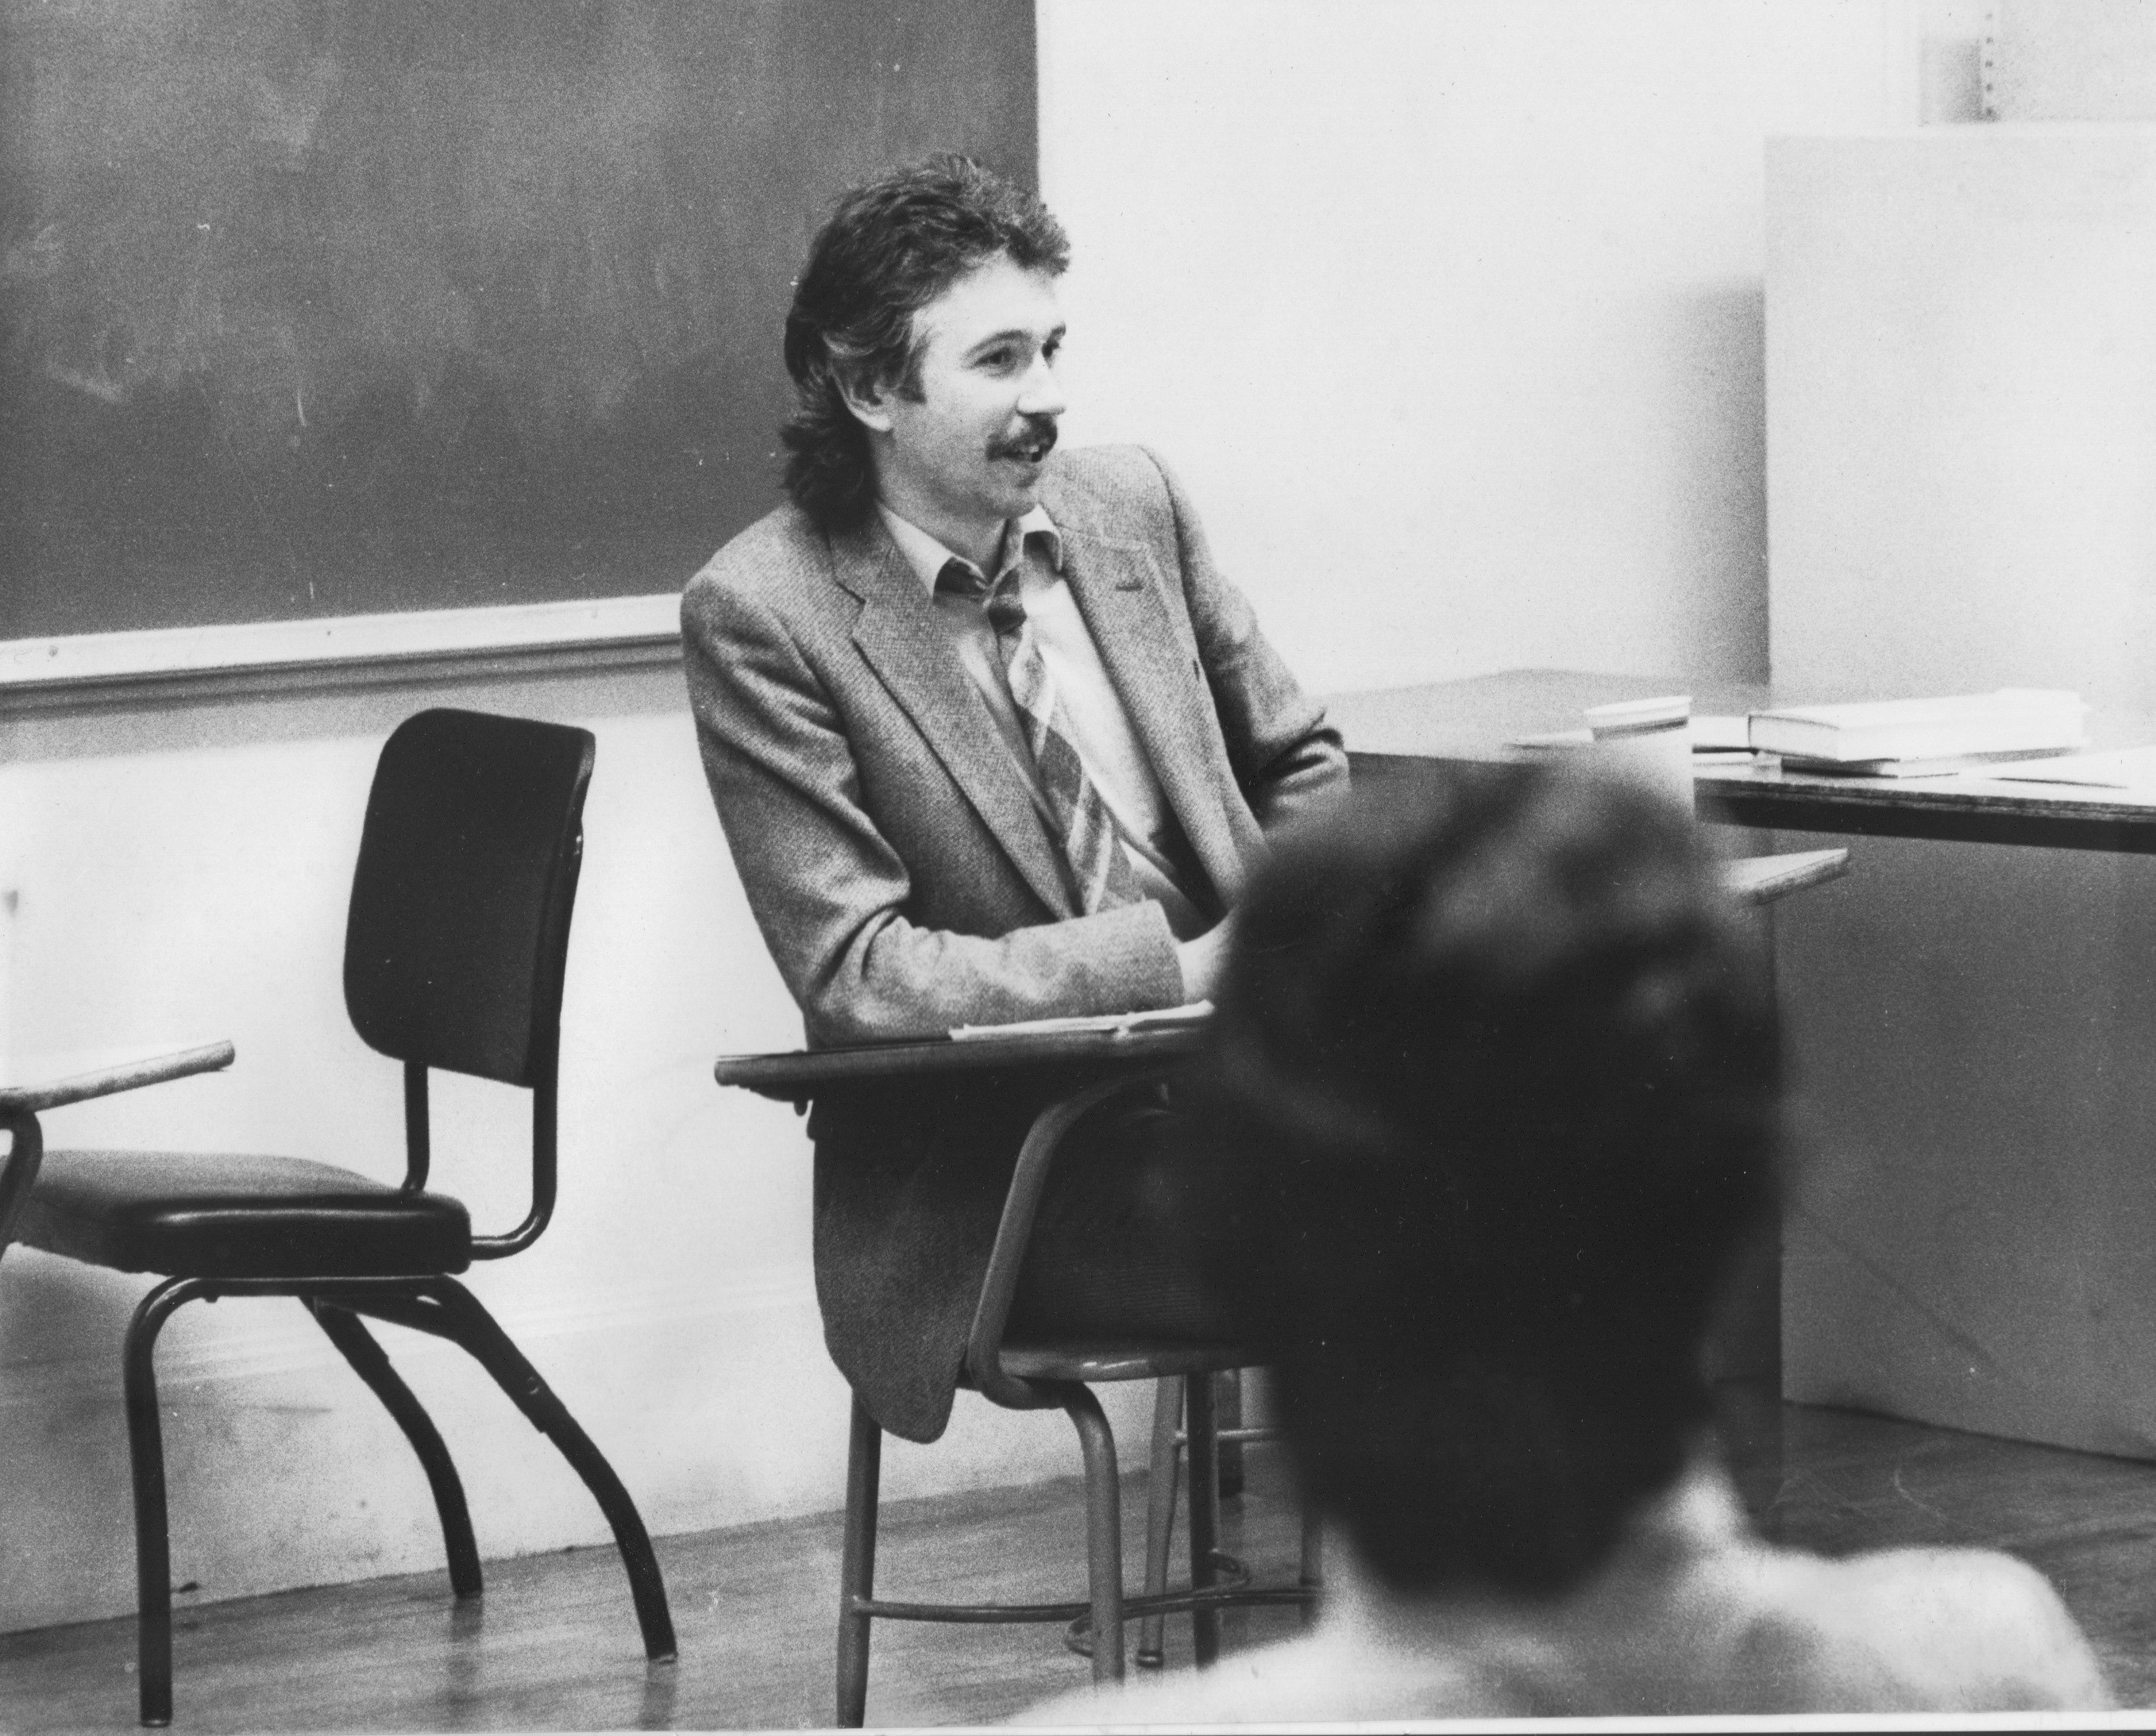
Who I am as a teacher is influenced by who I am as a learner….
History of academic mediocrity –failed high school leaving exams, university places cancelled, College of Technology, graduated in bottom half of my class, turned down for graduate study, failed my master’s degree exam – Broadening student-centered assessment measures
Watching my doctoral supervisor – giving me ‘bad’ inconvenient news in a way that I knew was in my own best interests
Ethical use of teacher power
Relational underpinnings to critical thinking
An authoritative ally

Slide 5
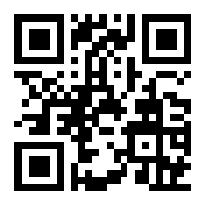
Sli.do
Go to sli.do
Enter Code: 903011
Or, use the QR Code opposite
Reply to the question…..
When somebody is thinking critically, what does it LOOK, SOUND or FEEL like?
https://app.sli.do/event/e1uafnjc/live/polls

Slide 6
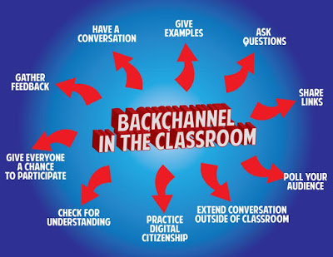
sli.do backchannelchat.com tweedback.de
Interrupts the normal privileging of extroverts, host language speakers
Students can ask questions without fear of seeming unintelligent
You can pose a question at start of class to assess knowledge, experience & preconceptions of students – but also to uncover ‘unsayables’: “what’s a recent example of structural racism you’ve witnessed, enacted or experienced at the university?”
You can pose quick questions during class to check for understanding, identify misconceptions
Students can critique your actions
Illustrates diversity of reactions, interpretations, meaning-making

Slide 7

Hunting & Checking Assumptions
TAKING INFORMED ACTIONS
Exploring Multiple Perspectives
TAKING INFORMED ACTIONS

Slide 8
Critical Thinking as Survival
-My Clinical Depression
Assumptions:
Clinical Depression is Caused by External Circumstances
Therefore I Shouldn’t Be Depressed
The Way to Deal With Depression Is To Reason Through It
You Must Tell Yourself To Snap Out of It
Medications Are For Those Too Weak To Deal With The World
Rooted in Ideology: PATRIARCHY
(Men are to be entrusted with making decisions
by virtue of their superior rationality & logic)

Slide 9
Re-Framed Assumptions
Depression is a chemical imbalance in the brain – not a flaw in character
Talk & cognitive behavior therapy is helpful against a background of medication
Patriarchy damages men by portraying toxic masculinity as the ideal – (“I can deal with this myself”, “I don’t need help”, “Women may need pills but I don’t”, “I need to be strong”)
My responsibility is to make appropriate public disclosure of my own response to my own depression

Slide 10
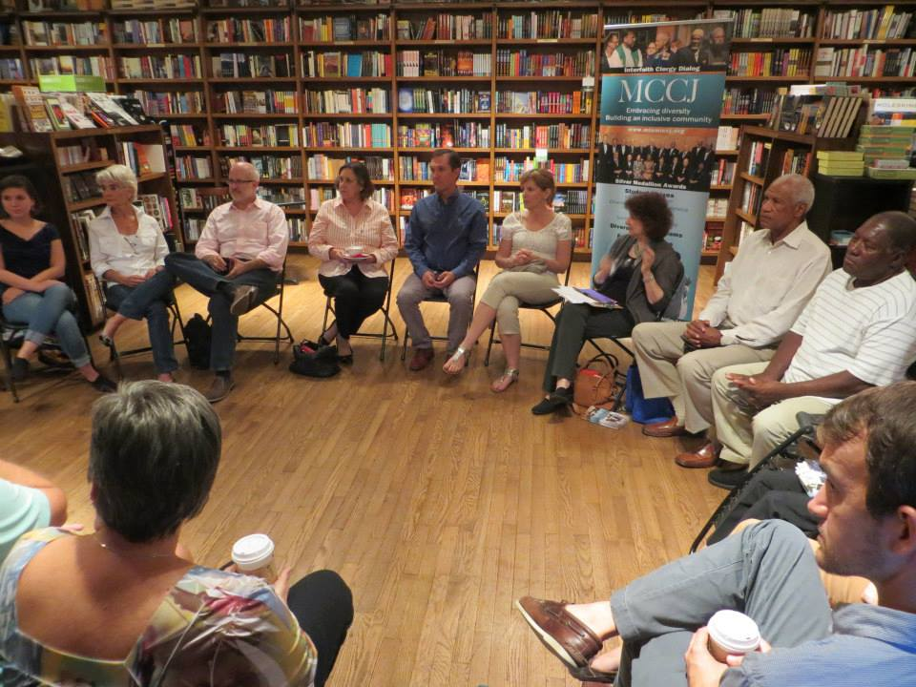

Slide 11
THE CIRCLE - My Assumptions
If I get to class early & arrange the chairs in a circle…
Students will feel their experience is respected & acknowledged when they walk in.
This will create a relaxed and congenial environment for learning
The distance between me as the teacher & them as the students will be reduced
Students will be more likely to participate, contribute, ask questions etc.

Slide 12


The Circle Through Students’ Eyes
The circle is an arena of surveillance – everything I do will be seen, my mistakes will be noticed by everyone (peers & instructor)
The circle is alienating – if anything about me marks me out as different (how I look or sound) my discomfort is increased
The circle is coercion – you are coercing me into speech before you have earned the right to do that
The circle increases mistrust – I can’t sit back & judge your competence or authenticity, just let me process

Slide 13
NOW…
I still use the circle but explain…
It’s to keep sight lines clear – so students who wish to contribute or ask a question can do that easily
It’s so students don’t have to talk to the back of other people’s heads
I won’t assume that those who are quiet are less diligent or intelligent
I must self-disclose before expecting students to do the same

Slide 14
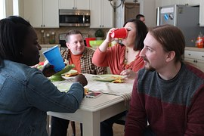
The Good White
I am a GOOD WHITE PERSON free of racism
Assumptions…
I have escaped racist conditioning
I have self-knowledge
I can monitor my own racism
I know how my actions are perceived & experienced
I avoid committing racial micro-aggressions
I’m an ally to colleagues & students of color
Racism is something committed by less-enlightened White friends & colleagues

Slide 15
I will never be free of the ideology of White supremacy
I can try to unearth its presence personally & institutionally
My responsibility is to raise racial questions & not to wait for colleagues of color to do this
Whether I am an ally or not is not my judgment to make
There is no ‘correct’ or ’right way’ to do this work – the only two options are to do it IMPERFECTLY or NOT AT ALL
I will never be fully antiracist

Slide 16
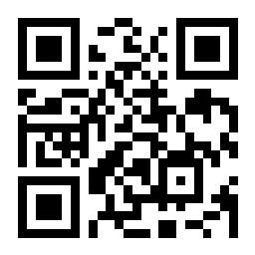
PAUSE FOR QUESTIONS…
Use Zoom Chat if you’re OK being identified
To ask questions ANONYMOUSLY…go to sli.do
Enter code: 268518
Or use the QR code

Slide 17

Critical Thinking Through Students’ Eyes
ONE MINUTE PAPER
MUDDIEST POINT
AFTER HOURS GROUP
SOCIAL MEDIA
LEARNING AUDIT
CRITICAL INCIDENT QUESTIONNAIRE (CIQ)
Ch. 6 “Seeing ourselves through students’ eyes” S.D. Brookfield. 2017. Becoming a critically reflective teacher. Hoboken, NJ: Wiley

Slide 18
One Minute Paper – what questions are you left with after this discussion?
Muddiest Point – what part of the presentation did you find the hardest to understand?
After Hours Group – what do I need to know as your instructor about how to better support your learning in this course?
Social Media – you can use tools like sli.do, backchannelchat.com or tweedback.de to collect this data in ways that preserve students’ anonymity
Learning Audit….
Here’s what I know that I didn’t know this time last week
Here’s what I can do that I couldn’t do this time last week
Here’s what I could teach someone else to know/do that I couldn’t teach them this time last week

Slide 19

What Students Say is Helpful
MODELING
Seeing It MODELLED by instructors through team-teaching and through instructors practicing critical reflection & naming that process
PEER LEARNING
Using peers as sounding boards & mirrors to help reveal other ways of thinking & acting
SEQUENCED & SCAFFOLDED
Begin with simple case studies & scenarios
Move into analyzing increasingly complex questions
Over time bring the analysis to bear directly on our own reasoning and actions

Slide 20
Spatially Separated Teaching Stations
Assumptions Inventories – Talking Out Loud
Here’s the Assumptions I’m Working Under
Here’s Why I Think They’re Accurate & Valid – Experience as Corroboration
Here’s How My Assumptions have been Confirmed / Deepened by My Practice
Here’s How My Assumptions have Been Challenged by My Practice or Peers
Team Teaching
Structured Devil’s Advocacy

Slide 21
Critical Thinking About My Teaching:
The First Class Speech
Call me Stephen – friendly atmosphere
I look forward to teaching – I learn so much from my students
My job – help you realize what you know
Questions – encouraged but…
I don’t know all the answers
Questions are gifts for my learning
Mistakes – richest moment in learning
Unexpected Event – pool our wisdom
This speech…. Puts students at ease
Makes me relatable/approachable
Lets them know mistakes are normal
Honours & respects their experiences

Slide 22


Slide 23
RESOURCES
Becoming a Critically Reflective Teacher (2017, 2nd. Ed.)
Teaching for Critical Thinking (2012)
The Skillful Teacher (2015 3rd. Ed.)
The Discussion Book (2016) with Stephen Preskill
All published by Jossey-Bass/Wiley (Hoboken, NJ)
www.stephenbrookfield.com

