Slide 1
Teaching Well: Going from Good to Great School of the Arts University of Nebraska, Omaha April 15th, 2021
Stephen Brookfield (he, him, his)
Distinguished Scholar, Antioch University
http://www.stephenbrookfield.com/

Slide 2
HOME PAGE - www.stephenbrookfield.com
My home page is open access so if you want to find out more about any of the exercises or activities I mention go to the page and click on the ‘Resources’ link.
Scroll down & you will find multiple PDF files of workshop packets stuffed with activities or power point files.
You do not need to ask my permission to use any of these resources. If they’re useful then please try them out and adapt them to your context.
To follow along today or retrieve these slides later click on the ‘Resources’ link at the top right of page. This presentation is the 1st power point listed.
www.stephenbrookfield.com

Slide 3
Who I am
I am from…*
the sound of seagulls crying over the north sea and merseybeat blasting at the Cavern club,
the smell of fish & chips, factory waste and coal burning fires,
the taste of grease, sour milk tea and dust at the back of my throat
the idea of community pride & the triumph of humor over pretentiousness
Born in Bootle, Liverpool, 1949
Moved to the south of England as a teenager (mum hated Liverpool) - cultural genocide to rid me of my Scouse accent
All education in UK, after graduation worked in community colleges & adult education
Lost my lecturer/organizer job in 1980 & fled (temporarily) to New York – a Thatcher political refugee
Met my partner there & moved to her home state (Minnesota) in 1992, raising 2 kids there
Now the part-time “Distinguished Scholar” at Antioch University
Leader of The 99ers – pop punk band w/ 6 albums on Spinout Records (listen to us on Spotify, I Tunes, etc.)
* Adapted from the poem Where I’m From by George Ella Lyon

Slide 4
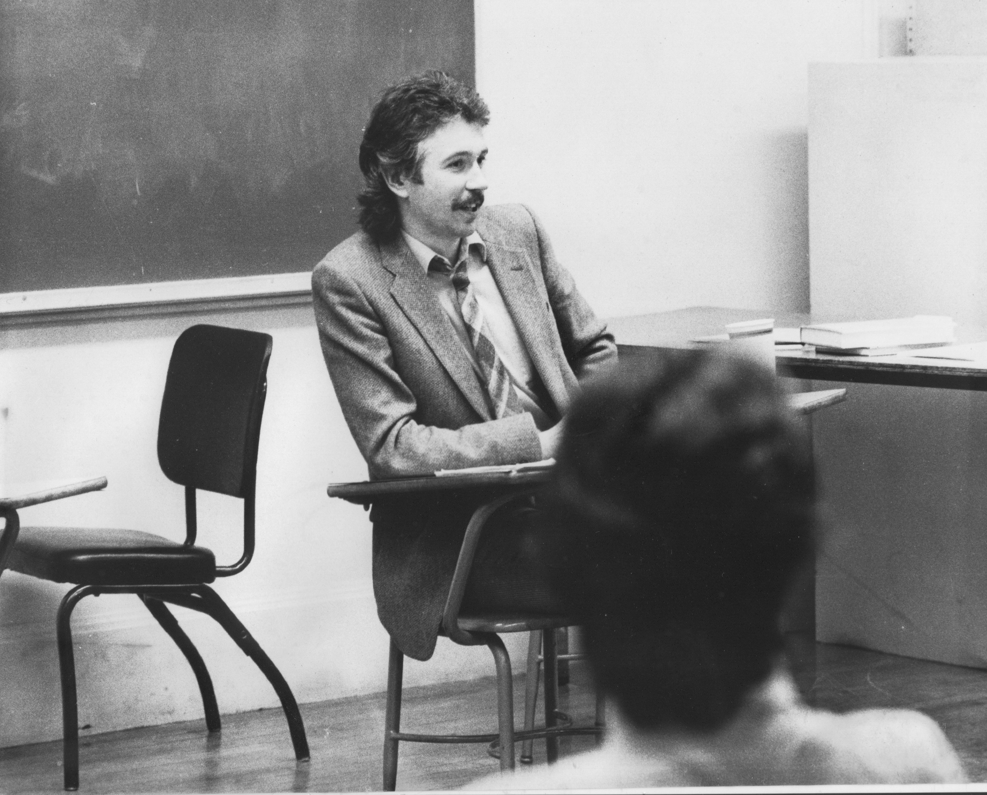
Situating Myself as a Teacher… History of academic mediocrity –failed high school leaving exams, university places cancelled, College of Technology, graduated in bottom half of my class, turned down for graduate study, failed my master’s degree exam – Broadening student-centered assessment measures Watching my doctoral supervisor – giving me ‘bad’ inconvenient news in a way that I knew was in my own best interests Ethical use of teacher power Relational underpinnings to critical thinking Balancing Credibility & Authenticity

Slide 5
Four Assumptions I’m Making
We want to do good work
We want to teach well
We want students to learn to think and practice in ways we believe are valuable
We’re happiest & most fulfilled when we are fully engaged in, & attentive to, the moments when we feel something important/significant is happening in our interactions with students

Slide 6
Let’s use an anonymous feedback tool to receive immediate information Go to: sli.do Enter Code: 341791 Or use the QR code opposite Respond to the following question – When you feel that you’re teaching well, what does that LOOK, SOUND &/or FEEL like?

Slide 7
Content Knowledge Content grammar – a comprehensive, deep & up to date knowledge of the building blocks of skill and information that students need to think and work as an artist, writer, designer, art historian, actor, playwright, poet, director, etc. Epistemological grammar – the multiple & contested ways people in your artistic discipline judge creative work to be important, significant, powerful authentic & legitimate
Pedagogic Knowledge
A continuous awareness of how students experience learning in your course in multiple ways – sli.do, backchannelchat.com, the CIQ
An ability to design learning in which you can adjust activities so that students are supported but also challenged to move beyond current levels of aesthetic skill, judgment & creativity
A readiness to explain your process to students, saying what your activities are trying to achieve and the experience or theory they’re based on
A willingness to model publicly learning activities & processes before asking students to engage in these – bringing in your own work for critique

Slide 8
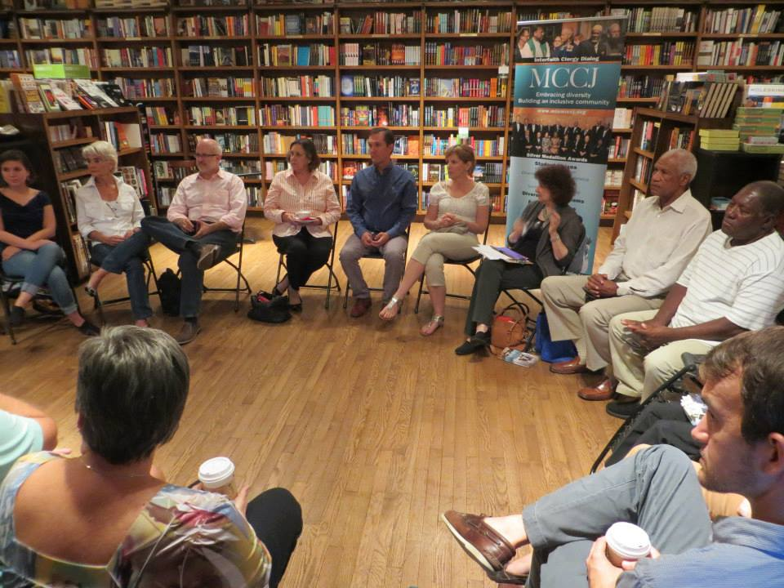

Slide 9
Assumptions If I arrange chairs in a circle
Students will feel their experience is respected & acknowledged when they walk in.
This will create a relaxed and congenial environment for learning
The distance between me as the teacher & them as the students will be reduced
Students will be more likely to participate, contribute & ask questions

Slide 10
Students’ Perceptions
The circle is an arena of surveillance – everything I do will be seen, my mistakes will be noticed by everyone (peers & instructor)
The circle is alienating – if anything about me marks me out as different (how I look or sound) my discomfort is increased
The circle is coercion – you are forcing me to speak before you’ve earned the right to do that
The circle increases mistrust – I can’t sit back & judge your competence or authenticity. Please just let me mull things over on my own. When I feel ready, I’ll move into the circle space

Slide 11
Now….
I still use the circle but explain…
It’s to keep sight lines clear – so students who wish to contribute or ask a question can do that easily
It’s also so students don’t have to talk to the back of other people’s heads
I won’t assume that those who are quiet are less diligent or intelligent
I won’t assume those who speak are more diligent or intelligent
I must self-disclose some ideas & thoughts before expecting students to do the same

Slide 12
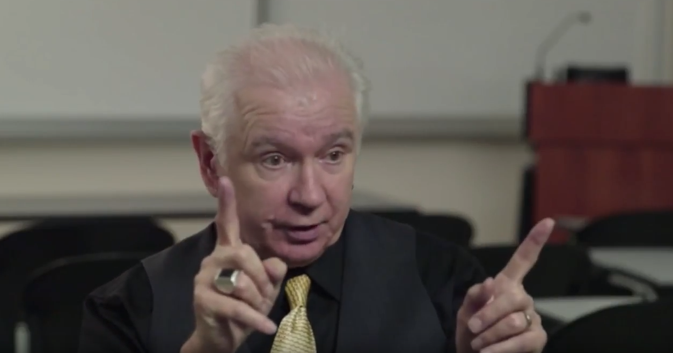
My climate setting speech
Call me Stephen – friendly atmosphere
I look forward to teaching – I learn so much from my students
My job – help you realize what you know & can do
Questions – encouraged but nobody (least of all me) knows all the answers
Unanswered = Gifts for learning
No-one knows everything
Mistakes – richest moment in learning
Here’s examples of my errors

Slide 13
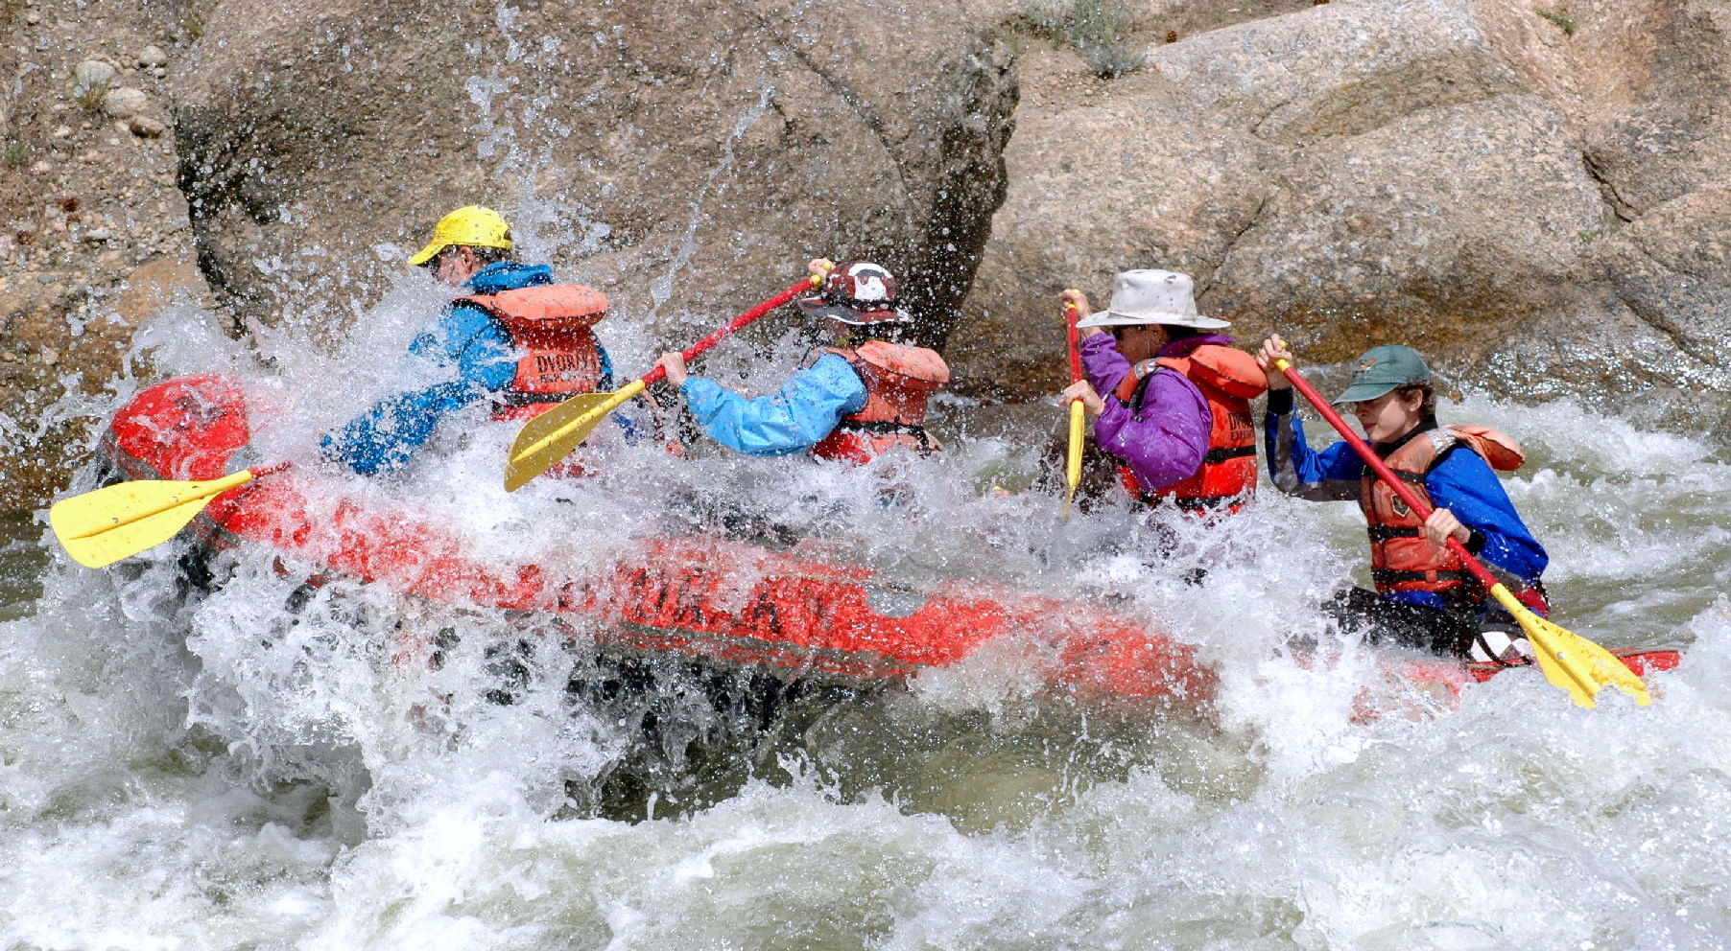

Slide 14
Circle of Voices Protocol
(1) Begin with a period of 1-2 minutes silence where you think about your response to a question
What would you like your students to say about your course or your teaching when they were out of your earshot?
(2) Go alphabetically around the group and have each person give their response to the question(s) they’ve just been thinking about. Each person tries to keep their comments to a minute or so. No interruptions of each other please.
(3) Once everyone has spoken move into open conversation – anyone can speak at any time & there is no order of contribution. However, try to speak ONLY about what someone ELSE said in the opening round of comments.

Slide 15
CREDIBILITY Expertise – We know our stuff, give multiple examples, & demonstrate our expertise by responding to unexpected questions Experience – We’ve been around the block, know our area of practice Rationale – There’s a method to our madness, we explain why we do what we do Conviction – We show students we want to make sure they’ve understood the material correctly by regular check-ins & individualized evaluation Brookfield, S.D. 2015 The skillful teacher. Hoboken, NJ: Wiley
AUTHENTICITY
CONGRUENCE – our words & actions match & are consistent
FULL DISCLOSURE – any expectations, criteria, & agendas we hold are regularly shared with students
RESPONSIVENESS – we seek out & respond to students’ concerns
PERSONHOOD – we use appropriate autobiographical disclosure to engage attention & support learning
Brookfield, S.D. 2015 The skillful teacher. Hoboken, NJ: Wiley

Slide 16
A weekly data source for what & how students are learning – the Critical Incident Questionnaire (CIQ)
At what moment in class this week were you most engaged as a learner?
At what moment in class this week were you most distanced as a learner?
What action that anyone in class took this week was most helpful for your learning?
What action that anyone in class took this week was most confusing for your learning?
What surprised you most about your learning this week?
Find the questionnaire & download it at: http://www.stephenbrookfield.com/critical-incident-questionnaire
By Their Pupils They’ll Be Taught: Using Critical Incident Questionnaire as Feedback by Mary Ann Jacobs, Journal of Invitational Theory and Practice, 2015, Vol. 21, pp. 9-22.
Assessing learning, critical reflection, and quality educational outcomes: The Critical Incident Questionnaire by Donald Gilstrap and Jason Dupree, College and Research Libraries, 2008, Vol 69, No. 5.
Using Critical Incident Questionnaires (CIQs) to Foster Critical Reflection and Formative Assessment­­simplified with Google Forms. By H. Brooke Hessler, Ph.D.
Easily adaptable via googledocs, sli.do, backchannelchat.com etc.

Slide 17
How it’s administered
Given out during the last 5 minutes of the last class of the week – students give their completed CIQ’s to a volunteer before they leave the room
It’s deliberately anonymous
You read the responses &, at the start of the next class, you report back the main themes, questions raised & commonalities/differences revealed
As you respond to the comments you talk about what they mean for your practices & actions – you explain calibrations you’re making in response, OR explain why you need to stick to your agenda, format, process etc.
Student-centered responsiveness is a process of negotiation NOT capitulation to majority wishes
Student-centeredness is finding out how students experience learning so you can build bridges to take them where they need to go

Slide 18
Some of Stephen’s Resources
http://www.stephenbrookfield.com/ (CIQ, powerpoints, pdf’s, videos, writings, visuals
Books:
Engaging Imagination: Helping students become creative & reflective thinkers (w/ Alison James) (2014)
The skillful teacher: on trust, technique & responsiveness in the classroom (3rd. Ed. 2015)
Becoming a critically reflective teacher (2nd Ed. 2017)
The discussion book: 50 great ways to get people talking (2016)
(All published by Wiley)

