Slide 1
Teaching with Racial Identity in Mind Thomas Jefferson University April 4th, 2022
Stephen Brookfield
Distinguished Scholar, Antioch University
http://www.stephenbrookfield.com/

Slide 2
How to access this power point…
Go to my home page: http://www.stephenbrookfield.com/
Click on the “Resources” link (top left, next to ‘Home’
Scroll down to power points & pdf’s http://www.stephenbrookfield.com/powerpoints-pdfs
This power point is the 1st one listed –Teaching with Racial Identity in Mind
Feel free to steal anything from my home page – it’s open access for free download

Slide 3
The (White) Elephant in the Room Another White man leading something on race – doesn’t this underscore the power of Whiteness?
The problem of race is the problem of unchallenged white supremacy – its idea & practice
At the heart of racism is the fact that many White folks such as Stephen Brookfield have not examined what it means to have a White racial identity
White students & colleagues need to see us typically & unremarkably center racial dynamics as a factor in teaching & leadership – “equity pause” in meetings
Diversity, equity & inclusion (DEI) work often involves cross-racial conversations & alliances – facilitated by a team of colleagues of different racial identities

Slide 4
I am from…*
the sound of seagulls crying over the north sea and merseybeat blasting at the Cavern club,
the smell of fish & chips, factory waste and coal burning fires,
the taste of grease, sour milk tea and dust at the back of my throat
the idea of community pride & the triumph of humor over pretentiousness
* Adapted from the poem Where I’m From by George Ella Lyon

Slide 5
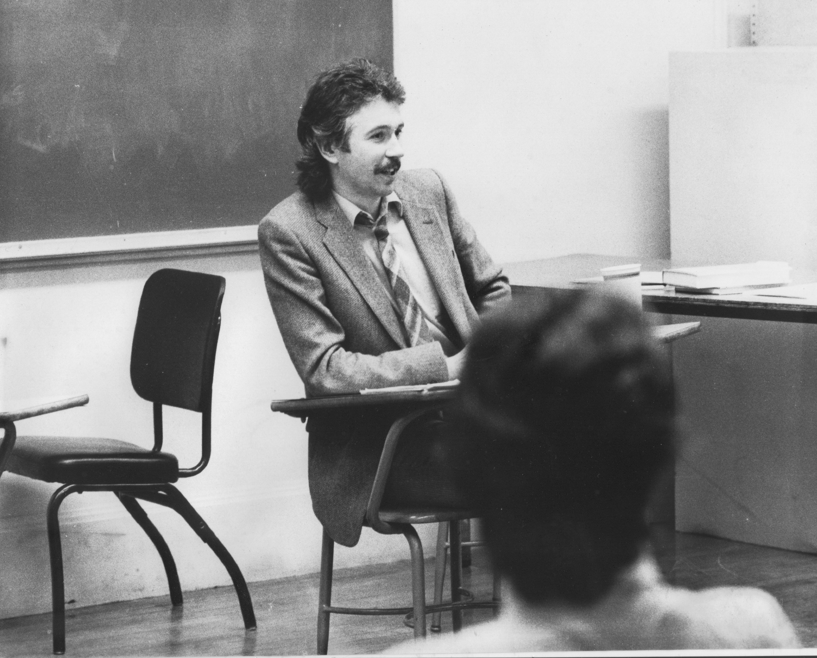
Situating Myself as a Teacher
History of academic mediocrity –failed high school leaving exams, university places cancelled, College of Technology, graduated in bottom half of my class, turned down for graduate study, failed my master’s degree exam
Broadening student-centered assessment measures Watching my doctoral supervisor – giving me ‘bad’ inconvenient news in a way that I knew was in my own best interests
Ethical use of teacher power
Relational underpinnings to critical thinking
Balancing credibility & authenticity

Slide 6
Situating Myself Racially Born into a White family in Liverpool, England grew up in the UK Did not speak to anyone who wasn’t White until I was 18 Spent over half my life regarding myself as a “Good White Person”* who has escaped racism with a color-blind perspective Will never lose the White supremacist conditioning I’ve received - this asserts that leaders & power ‘naturally’ look white because Whites use reason, logic, stay calm & make objective decisions. It also maintains that Black, Indigenous & People of Color (BIPOC) are too emotional, volatile & unpredictable to be given access to power Will always feel “unqualified” to talk about racism - & then remind myself I’m an expert on how white supremacy is learned Believe that Whites like me need to develop an antiracist identity** *Shannon Sullivan. 2014. Good White People (SUNY Press) ** Stephen Brookfield & Mary Hess. 2021. Becoming a White Antiracist (Stylus)

Slide 7
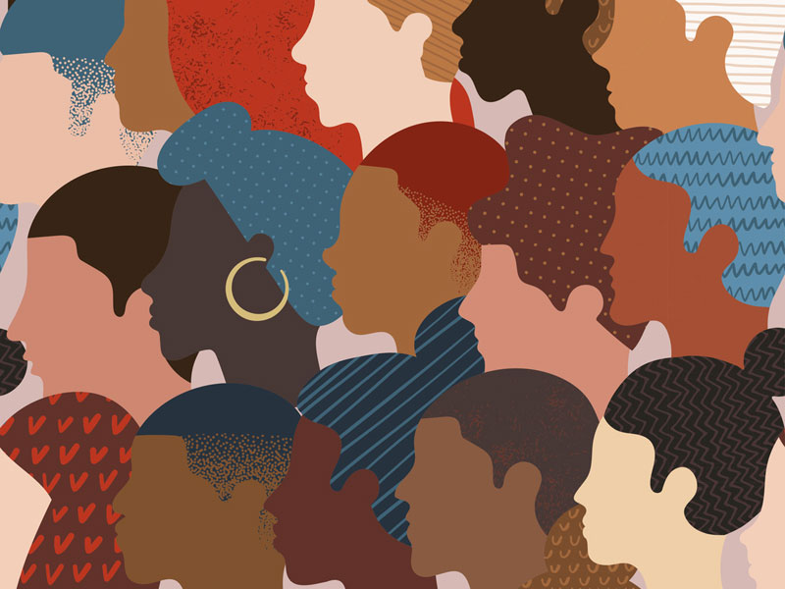
Why Spend So Much Time on ME in the first few slides? Isn’t this incredible self-indulgence?
Because students say that if a teacher models autobiographical disclosure around racial identity, & publicly engages with issues of race – it makes it MUCH easier for students to raise any concerns they have around racial dynamics in the classroom

Slide 8
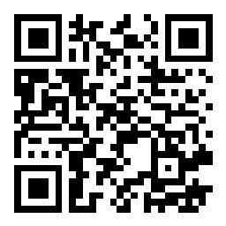
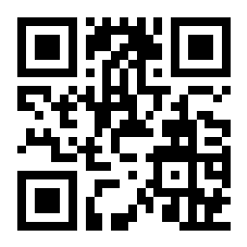
Let’s try a social media tool
Go to sli.do
Enter Code: 18670
Or use the QR code opposite (if you’re using a smart phone)
Give your response to the following question:
As we move into talking about race I feel....

Slide 9
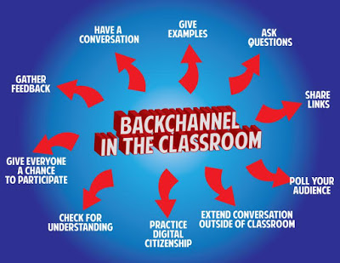
Pose a question at start of class to assess what knowledge, experience & preconceptions students bring
Pose quick questions during class to check for understanding, identify misconceptions
Invite students to raise questions or seek clarification anonymously
Interrupts the normal privileging of speech, extroverts, dominant language speakers – no one can dominate
Anonymity means students aren’t afraid to ask ‘dumb’ questions
As with all activities, open to sabotage
sli.do backchannelchat.com tweedback.de

Slide 10
How students of color experience predominantly White spaces
This is an unsafe space as regards us raising questions or issues around race
It’s better for us to stay silent than risk being regarded as troublesome or playing the race card
We feel there are constant unspoken assumptions being made about our intellectual capability based on my racial identity
Where are BIPOC amongst faculty and leadership?
Where are BIPOC only spaces where we can engage in ‘real’ talk about survival?
Why don’t White folks raise questions of race? Why do we always have to do this?
Please stop asking us to educate you about this
Please stop showing us how ‘woke’ you are
Please show us that you take equity seriously

Slide 11
Equity
A partially functioning ideal - something we never achieve exactly but we strive for
Something students attend to & take seriously – “that’s not fair” = unequal access to resources or unequal treatment based on arbitrary variable
Often conceptualized & practiced as an equal opportunity for all to participate in learning &/or decision-making
Often conflated with inclusion and balance – all perspectives are considered, striving for representation of students, teachers, authors, content
Equal time & weight given to arguments
Entails redressing an imbalance

Slide 12
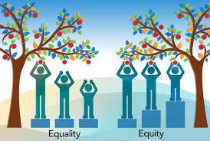
Some Equity Emphases
Provision of supports for those previously marginalized once they arrive on campus – cluster hires, BIPOC-only support spaces
The fight against dominant ideologies such as white supremacy, patriarchy, ableism and transphobia
The deliberate attempt to include scholarship, paradigms & practices from previously excluded groups
The inclusion of multiple perspectives, bodies of knowledge, ways of knowing, modes of communication and forms of assessment – orality, aesthetics, visual, musical (Dancing your Physics Ph.D. https://www.youtube.com/watch?v=UlDWRZ7IYqw)
Questioning the automatic privileging of Eurocentric epistemology – written text, solo scholarship, narrative as overly subjective & untrustworthy, suspicion of emotional expression
An attempt to incorporate & examine questions of establishing truth & legitimate knowledge, “regimes of truth*”
*Foucault, M. 1980. Power/knowledge: Selected interviews and other writings, 1972-1977. New York: Pantheon Press.

Slide 13
In a predominantly White faculty, staff & leadership institution “Good Whites” – like me (Stephen)
Believe that we don’t see race
Believe everyone is a human being & we should treat everyone the same (colorblind ideology)
Believe we focus on actions & individual character, not racial identity
Choose when to engage in race and anti-racism
Can monitor our own racism
Believe we have a pure, anti-racist soul
Believe we are free of white supremacist conditioning
View racism as something committed by less enlightened whites
View ourselves as allies of people of color
(Shannon Sullivan Good White People 2014)

Slide 14
Typical Behaviors of “Good Whites” in a Predominantly White Organization
When confronted with examples of their learned racism, good Whites will vigorously deny any racist intent, claim they have been misunderstood, are acting innocently, & are being unfairly accused
We will become defensive & immediately seek to explain to people of color the “real” meaning of their behavior
We will resist “sitting with” the reality that they have learned racism & White supremacy throughout their lives & carry those viruses
We will accuse people of color of imagining things, seeing racism where it doesn’t exist, & denying the validity of Whites’ experience
We will come to each other’s defense in multi-racial discussions
I know this because these are all of my learned behaviors
(Robin DiAngelo White Fragility 2018) (Shannon Sullivan Good White People 2014)

Slide 15
Hard Truths – What I Know as a White Instructor in a Predominantly White Environment
I MUST call out racist behavior (including in myself) as soon as I see it. If I don’t I will have no credibility in the eyes of students and colleagues of color.
I MUST assume that for students and colleagues of color EVERYTHING is seen through the lens of race. For them, NOTHING is “race free”.
I MUST acknowledge my own racist behavior when it’s pointed out to me – not try to ‘explain’ it away, not protest my innocence: I must regard it as truth.
I MUST NEVER try to talk people of color “out of” their testimony of racism.
I MUST NEVER invoke “being respectful” or “seeing all sides of this” as a way of avoiding painful truths about my own socialization into, & learning of, racism.
I MUST NEVER claim to be an “ally” or anti-racist “friend”.
I MUST NEVER ask people of color to teach me about racism or to tell me what I should do – figuring out what whites should do is OUR responsibility.

Slide 16
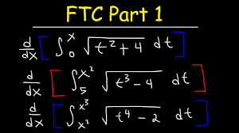
So What Can We Expect in a Multiracial classroom? An arithmetic level of understanding of the dynamics of pervasive, structural racism amongst many whites who have not thought much about racial identity & whiteness THIS IS A REASON FOR AFFINITY GROUPS
A calculus level of understanding amongst black, indigenous and people of color (BIPOC) who have negotiated the dynamics of structural racism & white supremacy all their lives
TIRED OF WITNESSING ‘WOKENESS’

Slide 17
WHITE AFFINITY GROUPS No need to prove oneself as a “good, woke White person” – or to declare allyship No opportunity to ask BIPOC to educate White people on race Lessens fear of saying the ‘wrong’ thing in front of BIPOC peers Removes temptation to ‘confess’ to racism & ask absolution from BIPOC
BIPOC AFFINITY GROUPS
No need to ‘take care’ of sensitivities of White egos
Chance to relax in real talk around experiences of racism
Can develop support networks & provide emotional sustenance
Share knowledge of negotiating the White power structure
No requests to ‘teach’ Whites about race

Slide 18
The danger of performing White ‘wokeness’
“I honestly have been having a hard time being in predominately white classes lately as people in this country realize, again, the issues that exist in America for Black people.
While she was giving her long spiel on her good work, I couldn't figure out where to place my feelings. I could see it from a mile away; I even prepped myself for it before the class.
I prepared for THIS, but I still wasn’t ready. Her actions were soooo predictable, well, to me. It was something I knew was bound to happen in a class placed right in the heart of the world grappling with whether or not Black lives matter. But still I felt completely uncomfortable, sick.
Now, I am not one to dim anyone's light, but all I felt like saying was, "oh, okay. That's cute. You want a cookie?"
I couldn't help but think, "this is not something new, why is it new to you? Why are you just now having these conversations?"
I do not know this woman and may never have a class with her again; however, I will always remember what she did and how it made me feel.”
Carmina Maye 2020 I Really Wanted this to Be a Poem. (Dept. of Art & Art Education, Teachers College)

Slide 19
Go to sli.do Enter code: 484515 (Or use the QR code opposite) Respond to this question… What are the problems or missteps you've witnessed or encountered when racial issues arise in classrooms, meetings or advisement?

Slide 20
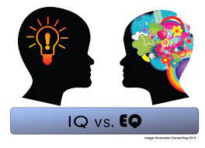
TWO KINDS OF PREPARATION FOR TEACHING & LEADING AROUND RACE
Technical (Content) – reading, viewing, thinking, reflecting on nature of racism, white identity, white supremacy, anti-blackness etc.
Technical (Process) – how to model disclosure, choose good narratives, build trust, scaffold learning from simple to complex, use protocols
Emotional (EQ) – this is inherently emotional work in which people are laying bare their identities, experiences, convictions and feelings. It will sometimes be raw & contentious and people will become distressed, angry, and uncomfortable
Emotional (Mistakes) – this is inherently unpredictable work & you’ll constantly feel like you’ve screwed up, made mistakes, said or done the wrong thing, and mishandled situations
Two ways to address race, racism, racial dynamics IMPERFECTLY or NOT AT ALL!

Slide 21
So where do we go from here?
Understand that calling out racism is the responsibility of whites – don’t wait for BIPOC to be the first to raise these issues
Don’t wait for people of color to say they’re uncomfortable with something – if you have any unease, name it
Work on naming racism as LEARNED behavior – not as an individual soul flaw or inherent lack of humanity, empathy, compassion
Strive to model anti-racist awareness in your own contributions
Understand white privilege/power as an unconscious phenomenon – as not having to worry about how your race makes things difficult for you & anticipate how to negotiate barriers & survive emotionally

Slide 22
So where do we go from here?
Don’t expect gratitude or thanks – you’re just doing the right thing
Don’t preach at, or disdain, those you regard as “less enlightened”
Don’t set up people to “confess” & then grant absolution
Don’t stay silent in multiracial discussions
Do assume you’ll say the “wrong” thing & leave feeling you messed up
For White faculty strive to act as allies – but watch out for making a big deal out of publicly declaring yourself an ally to BIPOC

Slide 23
How to Prepare for Teaching with Race in Mind
Lose Your Desire/Expectation to address this issue ‘Perfectly’
Begin By Modeling Self-Disclosure Around Your Own Racial Identity/Struggles
When Possible Teach & Model Racial Cross-Talk as a TEAM
Consider Using Digital Narratives*
Take the Emotional Temperature –sli.do, Mood Meter
Introduce the Concept of Brave Space
Consider Introducing Racial Affinity Groups
Use Conversational Protocols to Engage Everyone
(Circle of Voices, Circular Response, Bohmian Dialogue)
Check In Regularly via Anonymous Channels
(sli.do, backchannelchat.com)
* Letter to White America (George Yancy) https://opinionator.blogs.nytimes.com/2015/12/24/dear-white-america/
* What it Means to be American (Color of Fear) https://www.youtube.com/watch?time_continue=3&v=2nmhAJYxFT4&feature=emb_logo
* Conversations on Race (New York Times) https://www.nytimes.com/interactive/projects/your-stories/conversations-on-race
* How Can We Win (Kimberly Latrice Jones) https://www.youtube.com/watch?v=ZkedkvNn5V0

Slide 24
When Racial Dynamics Need to Be Addressed Consider the ‘Circle of Voices’ Protocol S. Brookfield & S. Preskill. 2015. The Discussion Book: 50 Great Ways to Get People Talking. Hoboken, NJ: Wiley.
CIRCLE OF VOICES
Equalizes the opportunity for conversation
Acknowledges silence as a necessary part of conversation
Allows every person to speak but in a way that’s as non-threatening as possible – important for subsequent participation
Designed to elicit a variety of perspectives & to stop the discussion being channeled prematurely into one analysis or viewpoint
Trains us in habits of careful listening
Encourages conversation to build on earlier contributions & go deeper

Slide 25
Circle of Voices When you enact, experience or observe equity based practice, what does it look, sound, feel like?
Begin by reflecting silently & individually on the discussion question for 2 minutes. Use the time to make written or mental responses to the question
Form into groups of four
Go round the circle in alphabetical order (first names). Each person has up to 1 minute of uninterrupted air time to give their viewpoint on the topic. No interruptions are allowed
After everyone has spoken uninterruptedly, move into free discussion. No order of speaking.
However, follow the ground rule that every comment offered must somehow refer back to a comment made by someone else in the opening circle of voices.
This need NOT be agreement - it can be a disagreement, a question, an elaboration / extension, an illustration, request for information

Slide 26
Some Resources Authored by Stephen
Becoming a white antiracist: A practical guide for educators, leaders & activists. 2021. Sterling, VA: Stylus (w/Mary Hess)
Gospel Beautiful Podcast: https://www.buzzsprout.com/680528/8460030-stephen-brookfield-and-mary-hess-becoming-a-white-antiracist
Teaching race: Helping students unmask and challenge racism. 2019. Hoboken, NJ: Wiley Publishing
Becoming a critically reflective teacher. 2017 (2nd. Ed.). Hoboken, NJ: Wiley Publishing
Handbook of race and adult education. 2010. Hoboken, NJ: Wiley Publishing (w/ Vanessa Sheared, Juanita Johnson-Bailey, Scipio Colin Jr III, & Elizabeth Peterson)
The discussion book: 50 great ways to get people talking. 2016. Hoboken, NJ: Wiley Publishing (w/Stephen Preskill)
www.stephenbrookfield.com
(Go to “Resources”, “Creating an Anti-Racist White Identity” and “Recent Writings” links)

Slide 27
General Resources
Ijeama Oluo. 2019. So you want to talk about race. New York: Seal Press. https://www.youtube.com/watch?v=TnybJZRWipg
George Yancy. Look! A White (2012), What White Looks Like (2004), White self-criticality beyond anti-racism https://www.youtube.com/watch?v=fyZNAAr8czE
N.M. Joseph, C. Haynes and F. Cobb (Eds.). 2016. Interrogating Whiteness & relinquishing power: White faculty’s commitment to racial consciousness in STEM classrooms. New York: Peter Lang,
Layla F. Saad. 2020. me and White supremacy: Combat racism, change the world, and become a good ancestor. Naperville, IL: Sourcebooks. https://www.youtube.com/watch?v=gMEXBFhA-NY
Derald Wing Sue 2016. Race talk & the conspiracy of silence. Hoboken, NJ: Wiley https://www.youtube.com/watch?v=Nrw6Bf5weTM&t=53s
Shannon Sullivan. 2014. Good White people. Albany: SUNY Press https://www.youtube.com/watch?v=UZo06BjmbbE
Robin DiAngelo. 2018. White fragility. Boston: Beacon Press https://www.youtube.com/watch?v=45ey4jgoxeU
Ibram X. Kendi. 2019. How to be an anti-racist. New York: One World Books https://www.youtube.com/watch?v=TzuOlyyQlug
Glenn Singleton. 2014 Courageous conversations about race. Thousand Oaks, CA: Corwin https://www.youtube.com/watch?v=IwaOBXzJ3hs
Solomon, Akiba & Rankin, Kenrya. 2019. How we fight white supremacy: A field guide to black resistance. New York: Bold Type Books https://www.youtube.com/watch?v=Cc51rbZok3k
Tim Wise. 2011. White like me. Berkeley, CA: Counterpoint https://www.youtube.com/watch?v=N4fbr1LlxEk

Slide 28
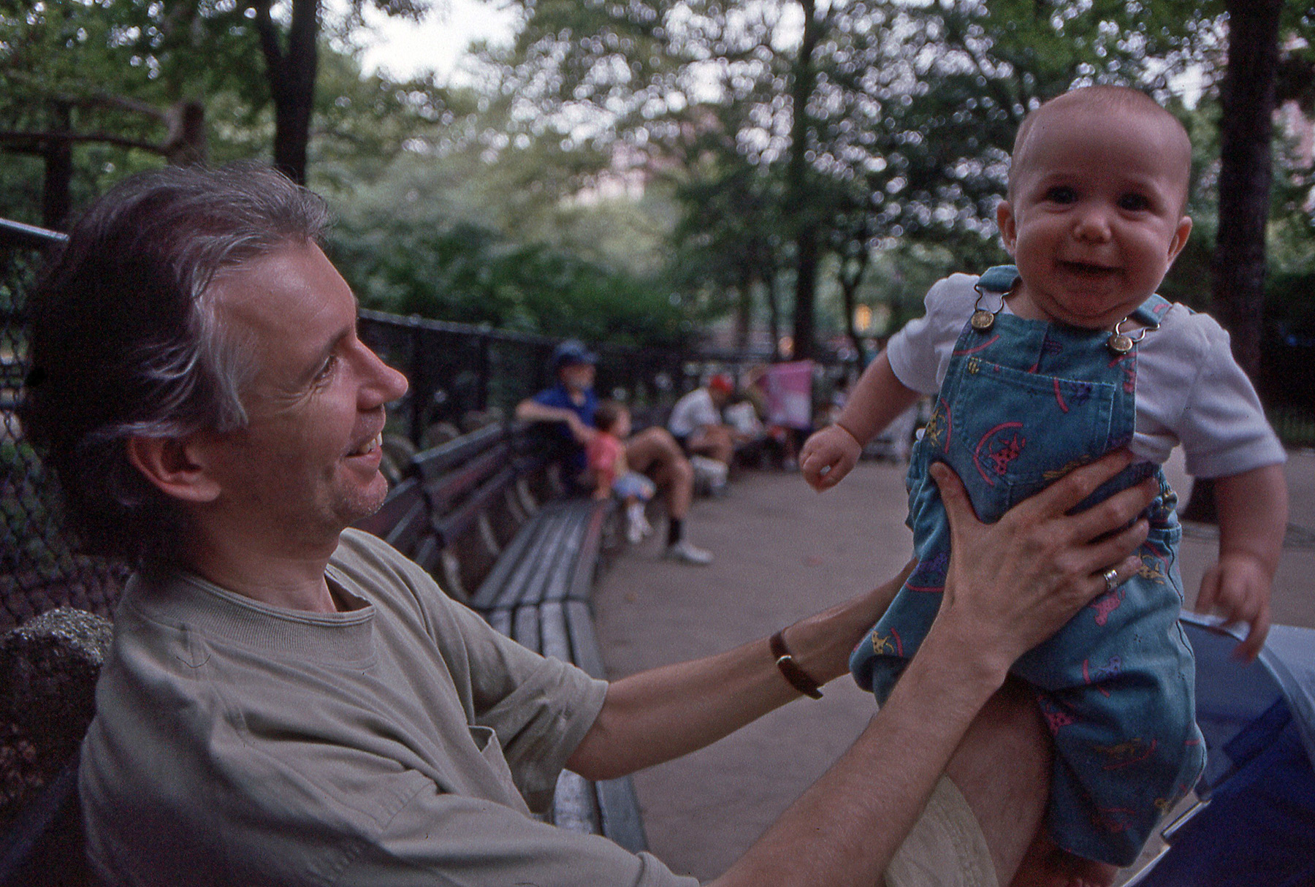
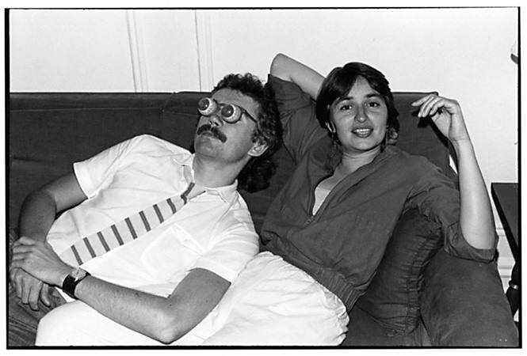
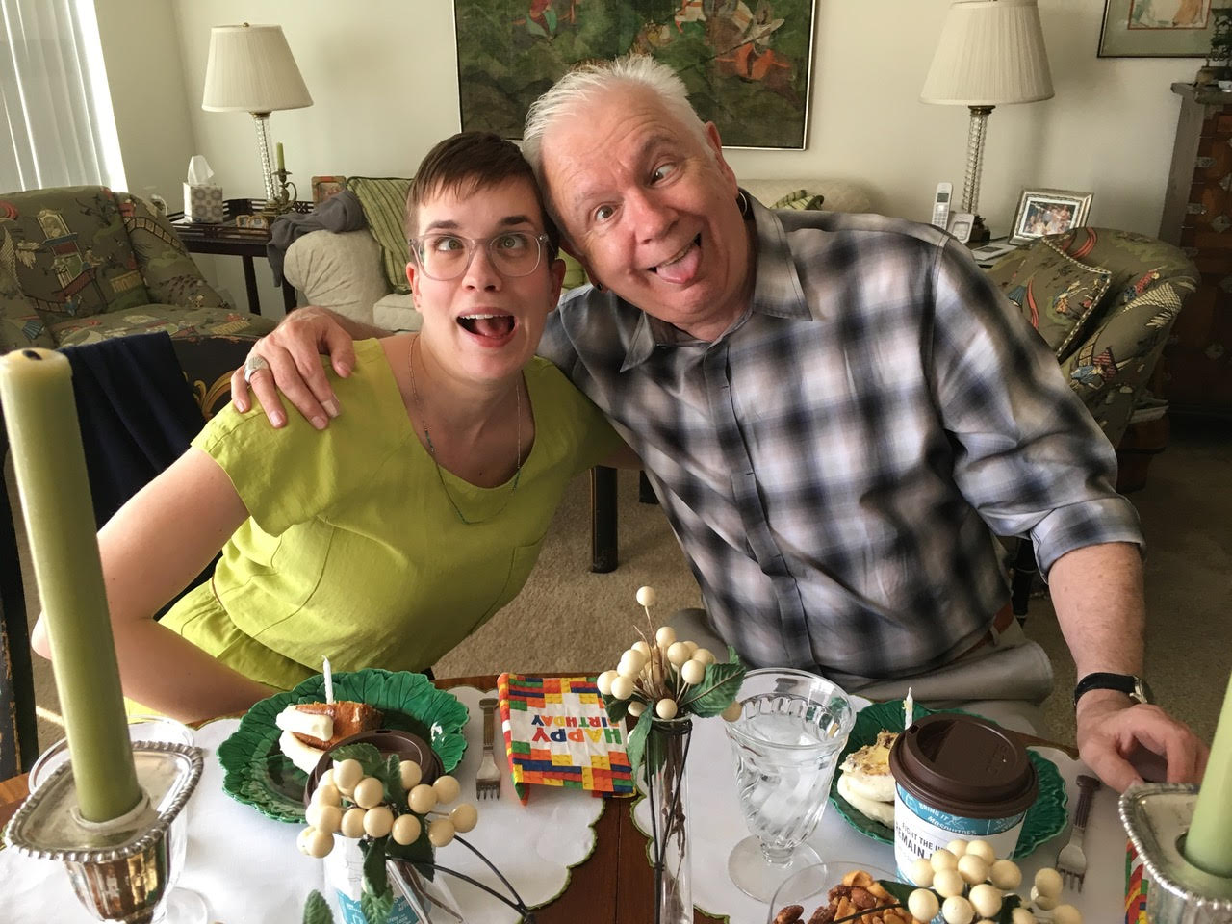
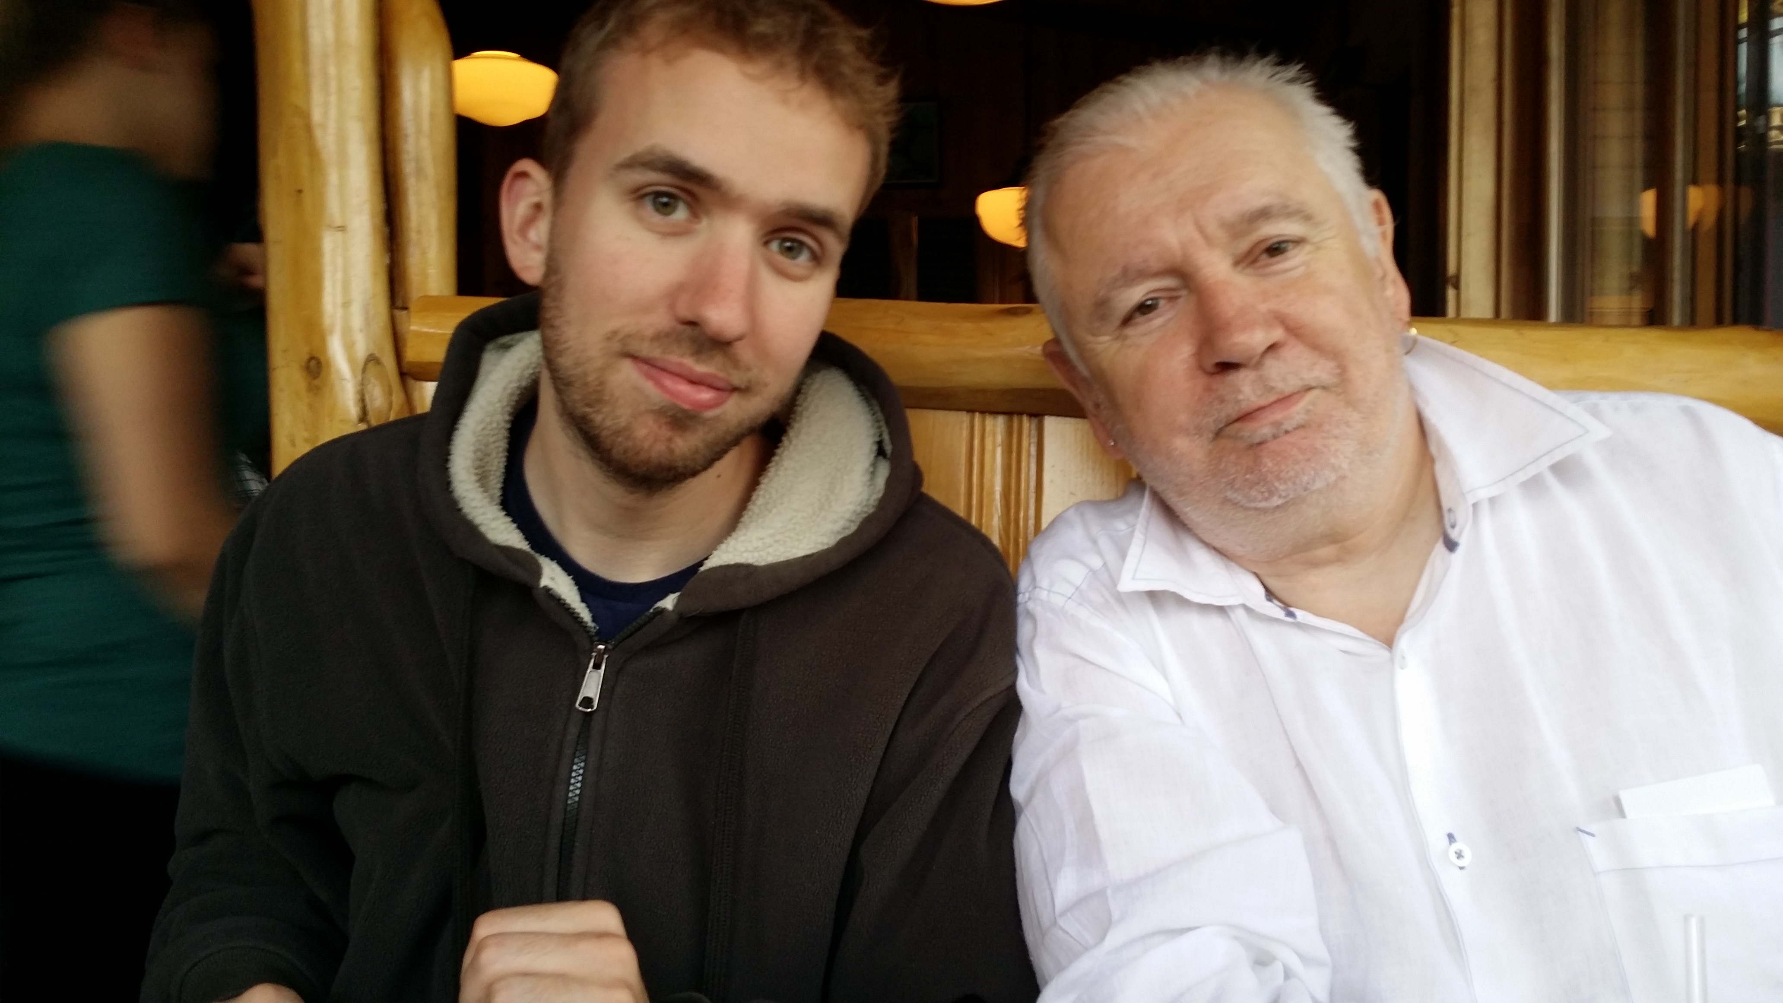
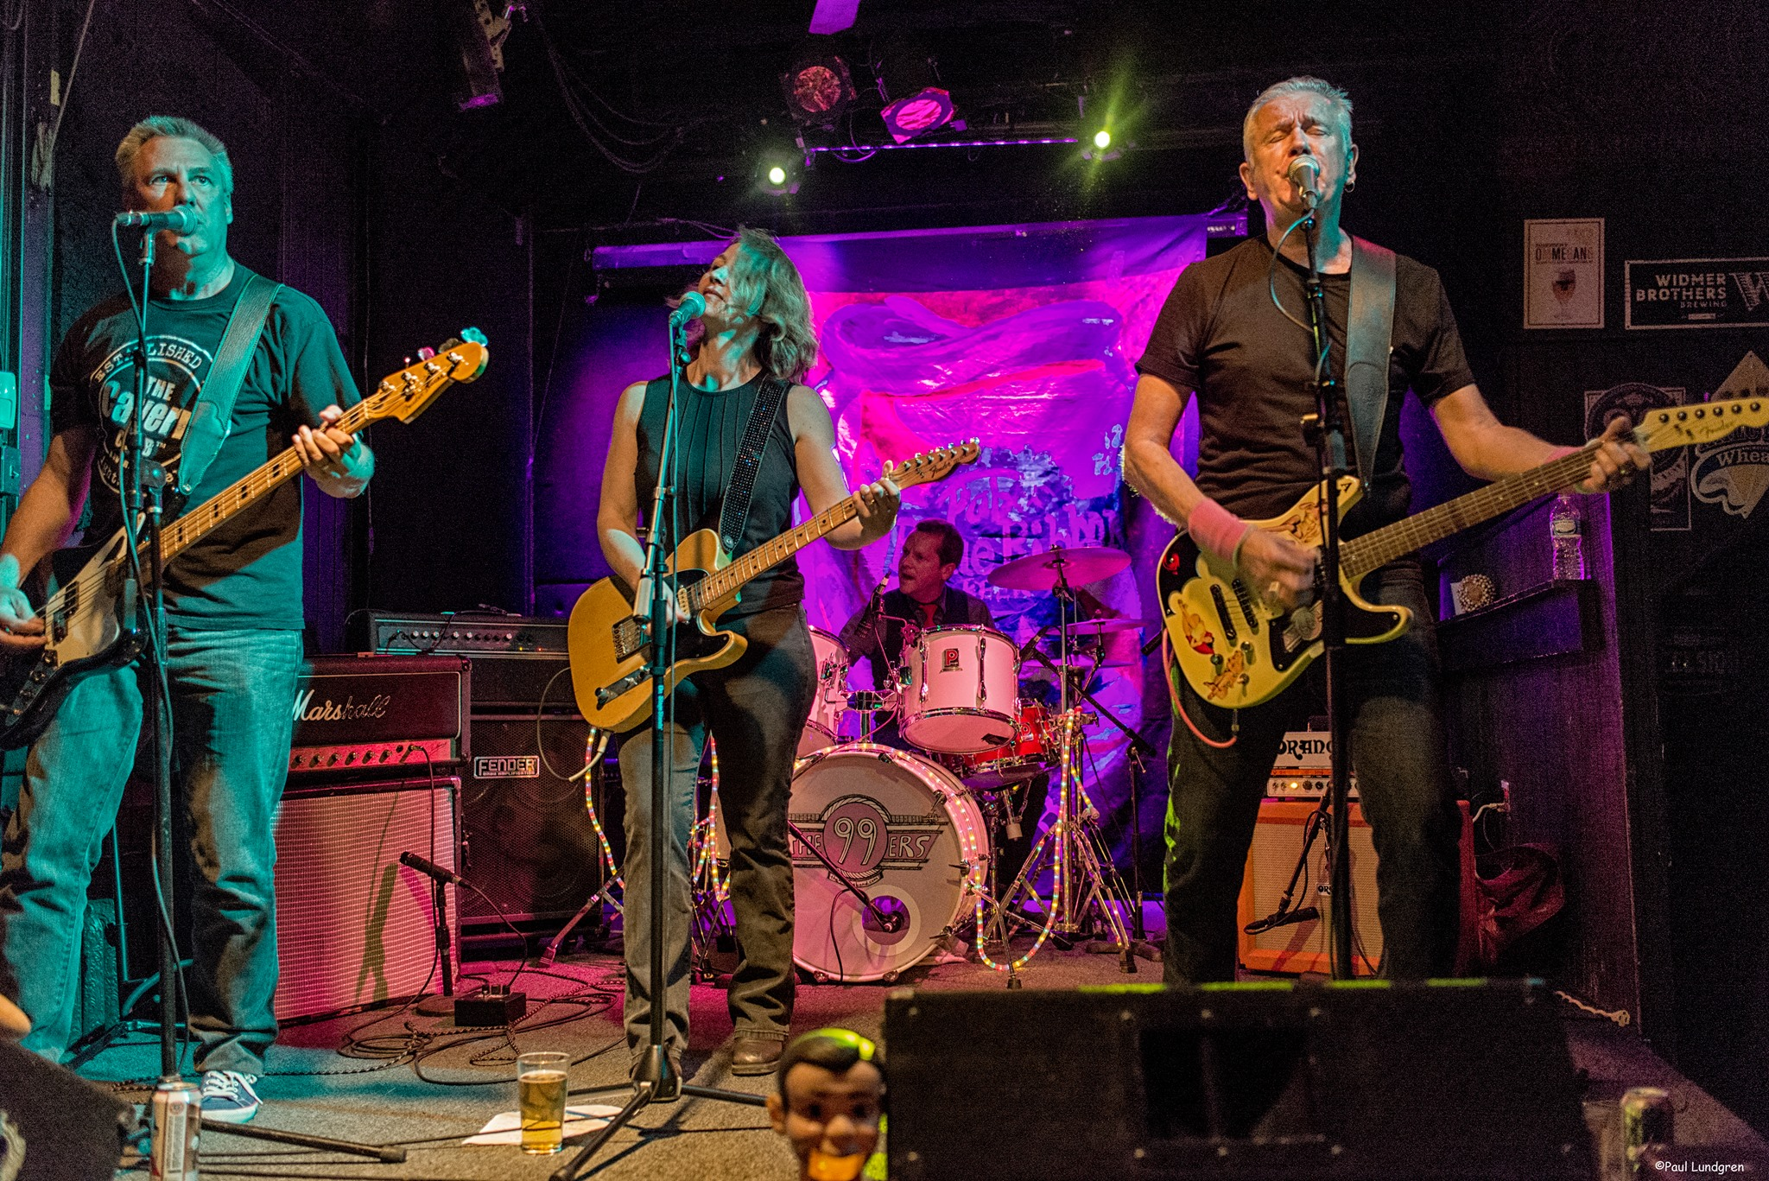
Who I am racially shapes how I experience the world – including my classroom As a White man Stephen has…. Often tried NOT to see color & treat everyone the same (color blindness) Had the freedom to choose when to focus on race Doesn’t have to worry about how his racial identity undercuts students’ perceptions of his pedagogic authority Is used to seeing people who look like him in leadership Will often be institutionally rewarded for raising issues of race & is not seen as playing the ‘race card’ Expects his expressions of ally-ship to be taken seriously Is regarded as ‘vulnerable’ and ‘brave’ when he admits to screwing up & owns his mistakes Is viewed with justifiable skepticism by many students of color when he talks about race Has withheld from commenting in multiracial groups & had that ‘malefic generosity’ seen as a lack of interest or commitment

Slide 29
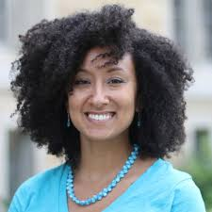
Team Teaching Allows You to…
Model how racial identity frames team decisions / process
Facilitate racial affinity groups
Show you sit with differences between you…
How you negotiate experiencing the classroom differently
Address racial imbalances in the teaching team’s operation
How you deal w/ micro aggressions, power asymmetries
How your racial & cultural identities frame your practice
Call & response, gumbo ya-ya, silence, group identity
Demonstrate how to engage in difficult conversations
….how to focus on behaviors not personhood
….how white supremacy is learned & internalized
….how racism is learned & NOT essential moral difference

Slide 30
Asymmetries of Power
Teachers – asymmetries of knowledge, understanding, skill, command & performance: we know more, have studied longer, have a command of research protocols, used to academic discourse
Students – bring asymmetries in terms of readiness for learning, previous experience, previous access to resources, internalized racism. Also, whatever judgments & stereotypes attach to their identities outside the classroom are immediately reproduced inside – often supported by teachers’ learned preconceptions
Knowledge/Content – some knowledge, theories, explanations, hypotheses, laws, analytical frameworks, are viewed as more legitimate owing to methodology of empirical confirmation, their withstanding falsifiability, their heuristic ‘fit’ with the world etc. These are derived from Eurocentric epitemology

Slide 31
Diversity, Equity & Inclusion Acknowledges the importance of a full representation of ideas & perspectives Attention to a diversity of practices, scholarship and identities Striving to ensure that Black, Indigenous & People of Color are well represented on campus as students, staff, faculty & administration - cluster hires Curricula represents multiple paradigms – Afrocentric, Indigenous, Latinx, Asian diaspora Multiple modes of pedagogy, communication, assessment & evaluation – visual, oral, narrative, musical, dramatic Dancing your Physics Ph.D. https://www.youtube.com/watch?v=UlDWRZ7IYqw
Anti-Racism
Assumes that structural inequity is in place across institutions, policies & practices
Assumes that white supremacy pervades organizations & community – the ideology that because of their supposedly superior intelligence & capacity to use reason & logic that whites should “naturally” be in positions of power & authority (correlated particularly with anti-blackness that criminalizes black & brown bodies as volatile, inherently uncontrollable & prone to/on the verge of violence)
Focused on dismantling ideology & practice of white supremacy - changing systems & structures to ensure full participation of BIPOC
Institutional expectation of antiracist work as part of what it means to be an academic, staff member, administrator, institutional leader
Deliberately prioritizes issues of race in construction, dissemination & application of knowledge

