Slide 1
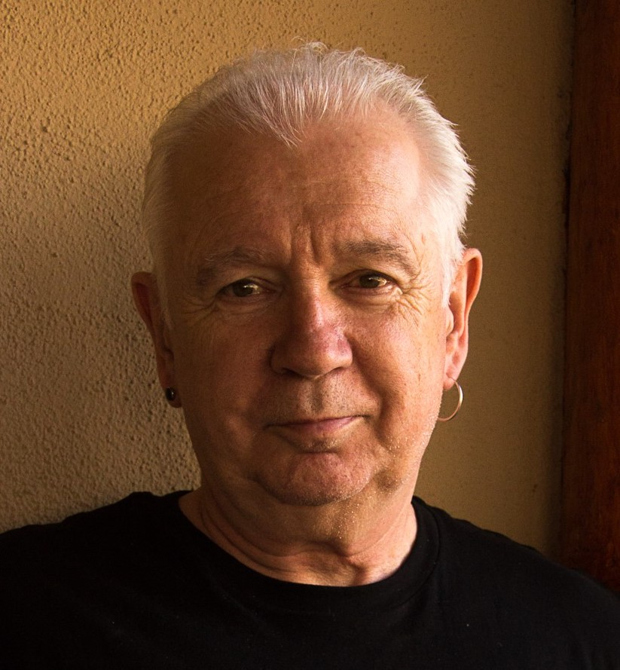
“You don't walk in my shoes so how can you know what I'm learning?” Assessing the impact of our teaching on students
University of Alberta Online Teaching Institute,
August 10th, 2021
Stephen Brookfield
Distinguished Scholar, Antioch University
http://www.stephenbrookfield.com/

Slide 2

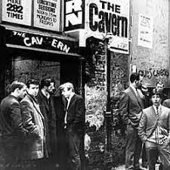

Slide 3
My Web Site
My website is open access so if you want to find out more about any of the exercises or activities I mention go to the page and click on the ‘Resources’ link.
Scroll down & you will find multiple PDF files of workshop packets stuffed with activities or power point files.
Today’s power point is the first one listed: http://www.stephenbrookfield.com/powerpoints-pdfs
You do not need to ask my permission to use any of these resources. If they’re useful then please try them out and adapt them to your context.
www.stephenbrookfield.com

Slide 4
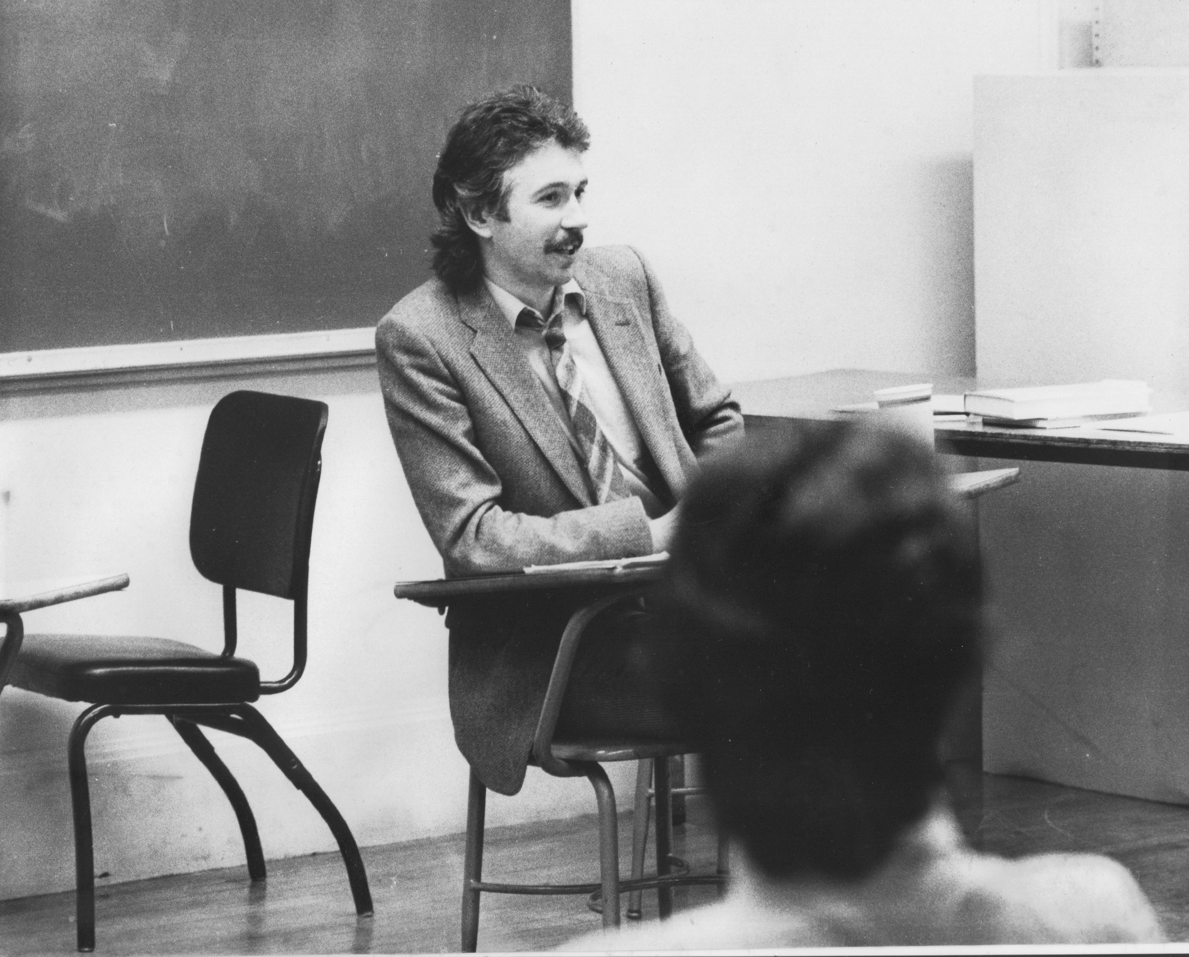
Watching my doctoral supervisor – giving me ‘bad’ inconvenient news in a way that I knew was in my own best interests
Ethical use of teacher power
Relational underpinnings to critical thinking
An authoritative ally
Who I am as a teacher is influenced by who I am as a learner….
History of academic mediocrity –failed high school leaving exams, university places cancelled, College of Technology, graduated in bottom half of my class, turned down for graduate study, failed my master’s degree exam – Broadening student-centered assessment measures

Slide 5
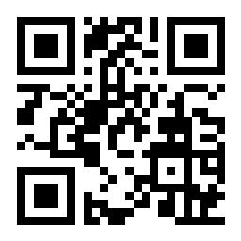
Sli.do
Go to sli.do & enter Code: 583111
Or, use the QR Code opposite
Reply to the question: When students are learning well, what does it LOOK, SOUND & FEEL like?
Your responses will help form a word cloud

Slide 6

sli.do backchannelchat.com tweedback.de
USES
Interrupts the normal privileging of extroverts, dominant language speakers
Students can ask questions without fear
You can pose a question at start of class to assess knowledge, experience & preconceptions of students – but also to uncover ‘unsayables’: “what’s a recent example of structural racism you’ve witnessed, enacted or experienced at the school?”
You can pose quick questions during class to check for understanding, identify misconceptions
Students can critique your actions

Slide 7
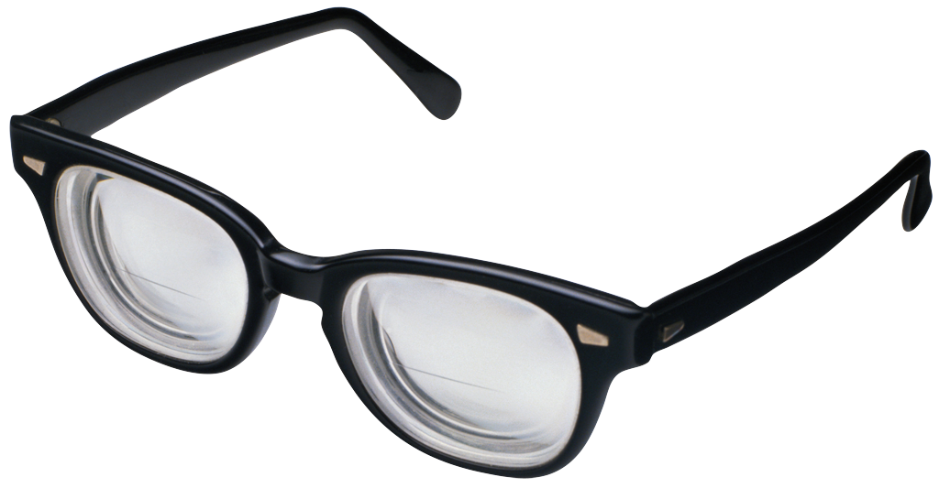
Assessing Teacher Impact: Assumptions
We have four lenses available through which we can assess our impact
Students’ Eyes
Colleagues’ Perceptions
Theory
Autobiography
The most important knowledge we need to do good work is information about how students are experiencing their learning & our actions

Slide 8

Students’ Eyes
ONE MINUTE PAPER
MUDDIEST POINT
AFTER HOURS GROUP
SOCIAL MEDIA
LEARNING AUDIT
CRITICAL INCIDENT QUESTIONNAIRE (CIQ)
Ch. 6 “Seeing ourselves through students’ eyes” S.D. Brookfield. 2017. Becoming a critically reflective teacher. Hoboken, NJ: Wiley

Slide 9
One Minute Paper – what questions are you left with after this discussion?
Muddiest Point – what part of the presentation did you find the hardest to understand?
After Hours Group – what do I need to know as your instructor about how to better support your learning in this course?
Social Media – you can use tools like sli.do, backchannelchat.com or tweedback.de to collect this data in ways that preserve students’ anonymity
Learning Audit….
Here’s what I know that I didn’t know this time last week
Here’s what I can do that I couldn’t do this time last week
Here’s what I could teach someone else to know/do that I couldn’t teach them this time last week

Slide 10
CRITICAL INCIDENT QUESTIONNAIRE
Moment you were Most Engaged as a Learner in Class this Week
Moment you were Most Distanced as a Learner in Class this Week
Most Helpful Action that Anyone in Class Took
Most Puzzling Action that Anyone in Class Took
What Surprised You Most in Class this Week
(Download directly from www.stephenbrookfield.com)

Slide 11

How the CIQ is Administered
Given the Last 5 minutes of Last Class of Week
Anonymous
Frequency Analysis of Main Themes
Report Results Out at Start of Next Class
Disclose How Results Confirm or Challenge Your Assumptions / Provide You with new Perspectives
Disclose Any Changes You Will Make – or Why You Won’t
Student-Centered: Negotiation NOT Capitulation

Slide 12
Two Things I’ve Learned (000’s of CIQ’s over 30 years)
POWER IS ALWAYS THERE
GROUP WORK IS MUCH MORE PROBLEMATIC THAN I HAD ASSUMED – NEED FOCUS & STRUCTURE
S.D. Brookfield 2015 The Skillful Teacher. Hoboken, NJ: Wiley
S.D. Brookfield 2017 Becoming a Critically Reflective Teacher. Hoboken, NJ: Wiley

Slide 13

Students are ALWAYS watching you & reading meaning into your words & actions
You can’t really ever be a ‘fly on the wall’ even in discussions where you don’t talk
Visiting Groups
Supportive?
Interfering?

Slide 14
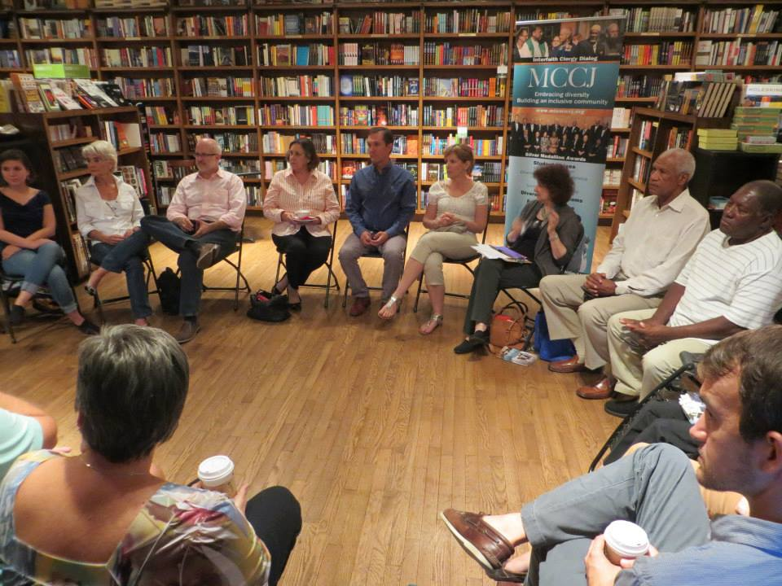

Slide 15
My Assumptions
If I get to class early & arrange the chairs in a circle…
Students will feel their experience is respected & acknowledged when they walk in.
This will create a relaxed and congenial environment for learning
The distance between me as the teacher & them as the students will be reduced
Students will be more likely to participate, contribute, ask questions etc.

Slide 16
Students’ Eyes
The circle is an arena of surveillance – everything I do will be seen, my mistakes will be noticed by everyone (peers & instructor)
The circle is alienating – if anything about me marks me out as different (how I look or sound) my discomfort is increased
The circle is coercion – you are coercing me into speech before you have earned the right to do that
The circle increases mistrust – I can’t sit back & judge your competence or authenticity, just let me process

Slide 17
NOW…
I still use the circle but explain…
It’s to keep sight lines clear – so students who wish to contribute or ask a question can do that easily
It’s so students don’t have to talk to the back of other people’s heads
I won’t assume that those who are quiet are less diligent or intelligent
I must self-disclose before expecting students to do the same

Slide 18
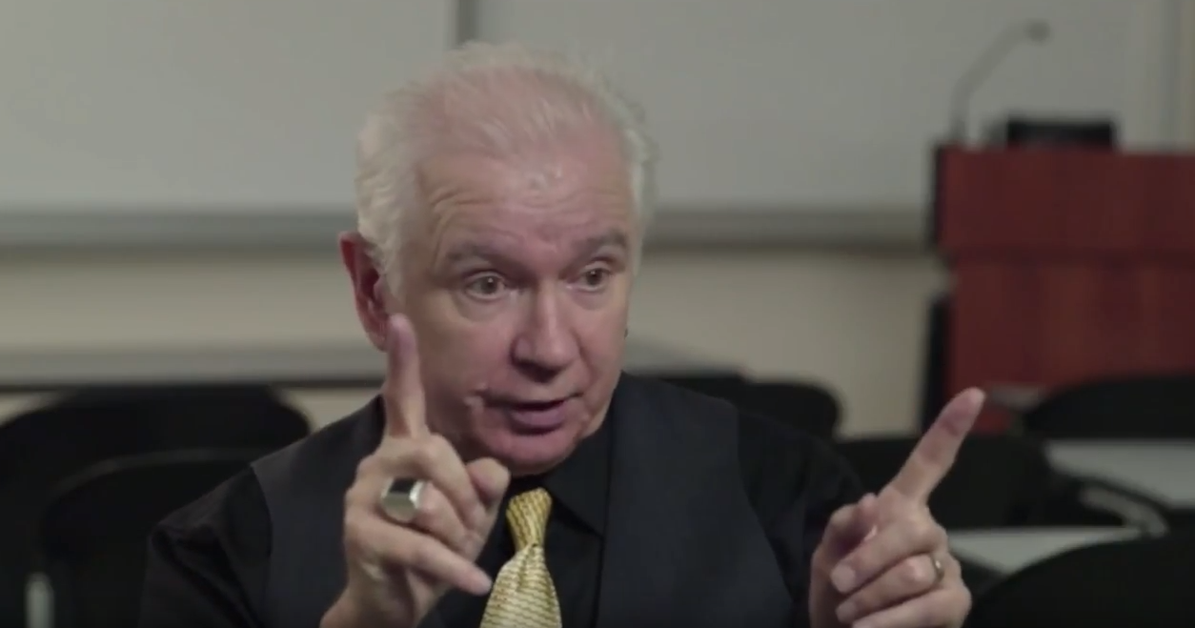
An Example of Critical Reflection on My Teaching: The 1st Class Speech
Call me Stephen – friendly atmosphere
I look forward to teaching – I learn so much from my students
My job – help you realize what you know
Questions – encouraged but I don’t know all the answers / gifts for learning
Mistakes – richest moment in learning
Unexpected Event – pool our wisdom

Slide 19


Slide 20
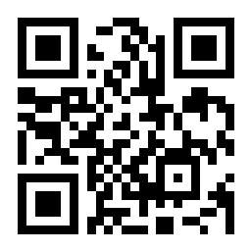
Go to sli.do
Enter code 925873
(Or, use QR Code opposite)
Answer this question:
What do you want students to say about your teaching when they are out of your earshot?

Slide 21
Credibility – “she/he/they know her/his stuff” / “I’m going to learn something important if I stick around him/her/them”
Demonstrable expertise
Rationale for Practice
Conviction re. importance of learning
The quickest earner of credibility?: Answering a clearly unanticipated question helpfully & with authority
Authenticity – “I can trust her” / “what you see is what you get”
Practicing what you preach
Responsiveness to students’ experiences & concerns
Transparency & Full Disclosure
Appropriate Autobiographical Disclosure

