Slide 1
The Dynamics of Teaching & Leadership Around Race
Stephen Brookfield
Distinguished Scholar, Antioch University
http://www.stephenbrookfield.com/

Slide 2
How to access this power point
Go to my home page: http://www.stephenbrookfield.com/
Click on the “Resources” link (top left, next to ‘Home’
Scroll down to power points & pdf’s http://www.stephenbrookfield.com/powerpoints-pdfs
This power point is the 1st one listed –The Dynamics of Teaching & Leadership Around Race
Feel free to steal anything from my home page – it’s open access for free download

Slide 3
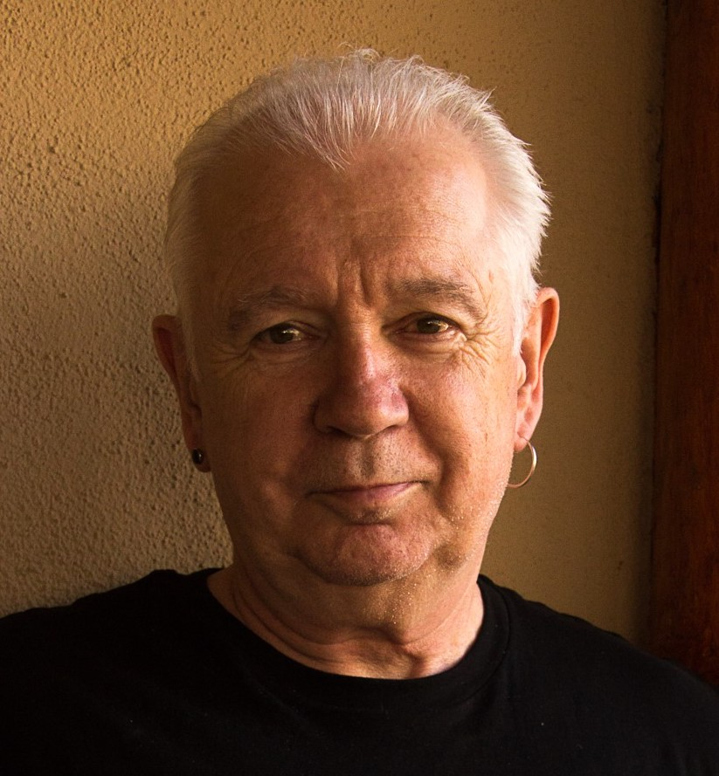
The (White) Elephant in the Room
Another White man leading something on race – doesn’t this underscore the power of Whiteness?
At the heart of racism is the fact that many White folks have not examined what it means to have a White racial identity
The idea of ‘interest convergence’ – change happens when White people see how it benefits them
White students & colleagues need to see us typically & unremarkably center racial dynamics as a factor in teaching & leadership – “equity pause” in meetings
Diversity, equity & inclusion (DEI) work often involves cross-racial conversations & alliances – a team of colleagues of different racial identities best facilitate this

Slide 4

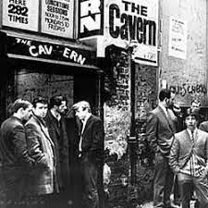

Slide 5
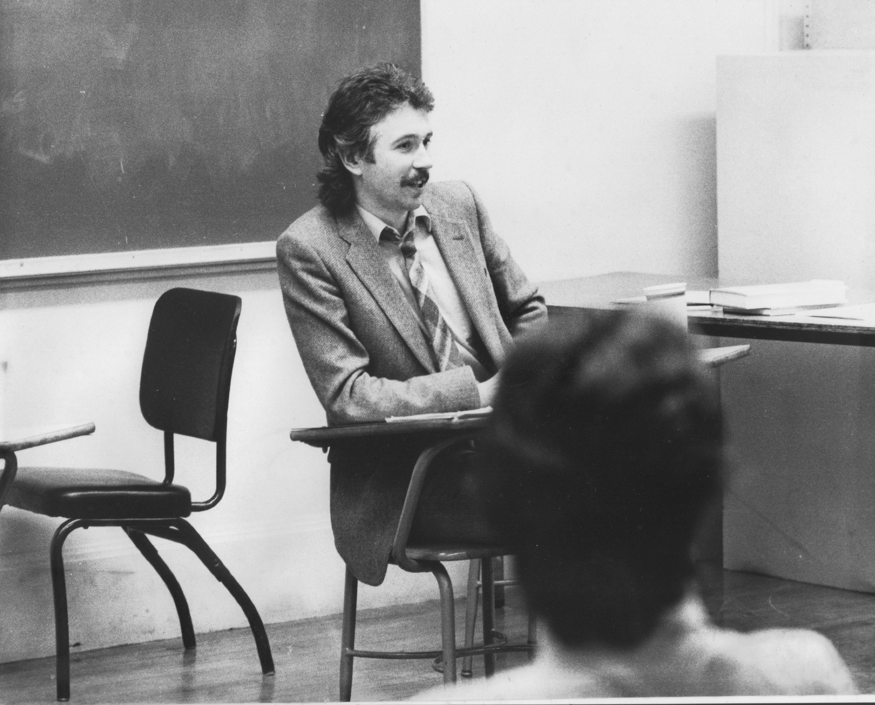
Situating Myself as a Teacher
History of academic mediocrity –failed high school leaving exams, university places cancelled, College of Technology, graduated in bottom half of my class, turned down for graduate study, failed my master’s degree exam – Broadening student-centered assessment measures
Watching my doctoral supervisor – giving me ‘bad’ inconvenient news in a way that I knew was in my own best interests
Ethical use of teacher power
Relational underpinnings to critical thinking
Balancing credibility & authenticity

Slide 6
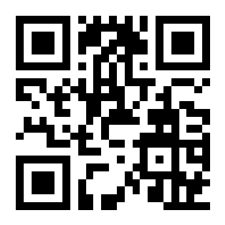
Go to: sli.do
Enter Code: 18670
Or use the QR code opposite
You’ll see a statement: “When I know we're going to talk about race I feel....”
Vote for the response that most closely matches your own

Slide 7
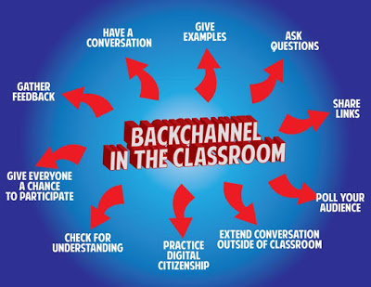
sli.do backchannelchat.com tweedback.de
Pose a question at start of class to assess what knowledge, experience & preconceptions students bring
Pose quick questions during class to check for understanding, identify misconceptions
Invite students to raise questions or seek clarification anonymously
Interrupts the normal privileging of speech, extroverts, dominant language speakers – no one can dominate
Anonymity means students aren’t afraid to ask ‘dumb’ questions
As with all activities, open to sabotage
sli.do
backchannelchat.com
tweedback.de

Slide 8
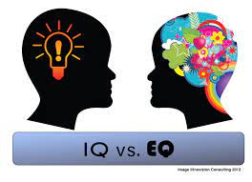
TWO KINDS OF PREPARATION FOR TEACHING & LEADING AROUND RACE
Technical (Content) – reading, viewing, thinking, reflecting on nature of racism, white identity, white supremacy, anti-blackness etc.
Technical (Process) – how to model disclosure, choose good narratives, build trust, scaffold learning from simple to complex, use protocols
Emotional (EQ) – this is inherently emotional work in which people are laying bare their identities, experiences, convictions and feelings. It will sometimes be raw & contentious and people will become distressed, angry, and uncomfortable
Emotional (Mistakes) – this is inherently unpredictable work & you’ll constantly feel like you’ve screwed up, made mistakes, said or done the wrong thing, and mishandled situations
Two ways do do anti-racist work – IMPERFECTLY or NOT AT ALL!

Slide 9
Preparing to Teach with Race in Mind – A Sequence
Lose Your Desire/Expectation to Be ‘Perfect’
When Possible Teach & Model Racial Cross-Talk as a TEAM
Begin w/ Introductory Reading/Viewing*
Take the Emotional Temperature –sli.do, Mood Meter
Begin By Modeling Self-Disclosure
Introduce the Concept of Brave Space
Consider Introducing Racial Affinity Groups
Use Conversational Protocols to Engage Everyone
(Circle of Voices, Circular Response, Bohmian Dialogue)
Check In Regularly via Anonymous Channels
(sli.do, backchannelchat.com)
* Letter to White America (George Yancy) https://opinionator.blogs.nytimes.com/2015/12/24/dear-white-america/
* What it Means to be American (Color of Fear) https://www.youtube.com/watch?time_continue=3&v=2nmhAJYxFT4&feature=emb_logo
* Conversations on Race (New York Times) https://www.nytimes.com/interactive/projects/your-stories/conversations-on-race
* How Can We Win (Kimberly Latrice Jones) https://www.youtube.com/watch?v=ZkedkvNn5V0

Slide 10
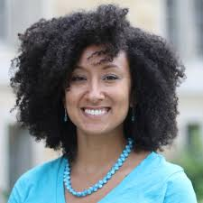
TEAM TEACHING
Allows you to….
Foreground race as an expected point of analysis
Model an open acknowledgment of how racial identity frames team decisions & process
Show you sit with difference – talking about how you acknowledge & negotiate teaching team members experiencing the classroom differently
Address racial imbalance in the teaching team’s operation, dynamics & decision-making – micro aggressions, power asymmetries
Demonstrate how to engage in difficult conversations in a way focused on behaviors not personhood, & on learned white supremacy not essential moral differences or failings
Facilitate racial affinity groups

Slide 11
MODELING
how our racial identity frames our actions & choices
the structural blindness we carry re. other racial groups
how addressing racial issues is part of good leadership
how we struggle to understand & negotiate racism we witness & enact
how we uncover assumptions that have been challenged
how we experience racism & racial microaggressions
how we practice self-care in the face of battle fatigue
how we build communities of support

Slide 12


https://www.citybureau.org/notebook/2019/12/19/safe-spaces-brave-spaces-and-why-we-gon-be-alright https://onlinelibrary.wiley.com/doi/abs/10.1002/9781119548492.ch4
The normality of strong emotions & feelings being expressed – anger, frustration, sadness, fatigue, desperation, confusion, anxiety
The discomfort that lies ahead that is completely predictable & ‘normal’
The lack of closure
The normality of silence as a necessary dynamic as we make sense of starkly different racial realities – beginning all discussions with a deliberately named period of silence; viewing multiple silences as necessary not awkward
The commitment to understanding others

Slide 13
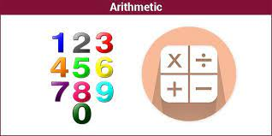
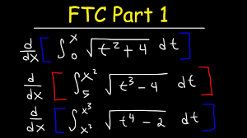
An arithmetic level of understanding of the dynamics of pervasive, structural racism amongst many whites who have not thought much about racial identity & whiteness
THIS IS A REASON FOR
AFFINITY GROUPS
Ali Michael 2015. Raising race questions. New York: Teachers College Press
A calculus level of understanding amongst Black, Indigenous and People of Color (BIPOC) who have negotiated the dynamics of structural racism all their lives & are tired of WITNESSING ‘WOKENESS’ in White people coming to new racial awareness

Slide 14
The Fatigue of WWW - Witnessing White Woke-ness
“I honestly have been having a hard time being in predominately white classes lately as people in this country realize, again, the issues that exist in America for Black people.
While she was giving her long spiel on her good work, I couldn't figure out where to place my feelings. I could see it from a mile away; I even prepped myself for it before the class.
I prepared for THIS, but I still wasn’t ready. Her actions were soooo predictable, well, to me. It was something I knew was bound to happen in a class placed right in the heart of the world grappling with whether or not Black lives matter. But still I felt completely uncomfortable, sick.
Now, I am not one to dim anyone's light, but all I felt like saying was, "oh, okay. That's cute. You want a cookie?"
I couldn't help but think, "this is not something new, why is it new to you? Why are you just now having these conversations?"
I do not know this woman and may never have a class with her again; however, I will always remember what she did and how it made me feel.”
Carmina Maye 2020 I Really Wanted this to Be a Poem. (Teachers College, Columbia University, New York)

Slide 15


WHITE AFFINITY GROUPS
No need to prove oneself as a “good, woke White person” – or to declare allyship
No opportunity to ask BIPOC to educate White people on race
Lessens fear of saying the ‘wrong’ thing in front of BIPOC peers
Removes temptation to ‘confess’ to racism & ask absolution from BIPOC
BIPOC AFFINITY GROUPS
No need to ‘take care’ of sensitivities of White egos
Chance to relax in real talk around experiences of racism
Can develop support networks & provide emotional sustenance
Share knowledge of negotiating the White power structure
No requests to ‘teach’ Whites about race

Slide 16
Hard Truths I’ve Learned as a White Instructor/Leader
I MUST call out racist behavior (including in myself) as soon as I see it. If I don’t I will have no credibility in eyes of BIPOC students & colleagues
I MUST assume that for students and colleagues of color EVERYTHING is seen through the lens of race. For them, NOTHING is “race free”.
I MUST acknowledge my own racist behavior when it’s pointed out to me – not try to ‘explain’ it away, not protest my innocence
I MUST watch out for the dangers of preaching, disdaining & withholding*
* European American Collaborative Challenging Whiteness. 2010. White on white: Developing capacity to communicate about race with critical humility” In, V. Sheared, J. Johnson-Bailey, S.A.J. Colin III, E. Peterson and S. Brookfield (Eds.). The handbook of race and adult education: A resource for dialogue on racism. San Francisco: Jossey-Bass.

Slide 17
Hard Truths I’ve Learned as a White Instructor/Leader
I MUST NEVER invoke “being respectful” as a way to avoid difficult conversations around racism.
I MUST NEVER claim to be an “ally”, “accomplice” “co-conspirator”– but must act in those ways
I MUST NEVER ask people of color to teach me about racism – figuring out what whites should do is MY responsibility.
I MUST NEVER ask a BIPOC student or colleague to speak for their race
I MUST NEVER “confess” my racism so as to seek “absolution” from BIPOC students & colleagues

Slide 18

Circle of Voices
S. Brookfield & S. Preskill. 2015. The Discussion Book: 50 Great Ways to Get People Talking. Hoboken, NJ: Wiley.
Requires every person to speak but in a way that’s as non-threatening as possible – important for subsequent participation
Designed to elicit a variety of perspectives & to stop the discussion being channeled prematurely into one analysis or viewpoint
Trains us in habits of careful listening
Encourages conversation to build on earlier contributions & go deeper

Slide 19
Circle of Voices
What are the chief difficulties you encounter as an instructor or leader when trying to get people to examine race as an issue?
PROCESS…
Individuals reflect silently & individually on the discussion topic or question (1-2 minutes). Then form groups of 5.
Participants go round the circle in order - each person has up to 1 minute of uninterrupted air time to give their viewpoint on the topic. No interruptions are allowed
After all have spoken, people move into free discussion with the ground rule that every comment offered must somehow refer back to a comment made by someone else in the opening circle of voices. This need NOT be agreement - it can be a disagreement, a question, an elaboration or extension, an illustration, a request for clarification etc.
PLEASE KEEP A NOTE OF THE DIFFICULTIES SHARED SO WE CAN TALK ABOUT THESE

Slide 20
Some Resources Authored by Stephen
Becoming a white antiracist: A practical guide for educators, leaders & activists. 2021. Sterling, VA: Stylus (w/Mary Hess)
Gospel Beautiful Podcast: https://www.buzzsprout.com/680528/8460030-stephen-brookfield-and-mary-hess-becoming-a-white-antiracist
Teaching race: Helping students unmask and challenge racism. Hoboken, NJ: Wiley Publishing
Becoming a critically reflective teacher. 2017 (2nd. Ed.). Hoboken, NJ: Wiley Publishing
Handbook of race and adult education. 2010. Hoboken, NJ: Wiley Publishing w/ Vanessa Sheared, Juanita Johnson-Bailey, Scipio Colin Jr III, & Elizabeth Peterson.
The discussion book: 50 great ways to get people talking. 2016. Hoboken, NJ: Wiley Publishing (w/Stephen Preskill)
www.stephenbrookfield.com
(Go to “Resources”, “Creating an Anti-Racist White Identity” and “Recent Writings” links)

Slide 21
General Resources
Ijeama Oluo. 2019. So you want to talk about race. New York: Seal Press. https://www.youtube.com/watch?v=TnybJZRWipg
George Yancy - Look! A White (2012), What White Looks Like (2004), White self-criticality beyond anti-racism (2016) https://www.youtube.com/watch?v=fyZNAAr8czE
N.M. Joseph, C. Haynes and F. Cobb (Eds.). 2016. Interrogating Whiteness & relinquishing power: White faculty’s commitment to racial consciousness in STEM classrooms. New York: Peter Lang,
Layla F. Saad. 2020. me and White supremacy: Combat racism, change the world, and become a good ancestor. Naperville, IL: Sourcebooks. https://www.youtube.com/watch?v=gMEXBFhA-NY
Derald Wing Sue 2016. Race talk & the conspiracy of silence. Hoboken, NJ: Wiley https://www.youtube.com/watch?v=Nrw6Bf5weTM&t=53s
Shannon Sullivan. 2014. Good White people. Albany: SUNY Press https://www.youtube.com/watch?v=UZo06BjmbbE
Robin DiAngelo. 2018. White fragility. Boston: Beacon Press https://www.youtube.com/watch?v=45ey4jgoxeU
Ibram X. Kendi. 2019. How to be an anti-racist. New York: One World Books https://www.youtube.com/watch?v=TzuOlyyQlug
Glenn Singleton. 2014 Courageous conversations about race. Thousand Oaks, CA: Corwin https://www.youtube.com/watch?v=IwaOBXzJ3hs
Tim Wise – White like me. 2011. Berkeley, CA: Counterpoint https://www.youtube.com/watch?v=N4fbr1LlxEk

