Slide 1
What Does it Mean to Teach Equitably?
University of Wisconsin System
Faculty College
May 26th & 27th, 2021
Stephen Brookfield
Distinguished Scholar, Antioch University
http://www.stephenbrookfield.com/

Slide 2
HOME PAGE - www.stephenbrookfield.com
My home page is open access so if you want to find out more about any of the exercises or activities I mention go to the page and click on the ‘Resources’ link.
Scroll down & you will find multiple PDF files of workshop packets stuffed with activities or power point files.
You do not need to ask my permission to use any of these resources. If they’re useful then please try them out and adapt them to your context.
To follow along today or retrieve these slides later click on the ‘Resources’ link at the top right of page. This presentation is the 1st power point listed.
www.stephenbrookfield.com

Slide 3
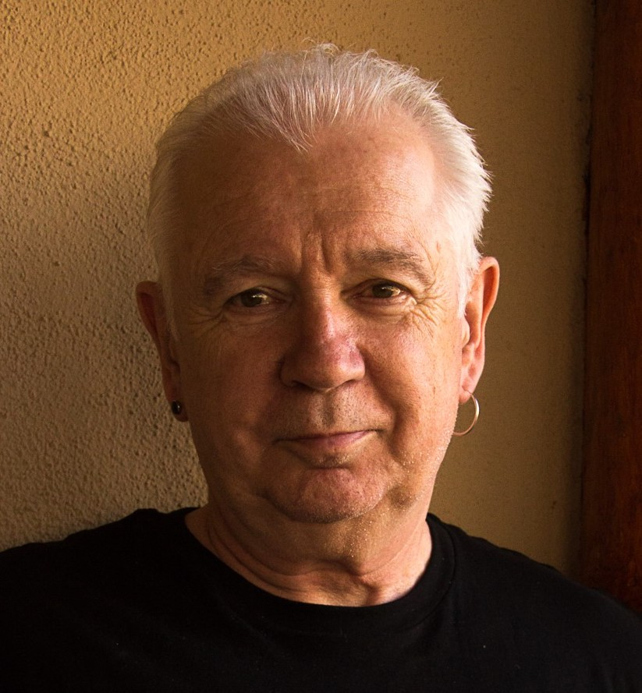

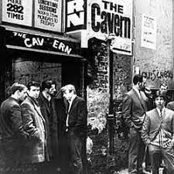
I am from…*
the sound of seagulls crying over the north sea and merseybeat blasting at the Cavern club,
the smell of fish & chips, factory waste and coal burning fires,
the taste of grease, sour milk tea and dust at the back of my throat
the idea of community pride & the triumph of humor over pretentiousness
Born in Bootle, Liverpool, 1949
Moved to the south of England as a teenager (mum hated Liverpool) - cultural genocide to rid me of my Scouse accent
All education in UK, after graduation worked in community colleges & adult education
Lost my lecturer/organizer job in 1980 & fled (temporarily) to New York – a Thatcher political refugee
Met my partner there & moved to her home state (Minnesota) in 1992, raising 2 kids there
Now the part-time “Distinguished Scholar” at Antioch University
Leader of The 99ers – pop punk band w/ 6 albums on Spinout Records (listen to us on Spotify, I Tunes, etc.)
* Adapted from the poem Where I’m From by George Ella Lyon

Slide 4
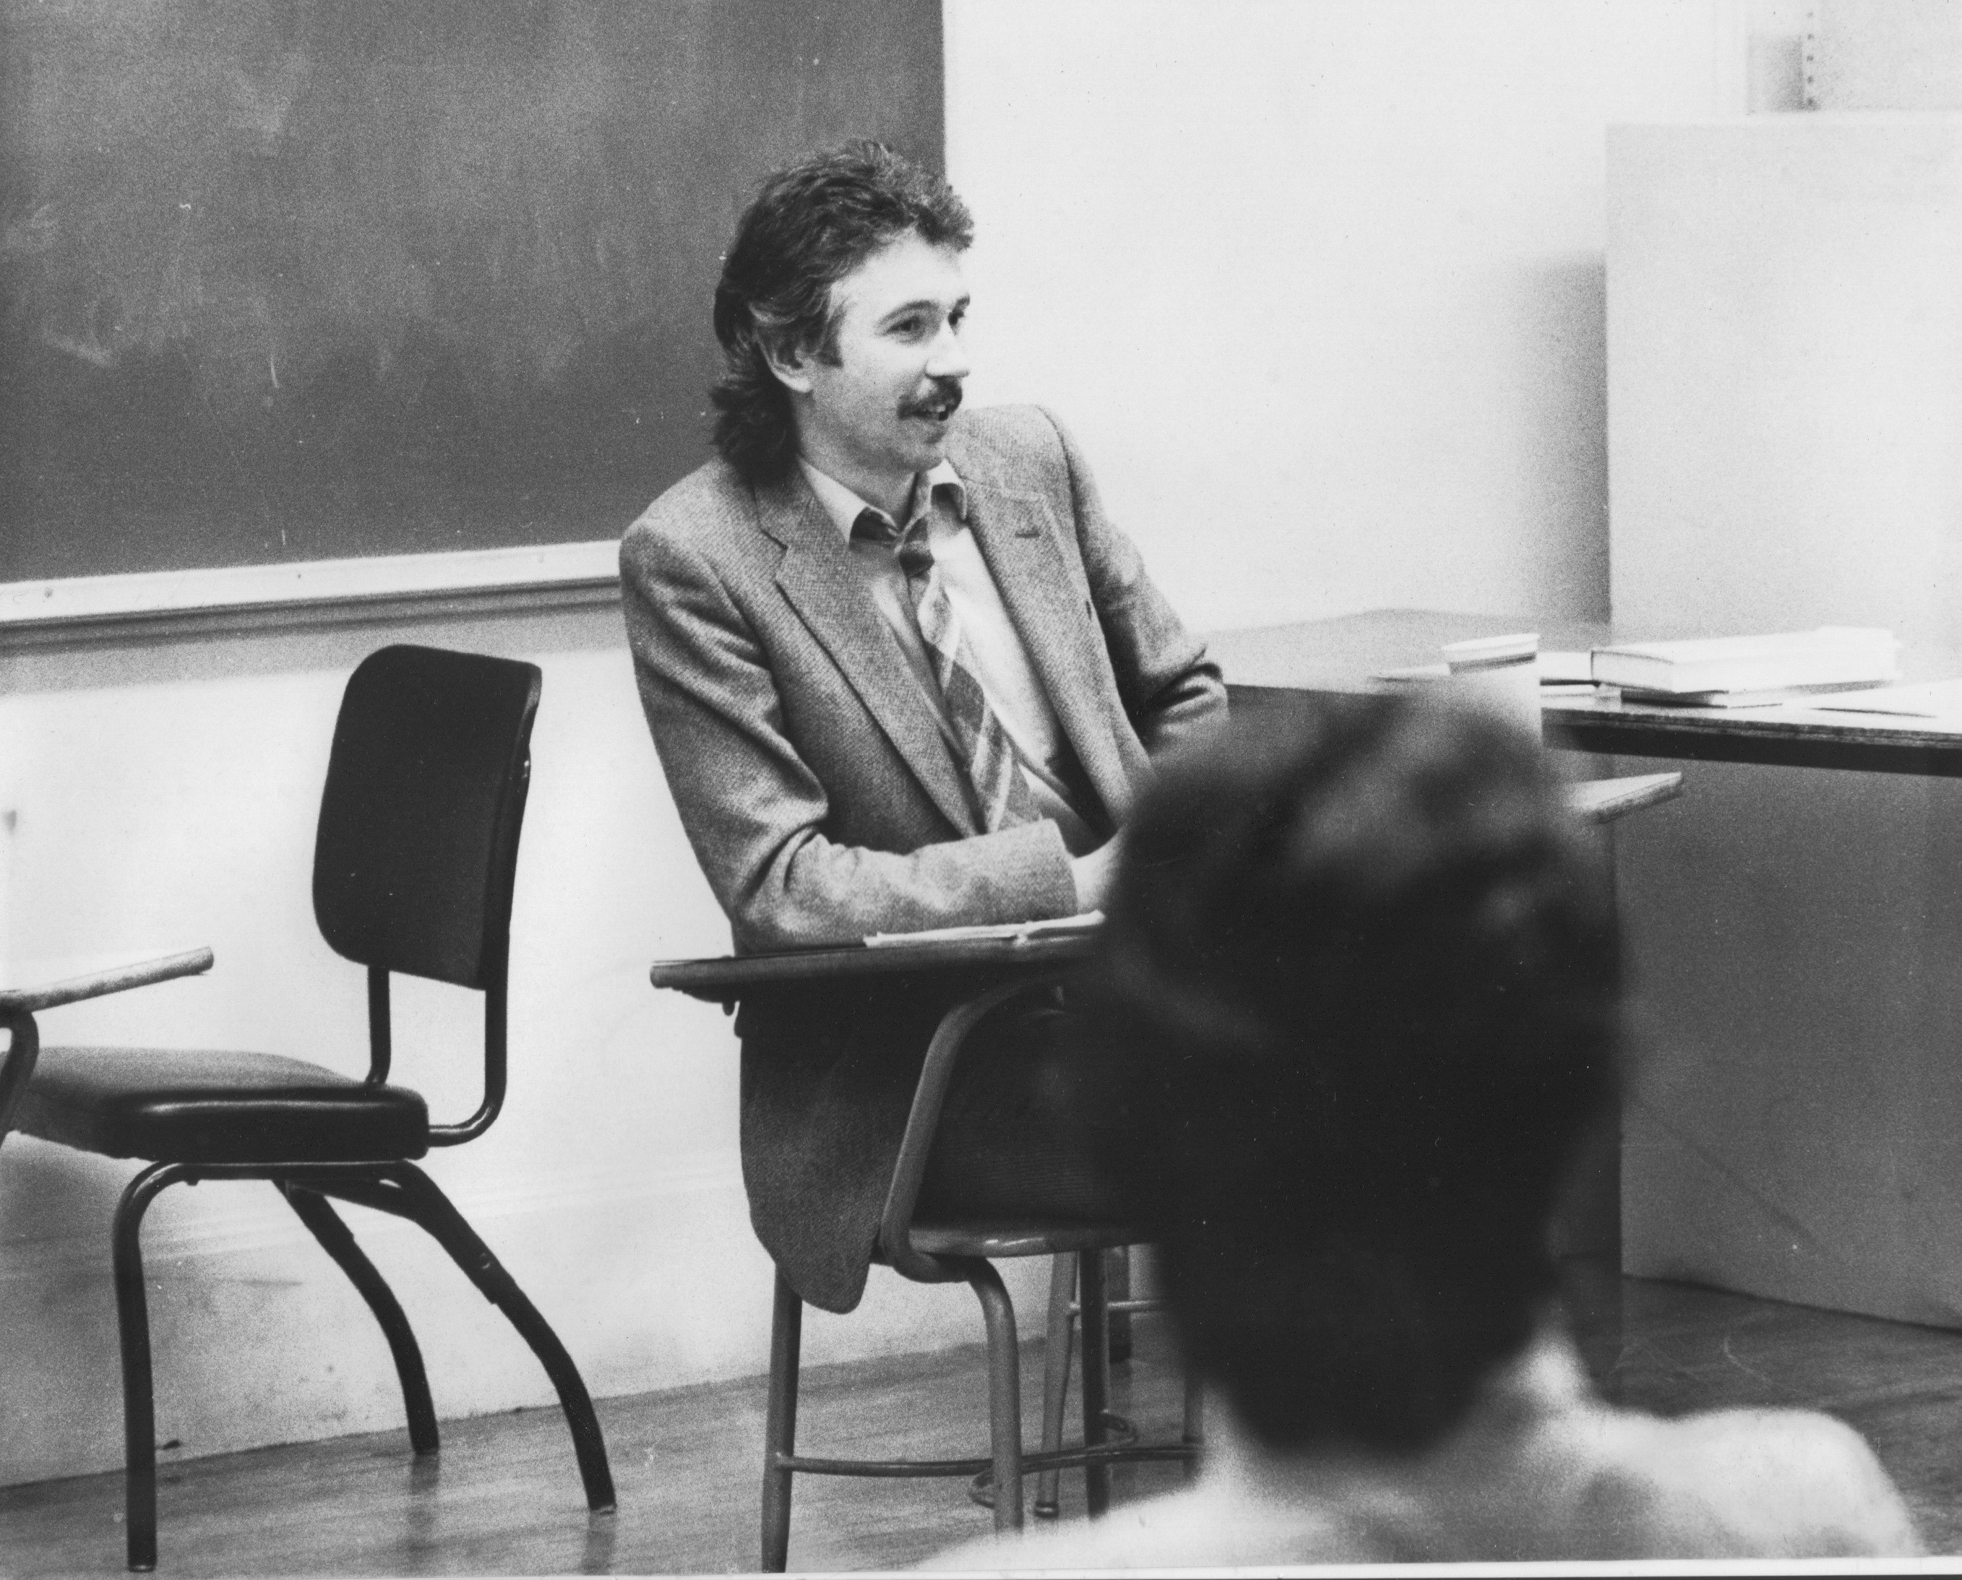
Situating Myself as a Teacher
History of academic mediocrity –failed high school leaving exams, university places cancelled, College of Technology, graduated in bottom half of my class, turned down for graduate study, failed my master’s degree exam – Broadening student-centered assessment measures
Watching my doctoral supervisor – giving me ‘bad’ inconvenient news in a way that I knew was in my own best interests
Ethical use of teacher power
Relational underpinnings to critical thinking
Balancing credibility & authenticity

Slide 5

Equity
A partially functioning ideal - something we never achieve exactly but we strive for
Something students attend to & take seriously – “that’s not fair” = unequal access to resources or unequal treatment based on arbitrary variable
Often conceptualized & practiced as an equal opportunity for all to participate in learning &/or decision-making
Often conflated with inclusion and balance – all perspectives are considered, striving for representation of students, teachers, authors, content
Equal time & weight given to arguments
Entails redressing an imbalance

Slide 6
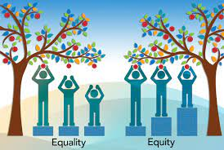
Some Equity Emphases
An equal opportunity for all students to gain access to higher education
Provision of supports for those previously marginalized once they arrive on campus – cluster hires, BIPOC-only support spaces
The fight against dominant ideologies such as white supremacy, patriarchy, ableism and transphobia
The deliberate attempt to include scholarship, paradigms & practices from previously excluded groups
The inclusion of multiple perspectives, bodies of knowledge, ways of knowing, modes of communication and forms of assessment – orality, aesthetics, visual, musical
An attempt to incorporate & examine questions of establishing truth & legitimate knowledge, “regimes of truth*”
*Foucault, M. 1980. Power/knowledge: Selected interviews and other writings, 1972-1977. New York: Pantheon Press.

Slide 7
Diversity, Equity & Inclusion
Acknowledges the importance of a full representation of ideas & perspectives
Attention to a diversity of practices, scholarship and identities
Striving to ensure that Black, Indigenous & People of Color are well represented on campus as students, staff, faculty & administration
Curricula represents multiple paradigms – Afrocentric, Indigenous, Latinx, Asian diaspora
Multiple modes of pedagogy, communication, assessment & evaluation – visual, oral, narrative, musical, dramatic
Dancing your Physics Ph.D. https://www.youtube.com/watch?v=UlDWRZ7IYqw
Anti-Racism
Assumes that structural inequity is in place across institutions, policies & practices
Assumes that white supremacy pervades organizations & community – the ideology that because of their supposedly superior intelligence & capacity to use reason & logic that whites should “naturally” be in positions of power & authority (correlated particularly with anti-blackness that criminalizes black & brown bodies as volatile, inherently uncontrollable & prone to/on the verge of violence)
Focused on dismantling ideology & practice of white supremacy - changing systems & structures to ensure full participation of BIPOC
Institutional expectation of antiracist work as part of what it means to be an academic, staff member, administrator, institutional leader
Deliberately prioritizes issues of race in construction, dissemination & application of knowledge

Slide 8
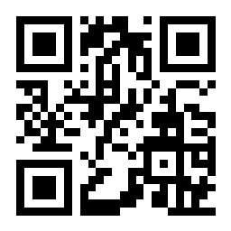
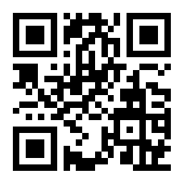
Go to sli.do
Enter code: 251402
(Or use the QR code opposite on your smart phone)
You have 90 seconds to respond to this question. Your response is anonymous
When you enact, experience or observe equity-based teaching, what does it look, sound, or feel like?

Slide 9
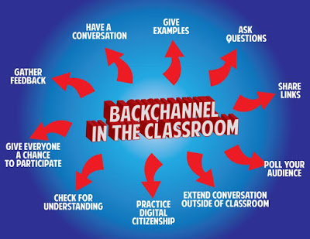
sli.do backchannelchat.com tweedback.de
Pose a question at start of class to assess what knowledge, experience & preconceptions students bring
Pose quick questions during class to check for understanding, identify misconceptions
Invite students to raise questions or seek clarification anonymously via a backchannel
Interrupts the normal privileging of speech, extroverts, dominant language speakers – no one can dominate
Anonymity means students aren’t afraid to ask ‘dumb’ questions
As with all activities, open to sabotage

Slide 10
As questions & issues occur to you during this session you can raise them 3 ways…
Zoom Chat – where your identity is revealed sli.do – where your post will be anonymous
Go to sli.do and enter code: 537243
(Or use the QR code opposite on your smart phone)
I will also invite people to give reactions & pose questions verbally

Slide 11

Asymmetries of Power
Teachers – asymmetries of knowledge, understanding, skill, command & performance: we know more, have studied longer, have a command of research protocols, used to academic discourse
Students – bring asymmetries in terms of readiness for learning, previous experience, & previous access to resources. Also, whatever judgments & stereotypes attach to their identities outside the classroom are immediately reproduced inside – often supported by teachers’ learned preconceptions
Knowledge/Content – some knowledge, theories, explanations, hypotheses, laws, analytical frameworks, are viewed as more legitimate owing to methodology of empirical confirmation, their withstanding falsifiability, their heuristic ‘fit’ with the world etc.

Slide 12
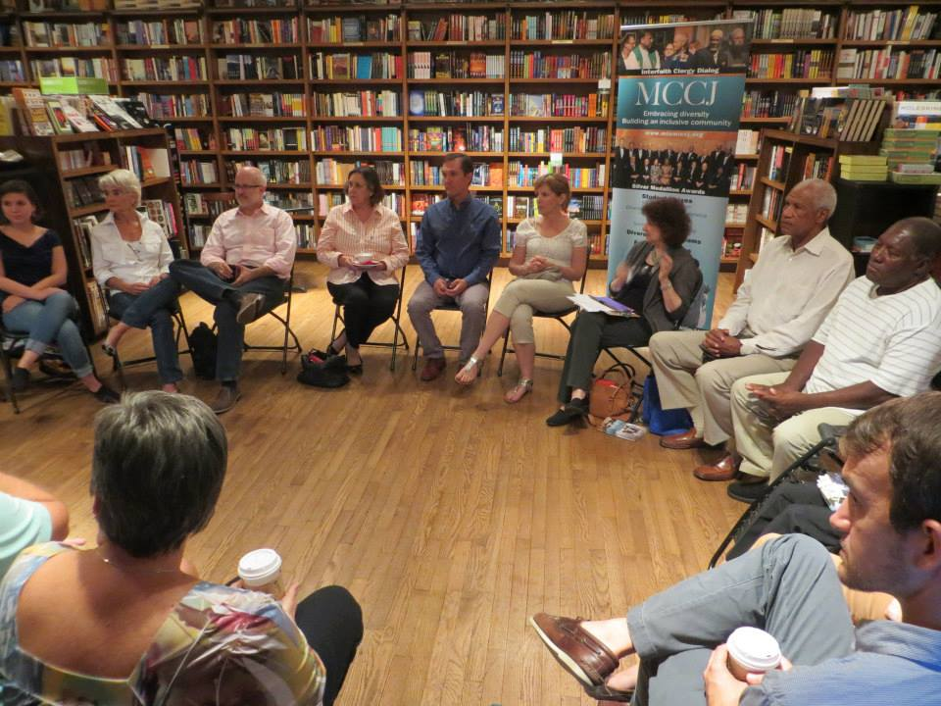
Equity?

Slide 13

Assumption
If I arrange chairs in a circle….
Students will feel their experience is respected & acknowledged when they walk in.
This will create a relaxed and congenial environment for learning
The distance between me as the teacher & them as the students will be reduced
Students will be more likely to participate, contribute & ask questions
Students will support peer learning

Slide 14


Students’ Perceptions
The circle is an arena of surveillance – everything I do will be seen, my mistakes will be noticed by everyone (peers & instructor)
The circle is alienating – if anything about me marks me out as different (how I look or sound) my discomfort is increased
The circle is coercion – you are forcing me to speak before you’ve earned the right to do that
The circle increases mistrust – I can’t sit back & judge your competence or authenticity. Please just let me mull things over on my own. When I feel ready, I’ll move into the circle space

Slide 15
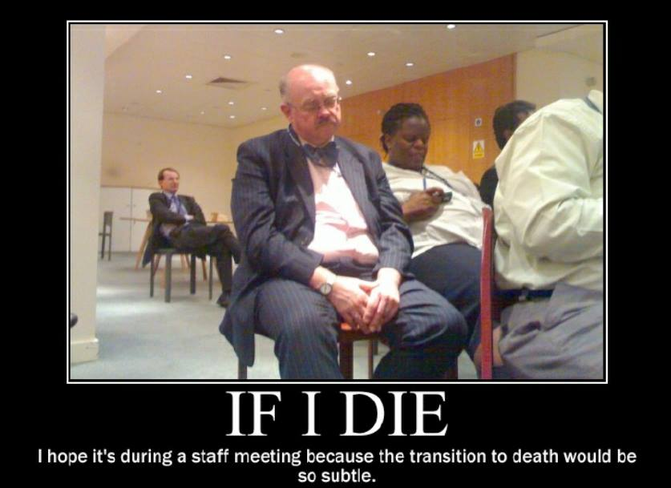
My personal experience as a student & conference goer is totally at odds with my practice as a teacher
I walk into my graduate class & see the chairs in a circle. My reaction – “Oh no! Not the circle again! Now I’m going to have to “share” in a vacuum with strangers.
Why can’t you let me sit in Siberia & just process & mull over what’s happening. When I’m ready I’ll move my chair into the circle & participate
At a faculty development training or academic conference the facilitator puts us in a circle & asks us to talk about what’s on our minds. My reaction – “Why should I do your work for you? You start by telling is on what’s on your mind – then maybe we can talk”
After returning from evening graduate classes & conferences I get to my classroom early the next day to put the chairs in a circle

Slide 16


Now….
I still use the circle but explain…
It’s to keep sight lines clear – so students who wish to contribute or ask a question can do that easily
It’s also so students don’t have to talk to the back of other people’s heads
I won’t assume that those who are quiet are less diligent or intelligent
I won’t assume those who speak are more diligent or intelligent
I must self-disclose some ideas & thoughts before expecting students to do the same

Slide 17
Classroom Equity Discussion Protocol
Here we will try a beginning protocol that is adaptable across both online & face-to-face contexts – the Circle of Voices
Please follow the protocol. We will work in groups of 5.
The question….
What are the most effective approaches, activities &/or exercises that you have enacted yourself, or seen colleagues implement, to incorporate racial analysis & questions of racial identity into the curriculum & classroom?
We begin with a mandatory 1-2 minute silent period for people to think about their response to the question & make written or mental notes. Please do that now.
After your two minutes thought are up, please take a screen, bathroom, fluids & movement break of 5 minutes.

Slide 18
Circle of Voices – an equity protocol to give time to think, ensure all have the chance to express their ideas in a way they wish to express them, prevent dominant voices determining the course of dialogue, & emphasize the importance of hearing & responding authentically
(1) Each person should read their “I am from…” prompts as a way of introducing themselves (as well as giving your institutional & departmental location in the UW system)
(2) After introductions, go alphabetically (using 1st names) around the group & have each person give their response to the question you’ve just thought about. Each person should keep their opening comments to no more than two minutes. No interruptions please as each person speaks.
(3) Once everyone has spoken then move into open conversation – anyone can speak at any time & there is no order of contribution. However, you should strive to speak ONLY about what SOMEONE ELSE said in the opening round of comments.
(Ask questions, point out similarities & differences, talk about new ideas you were exposed to, give examples to illustrate what someone said, state the basis of your disagreement with a comment, talk about how a comment led to a new understanding, reference a question or issue someone’s comment raised for you, give appreciation for a particular contribution.)
S. Brookfield & S. Preskill. 2016. The discussion book: 50 great ways to get people talking. Hoboken, NJ: Wiley

Slide 19
Please post questions and issues that arose in your circle of voices conversation to Zoom chat (for questions revealing your identity) or to sli.do (for questions where you wish to remain anonymous)
These can be about the circle of voices protocol itself or about the themes and items that generated conversation
For sli.doenter code: 537243
(Or use the QR code opposite on your smart phone)

Slide 20
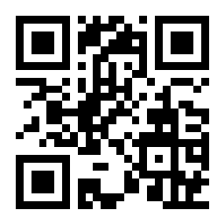
Critical Incident Questionnaire (CIQ)
An anonymous way to collect data from ALL
Go to: sli.do
Enter Code: 777366
Or use the QR code opposite
At what moments were you most engaged or distanced as a learner this morning?
What actions that anyone took in the workshop were most helpful or puzzling?
What surprised you most about this morning?

Slide 21
End of Session
Tomorrow morning we will look specifically at racial equity and what that might look like in our teaching – particularly in an institution where faculty and institutional leadership are predominantly White

Slide 22
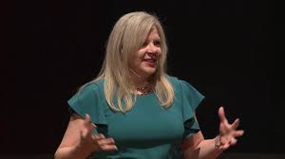
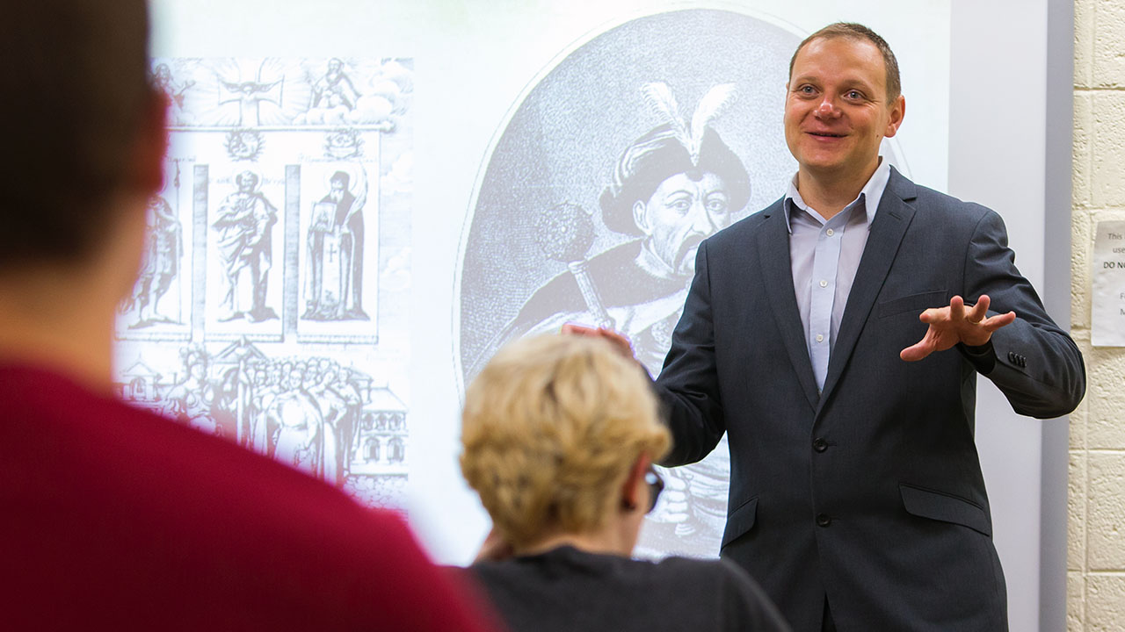
Reflections: Wisconsin Teaching Fellows & Scholars 2021-2022
Andrey V. Ivanov, Associate Professor, History, UW-Platteville
Jessica Van Slooten, Associate Professor, English, and Co-Chair, Women & Gender Studies, UW-Green Bay

Slide 23
May 27th UW Faculty College – Racial Equity
Today we will look specifically at racial equity and what that might look like in our teaching – particularly in an institution where faculty and institutional leadership are predominantly White
But the first order of business is to report out the results of yesterday’s Critical Incident Questionnaire (CIQ)
I do a frequency analysis of themes that are mentioned, making sure to include themes mentioned by at least 10% of participants
I also include individual comments that are provocative & interesting
I talk about assumptions that were confirmed & challenged by the CIQ
I talk about how the CIQ results impact planning for today

Slide 24

Purpose of this Equity Protocol – Lenses on the Different Worlds in the Same Classroom
Equalizes the chance to comment on how people experience the workshop, training or class
Alerts you to problems that are developing so you can address them early
Helps you readjust & calibrate what I need to do in today’s session
Shows the community the diversity of ways people are experiencing the event – sign we are entering adulthood is when we cease to universalize our own experiences*
Builds a case for why you constantly switch learning & teaching modalities
Encourages honest critique of your actions & how to model non-defensive responsiveness
* Habermas, J. 1990. Moral Consciousness and Communicative Action. Cambridge, MA: MIT Press

Slide 25
Q & A
Please post questions and issues you wish to pose to Zoom Chat (for questions where your identity is revealed) or sli.do (where your questions will be anonymous)
To use sli.do log in & enter code: 537423
(Or use the QR code opposite on your smart phone)

Slide 26
Racial Equity
Striving for strong representation of Black, Indigenous & People of Color (BIPOC) in faculty, students, staff & administration
Acknowledging the racial identity of founders of discipline, gatekeepers, journal editors, handbook & encyclopedia editors
Highlighting work of scholars, colleagues & students of color
Examining the different racial impacts of applications of knowledge produced in the discipline
Creating BIPOC spaces for students, administration, staff & faculty to share experiences, survive, support
Acknowledging the way racial identity – particularly Whiteness – carries embedded advantage
Addressing racial issues as an expected & natural part of what it means to think like a scientist
Building evidence of antiracist commitment into hiring, promotion & tenure decisions
Readjusting workload & compensation to accommodate antiracist work
Public modeling of racial learning by institutional leaders

Slide 27

Two Kinds of Preparation for Teaching that Incorporates Race
Technical (Content) – reading, viewing, thinking, reflecting on nature of racism, white identity, white supremacy, anti-blackness etc.
Technical (Process) – how to model disclosure, choose good narratives, build trust, scaffold learning from simple to complex, use protocols
Emotional (EQ) – this is inherently emotional work in which people are laying bare their identities, experiences, convictions and feelings. It will sometimes be raw & contentious and people will become distressed, angry, and uncomfortable
Emotional (Mistakes) – this is inherently unpredictable work & you’ll constantly feel like you’ve screwed up, made mistakes, said or done the wrong thing, and mishandled situations
Two ways do do anti-racist work – IMPERFECTLY or NOT AT ALL!

Slide 28
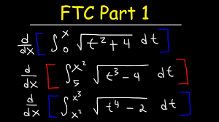
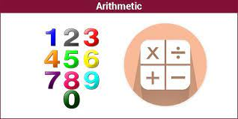
An arithmetic level of understanding of the dynamics of pervasive, structural racism amongst many whites who have not thought much about racial identity & whiteness
THIS IS A REASON FOR
AFFINITY GROUPS
A calculus level of understanding amongst black, indigenous and people of color (BIPOC) who have negotiated the dynamics of structural racism & white supremacy all their lives
TIRED OF WITNESSING ‘WOKENESS’

Slide 29
The Danger of Witnessing Woke-ness
“I honestly have been having a hard time being in predominately white classes lately as people in this country realize, again, the issues that exist in America for Black people.
While she was giving her long spiel on her good work, I couldn't figure out where to place my feelings. I could see it from a mile away; I even prepped myself for it before the class.
I prepared for THIS, but I still wasn’t ready. Her actions were soooo predictable, well, to me. It was something I knew was bound to happen in a class placed right in the heart of the world grappling with whether or not Black lives matter. But still I felt completely uncomfortable, sick.
Now, I am not one to dim anyone's light, but all I felt like saying was, "oh, okay. That's cute. You want a cookie?"
I couldn't help but think, "this is not something new, why is it new to you? Why are you just now having these conversations?"
I do not know this woman and may never have a class with her again; however, I will always remember what she did and how it made me feel.”
Carmina Maye 2020 I Really Wanted this to Be a Poem. (Dept. of Art & Art Education, Teachers College)

Slide 30
Q & A
Please post questions and issues you wish to pose to Zoom Chat (for questions where your identity is revealed) or sli.do (where your questions will be anonymous)
sli.do code: 537423
(Or use the QR code opposite on your smart phone)

Slide 31
A Note to White Faculty
“Good Whites” like me (Stephen)
Believe that we don’t see race
Believe everyone is a human being & we should treat everyone the same (colorblind ideology)
Believe we focus on actions & individual character, not racial identity
Choose when to engage in race and anti-racism
Can monitor our own racism
Believe we have a pure, anti-racist soul
Believe we are free of white supremacist conditioning
View racism as something committed by less enlightened whites
Regard ourselves as allies of people of color
Shannon Sullivan 2014. Good white people Albany: SUNY Press

Slide 32
Behaviors of “Good Whites”
When confronted with examples of their learned racism, good whites will vigorously deny any racist intent, claim they have been misunderstood, are acting innocently, & are being unfairly accused
Will become defensive & immediately seek to explain to people of color the “real” meaning of their behavior
Will resist “sitting with” the reality that they have learned racism & white supremacy throughout their lives & carry those viruses
Will accuse people of color of imagining things, seeing racism where it doesn’t exist, & denying the validity of whites’ experience
Will come to each other’s defense in multi-racial discussions
I know this because these are all of my learned behaviors
(Robin DiAngelo. 2018. White fragility. Boston: Beacon Shannon Sullivan 2014 Good white people SUNY)

Slide 33

Hard Truths I’ve Learned as a White Instructor
I MUST call out racist behavior (including in myself) as soon as I see it. If I don’t I will have no credibility in the eyes of students and colleagues of color.
I MUST assume that for students and colleagues of color EVERYTHING is seen through the lens of race. For them, NOTHING is “race free”.
I MUST acknowledge my own racist behavior when it’s pointed out to me – not try to ‘explain’ it away, not protest my innocence: I must regard it as truth.
I MUST NEVER try to talk people of color “out of” their testimony of racism.
I MUST NEVER invoke “being respectful” or “seeing all sides of this” as a way to avoid painful truths about my own socialization & learning of racism.
I MUST NEVER claim to be an “ally” or anti-racist “friend”.
I MUST NEVER ask people of color to teach me about racism or to tell me what I should do – figuring out what whites should do is OUR responsibility.

Slide 34
MODELING
We take the lead in modeling disclosure about how our racial identity frames our life, how we struggle to understand & negotiate racism, how we make sense of what’s happening in the wider world
BRAVE SPACES
It’s our responsibility to prepare students & colleagues for the ‘brave spaces’ they will enter as race is discussed…
The normality of strong emotions & feelings – anger, frustration, sadness, fatigue, desperation, confusion
The normality of silence as a necessary dynamic of making sense of starkly different realities
The discomfort that lies ahead & that is predictable & ‘normal’
The lack of closure

Slide 35
How to Prepare for Teaching with Race in Mind
Lose Your Desire/Expectation to Be Perfect
Send Round Introductory Reading/Viewing*
Take the Emotional Temperature –sli.do, Mood Meter
Begin By Modeling Self-Disclosure
Introduce the Concept of Brave Space
Use Conversational Protocols to Engage Everyone
(Circle of Voices, Circular Response, Bohmian)
Check In Regularly via Anonymous Channels
(sli.do, backchannelchat.com)
* Letter to White America (George Yancy) https://opinionator.blogs.nytimes.com/2015/12/24/dear-white-america/
* What it Means to be American (Color of Fear) https://www.youtube.com/watch?time_continue=3&v=2nmhAJYxFT4&feature=emb_logo
* Conversations on Race (New York Times) https://www.nytimes.com/interactive/projects/your-stories/conversations-on-race
* How Can We Win (Kimberly Latrice Jones) https://www.youtube.com/watch?v=ZkedkvNn5V0

Slide 36
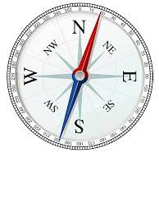

So where do we go from here?
Understand that calling out racism is the responsibility of whites – don’t wait for BIPOC to be the first to raise these issues
Don’t wait for people of color to say they’re uncomfortable with something – if you have any unease, name it
Work on naming racism as LEARNED behavior – not as an individual soul flaw or inherent lack of humanity, empathy, compassion
Strive to model anti-racist awareness in your own contributions
Understand white privilege/power as an unconscious phenomenon – as not having to worry about how your race makes things difficult for you & anticipate how to negotiate barriers & survive emotionally

Slide 37
Don’t expect gratitude or thanks – you’re just doing the right thing
Don’t preach at, or disdain, those you regard as “less enlightened”
Don’t set up people to “confess” & then grant absolution
Don’t stay silent in multiracial discussions
Do assume you’ll say the “wrong” thing & leave feeling you messed up
For White faculty strive to act as allies – but watch out for making a big deal out of publicly declaring yourself an ally to BIPOC

Slide 38
Q & A
Please post questions and issues you wish to pose to Zoom Chat (for questions where your identity is revealed) OR sli.do (where your questions will be anonymous) sli.do code: 537423
(Or use the QR code opposite on your smart phone)

Slide 39
Another Classroom Discussion Equity Protocol
Here we will try a different protocol that is slightly more complex. It is also adaptable across both online & face-to-face contexts – Circular Response
Please follow the protocol. We will work in groups of 5.
The question (a sort of two-parter!)….
What dynamics around dealing with racial identity or racism do you find the most difficult to negotiate as an educator? What fears, uncertainties & doubts do you carry into this work?
We begin with a mandatory 1-2 minute silent period for people to think about their response to the question & make written or mental notes. Please take that time now.
After your two minutes thought are up, please take a screen, bathroom, fluids & movement break of 5 minutes.

Slide 40
Circular Response
Each person reads their “I am from…” prompts as a way of introducing themselves (as well as giving your institutional & departmental location in the UW system).
After introductions, take a pause to regroup & focus on the question you just thought about. There’ll be some silence until someone is ready to give an opening response. The opening contributor speaks for no more than 2 minutes with no interruptions please.
The next to speak is the person whose last name follows on alphabetically from the 1st speaker. She or he takes time to think about the 1st speaker’s comment & then spends up to 2 minutes trying to build on it in some way. This can be an agreement or disagreement, extending the comment with an example, raising a question, explaining why it’s difficult to respond, applying the comment to a different context – no interruptions!
Person whose last name follows alphabetically from the 2nd speaker goes next. Again, she or he takes time to think about the opening comment & then spends up to 2 minutes trying to build on it in some way – no interruptions!
Process continues (with the order of contribution determined alphabetically by last names) until everyone has spoken with each person striving for up to 2 minutes to build on & respond to the previous speaker’s comment (with no interruptions)
Group then moves into open conversation with no ground rules – anyone can say anything in any order.
Gives everyone a chance to contribute
Builds the habit of careful & attentive listening and responding
Tends to focus the conversation & analysis more deeply around one or two issues
The second open conversational phase allows people to raise issues & questions not covered in the first part
S. Brookfield & S. Preskill. 2016. The discussion book: 50 great ways to get people talking. Hoboken, NJ: Wiley

Slide 41
Please post questions and issues that arose in your circular response conversation to Zoom Chat (for questions where your identity is revealed) or sli.do (where your questions will be anonymous)
These can be about the circular response protocol itself or about the themes and items that generated conversation
To use sli.do log in& enter code: 537423
(Or use the QR code opposite on your smart phone)

Slide 42
Some Resources from Stephen
Becoming a white antiracist: A practical guide for educators, leaders & activists. 2021. Sterling, VA: Stylus (w/Mary Hess)
Gospel Beautiful Podcast: https://www.buzzsprout.com/680528/8460030-stephen-brookfield-and-mary-hess-becoming-a-white-antiracist
Teaching race: Helping students unmask and challenge racism. Hoboken, NJ: Wiley Publishing
Becoming a critically reflective teacher. 2017 (2nd. Ed.). Hoboken, NJ: Wiley Publishing
Handbook of race and adult education. 2010. Hoboken, NJ: Wiley Publishing w/ Vanessa Sheared, Juanita Johnson-Bailey, Scipio Colin Jr III, & Elizabeth Peterson.
The discussion book: 50 great ways to get people talking. 2016. Hoboken, NJ: Wiley Publishing (w/Stephen Preskill)
www.stephenbrookfield.com
(Go to “Resources”, “Creating an Anti-Racist White Identity” and “Recent Writings” links)

Slide 43
General Resources
Ijeama Oluo – So You Want to Talk About Race (2019) https://www.youtube.com/watch?v=TnybJZRWipg
George Yancy - Look! A White (2012), What White Looks Like (2004), White Self-Criticality beyond Anti-Racism (2016) https://www.youtube.com/watch?v=fyZNAAr8czE
N.M. Joseph, C. Haynes and F. Cobb (Eds.). 2016. Interrogating Whiteness and Relinquishing Power: White Faculty’s Commitment to Racial Consciousness in STEM Classrooms. New York: Peter Lang,
Derald Wing Sue – Race Talk & the Conspiracy of Silence (2016) https://www.youtube.com/watch?v=Nrw6Bf5weTM&t=53s
Shannon Sullivan – Good White People (2014) https://www.youtube.com/watch?v=UZo06BjmbbE
Robin DiAngelo – White Fragility (2018) https://www.youtube.com/watch?v=45ey4jgoxeU
Ibram X. Kendi – How to Be an Anti-Racist (2019) https://www.youtube.com/watch?v=TzuOlyyQlug
Glenn Singleton – Courageous Conversations About Race (2014) https://www.youtube.com/watch?v=IwaOBXzJ3hs
Tim Wise – White Like Me (2011) https://www.youtube.com/watch?v=N4fbr1LlxEk

