Slide 1
What Does it Mean to Teach Equitably? University of the Sciences, Philadelphia, May 18th, 2021
Stephen Brookfield
Distinguished Scholar, Antioch University
http://www.stephenbrookfield.com/

Slide 2
HOME PAGE - www.stephenbrookfield.com
My home page is open access so if you want to find out more about any of the exercises or activities I mention go to the page and click on the ‘Resources’ link.
Scroll down & you will find multiple PDF files of workshop packets stuffed with activities or power point files.
You do not need to ask my permission to use any of these resources. If they’re useful then please try them out and adapt them to your context.
To follow along today or retrieve these slides later click on the ‘Resources’ link at the top right of page. This presentation is the 1st power point listed.
www.stephenbrookfield.com

Slide 3
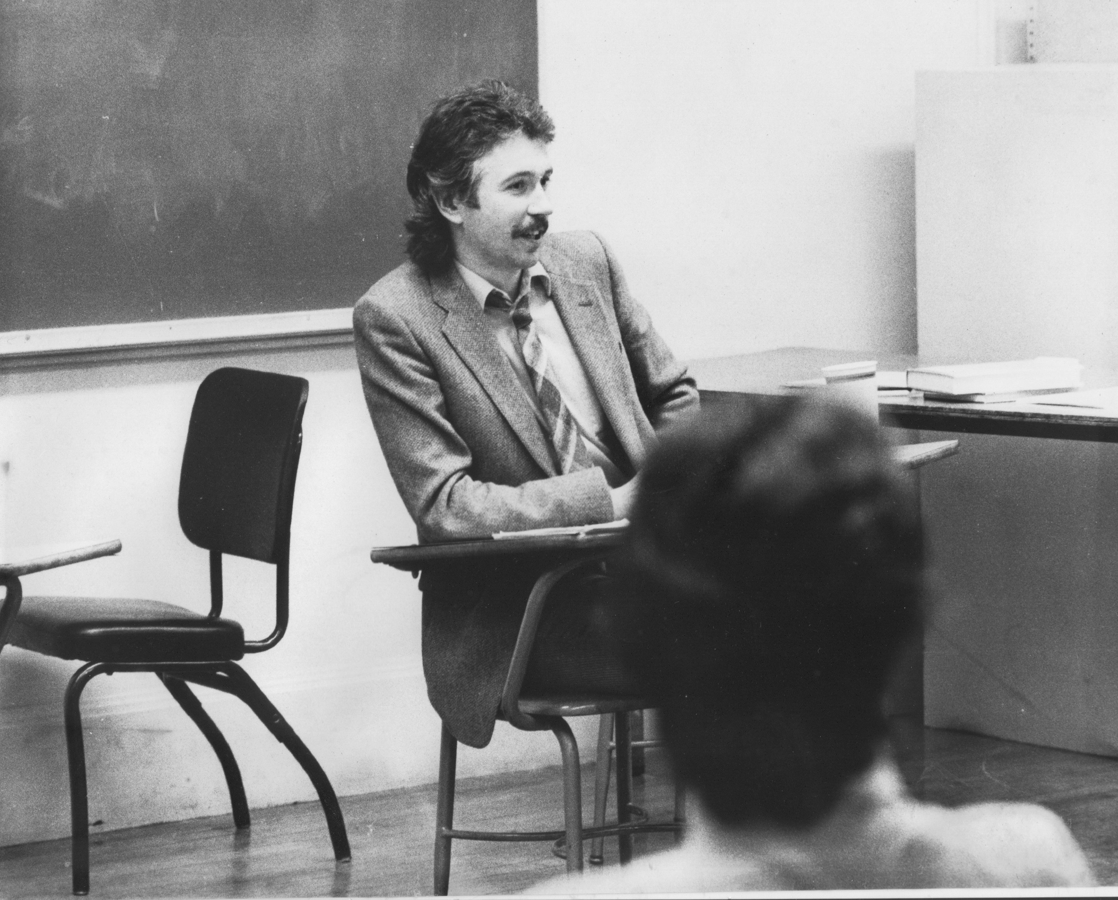
Situating Myself as a Teacher… History of academic mediocrity –failed high school leaving exams, university places cancelled, College of Technology, graduated in bottom half of my class, turned down for graduate study, failed my master’s degree exam – Broadening student-centered assessment measures Watching my doctoral supervisor – giving me ‘bad’ inconvenient news in a way that I knew was in my own best interests Ethical use of teacher power Relational underpinnings to critical thinking Balancing Credibility & Authenticity

Slide 4
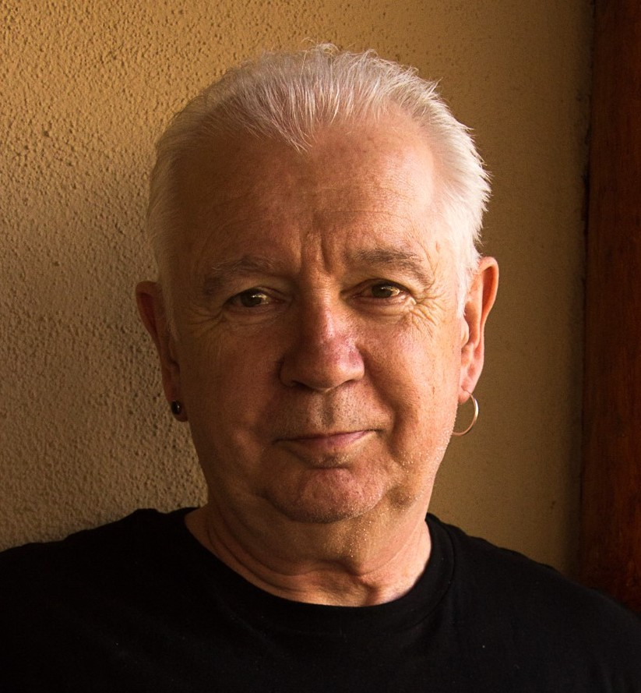
I am from…*
the sound of seagulls crying over the north sea and merseybeat blasting at the Cavern club,
the smell of fish & chips, factory waste and coal burning fires,
the taste of grease, sour milk tea and dust at the back of my throat
the idea of community pride & the triumph of humor over pretentiousness
Born in Bootle, Liverpool, 1949
Moved to the south of England as a teenager (mum hated Liverpool) - cultural genocide to rid me of my Scouse accent
All education in UK, after graduation worked in community colleges & adult education
Lost my lecturer/organizer job in 1980 & fled (temporarily) to New York – a Thatcher political refugee
Met my partner there & moved to her home state (Minnesota) in 1992, raising 2 kids there
Now the part-time “Distinguished Scholar” at Antioch University
Leader of The 99ers – pop punk band w/ 6 albums on Spinout Records (listen to us on Spotify, I Tunes, etc.)
* Adapted from the poem Where I’m From by George Ella Lyon

Slide 5
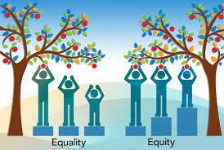
Equity
A partially functioning ideal - something we never achieve exactly but we strive for
Something students attend to & take seriously – “that’s not fair” = unequal access to resources or unequal treatment based on arbitrary variable
Often conceptualized & practiced as an equal opportunity for all to participate in learning &/or decision-making
Often conflated with inclusion and balance – all perspectives are considered, striving for representation of students, teachers, authors, content
Equal time & weight given to arguments
Entails redressing an imbalance

Slide 6
Diversity, Equity & Inclusion Acknowledges the importance of a full representation of ideas & perspectives Attention to a diversity of practices, scholarship and identities Striving to ensure that Black, Indigenous & People of Color are well represented on campus as students, staff, faculty & administration Asian & Asian American students as the model minority: https://www.nytimes.com/2016/04/05/opinion/a-conversation-with-asians-on-race.html Asian & Asian American students as an invisible identity – viewed as “practically white”, “docile”, “not a problem”, “not subject to racism”
Anti-Racism
Assumes that structural inequity is in place across institutions, policies & practices
Assumes that white supremacy pervades organizations & community – the ideology that because of their supposedly superior intelligence & capacity to use reason & logic that whites should “naturally” be in positions of power & authority (correlated particularly with anti-blackness that criminalizes black & brown bodies as volatile, inherently uncontrollable & prone to/on the verge of violence)
Focused on dismantling ideology & practice of white supremacy - changing systems & structures to ensure full participation of BIPOC
Institutional expectation of antiracist work as what it means to be an academic

Slide 7
Go to sli.do Enter code: 779413 (Or use the QR code opposite on your smart phone) You have 90 seconds to respond to this question. Your response is anonymous When you enact, experience or observe equity-based teaching, what does it look, sound, or feel like?

Slide 8
Anonymous Social Media Backchannels sli.do backchannelchat.com tweedback.de todaysmeet.com (now defunct)
Pose a question at start of class to assess what knowledge, experience & preconceptions students bring
Pose quick questions during class to check for understanding, identify misconceptions
Invite students to raise questions or seek clarification anonymously via a backchannel
Interrupts the normal privileging of speech, extroverts, dominant language speakers – no one can dominate
Anonymity means students aren’t afraid to ask ‘dumb’ questions
As with all activities, open to sabotage

Slide 9
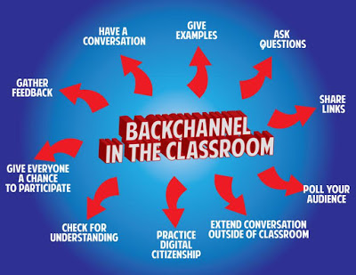
Please go to sli.do Enter code: 779413 (Or use the QR code opposite on your smart phone) Post any questions you’d like me to address to the sli.do link

Slide 10
Asymmetries of Power
Teachers – asymmetries of knowledge, understanding, skill, command & performance: we know more, have studied longer, have a command of research protocols, used to academic discourse
Students – bring asymmetries in terms of readiness for learning, previous experience, & previous access to resources. Also, whatever judgments & stereotypes attach to their identities outside the classroom are immediately reproduced inside – often supported by teachers’ learned preconceptions
Knowledge/Content – some knowledge, theories, explanations, hypotheses, laws, analytical frameworks, are viewed as more legitimate owing to methodology of empirical confirmation, their withstanding falsifiability, their heuristic ‘fit’ with the world etc.

Slide 11
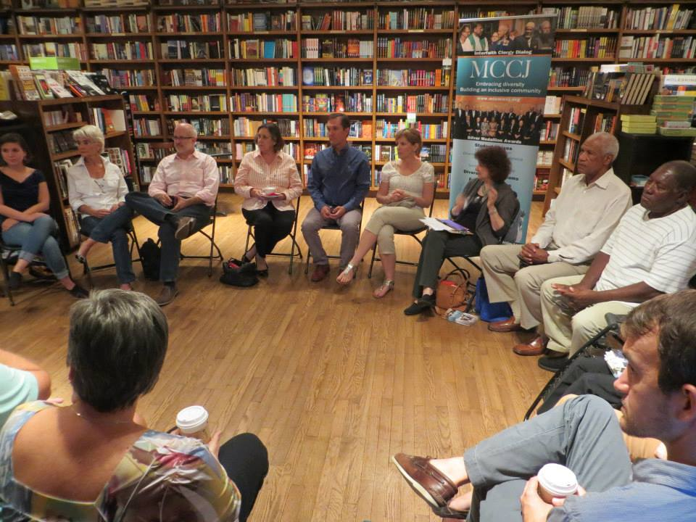
A complicating example

Slide 12
Assumption If I arrange chairs in a circle….
Students will feel their experience is respected & acknowledged when they walk in.
This will create a relaxed and congenial environment for learning
The distance between me as the teacher & them as the students will be reduced
Students will be more likely to participate, contribute & ask questions
Students will support peers learning

Slide 13
Students’ Perceptions
The circle is an arena of surveillance – everything I do will be seen, my mistakes will be noticed by everyone (peers & instructor)
The circle is alienating – if anything about me marks me out as different (how I look or sound) my discomfort is increased
The circle is coercion – you are forcing me to speak before you’ve earned the right to do that
The circle increases mistrust – I can’t sit back & judge your competence or authenticity. Please just let me mull things over on my own. When I feel ready, I’ll move into the circle space

Slide 14
My personal experience as a student & conference goer is totally at odds with my practice as a teacher
I walk into my graduate class & see the chairs in a circle. My reaction – “Oh no! Not the circle again! Now I’m going to have to “share” in a vacuum with strangers.
Why can’t you let me sit in Siberia & just process & mull over what’s happening. When I’m ready I’ll move my chair into the circle & participate
At a faculty development training or conference session the facilitator puts us in a circle & asks us to talk about what’s on our minds. My reaction – “Why should I do your work for you? You start by telling is on what’s on your mind – then maybe we can talk”
After returning from evening graduate classes & conferences I get to my classroom early the next day to put the chairs in a circle

Slide 15
Now….
I still use the circle but explain…
It’s to keep sight lines clear – so students who wish to contribute or ask a question can do that easily
It’s also so students don’t have to talk to the back of other people’s heads
I won’t assume that those who are quiet are less diligent or intelligent
I won’t assume those who speak are more diligent or intelligent
I must self-disclose some ideas & thoughts before expecting students to do the same

Slide 16
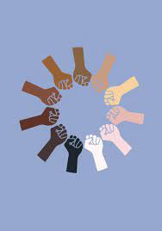
Racial Equity
Striving for strong representation of Black, Indigenous & People of Color (BIPOC) in faculty, students, staff & administration
Acknowledging the racial identity of founders of discipline, gatekeepers, journal editors, handbook & encyclopedia editors
Highlighting work of scholars, colleagues & students of color
Examining the different racial impacts of applications of knowledge produced in the discipline
Creating BIPOC spaces for students, administration, staff & faculty to share experiences, survive, support
Acknowledging the way racial identity – particularly Whiteness – carries embedded advantage
Addressing racial issues as an expected & natural part of what it means to think like a scientist
Building evidence of antiracist commitment into hiring, promotion & tenure decisions
Readjusting workload & compensation to accommodate antiracist work
Public modeling of racial learening by institutional leaders

Slide 17
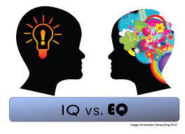
Two Kinds of Preparation for Teaching that Incorporates Race
Technical (Content) – reading, viewing, thinking, reflecting on nature of racism, white identity, white supremacy, anti-blackness etc.
Technical (Process) – how to model disclosure, choose good narratives, build trust, scaffold learning from simple to complex, use protocols
Emotional (EQ) – this is inherently emotional work in which people are laying bare their identities, experiences, convictions and feelings. It will sometimes be raw & contentious and people will become distressed, angry, and uncomfortable
Emotional (Mistakes) – this is inherently unpredictable work & you’ll constantly feel like you’ve screwed up, made mistakes, said or done the wrong thing, and mishandled situations
Two ways do do anti-racist work – IMPERFECTLY or NOT AT ALL!

Slide 18
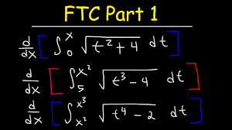
An arithmetic level of understanding of the dynamics of pervasive, structural racism amongst many whites who have not thought much about racial identity & whiteness THIS IS A REASON FOR AFFINITY GROUPS
A calculus level of understanding amongst black, indigenous and people of color (BIPOC) who have negotiated the dynamics of structural racism & white supremacy all their lives
TIRED OF WITNESSING ‘WOKENESS’

Slide 19
A Note to White Faculty “Good Whites” like me (Stephen)
Believe that we don’t see race
Believe everyone is a human being & we should treat everyone the same (colorblind ideology)
Believe we focus on actions & individual character, not racial identity
Choose when to engage in race and anti-racism
Can monitor our own racism
Believe we have a pure, anti-racist soul
Believe we are free of white supremacist conditioning
View racism as something committed by less enlightened whites
Regard ourselves as allies of people of color
Shannon Sullivan 2014. Good white people Albany: SUNY Press

Slide 20
Behaviors of “Good Whites”
When confronted with examples of their learned racism, good whites will vigorously deny any racist intent, claim they have been misunderstood, are acting innocently, & are being unfairly accused
Will become defensive & immediately seek to explain to people of color the “real” meaning of their behavior
Will resist “sitting with” the reality that they have learned racism & white supremacy throughout their lives & carry those viruses
Will accuse people of color of imagining things, seeing racism where it doesn’t exist, & denying the validity of whites’ experience
Will come to each other’s defense in multi-racial discussions
I know this because these are all of my learned behaviors
(Robin DiAngelo. 2018. White fragility. Boston: Beacon Shannon Sullivan 2014 Good white people SUNY)

Slide 21
Hard Truths I’ve Learned as a White Instructor
I MUST call out racist behavior (including in myself) as soon as I see it. If I don’t I will have no credibility in the eyes of students and colleagues of color.
I MUST assume that for students and colleagues of color EVERYTHING is seen through the lens of race. For them, NOTHING is “race free”.
I MUST acknowledge my own racist behavior when it’s pointed out to me – not try to ‘explain’ it away, not protest my innocence: I must regard it as truth.
I MUST NEVER try to talk people of color “out of” their testimony of racism.
I MUST NEVER invoke “being respectful” or “seeing all sides of this” as a way to avoid painful truths about my own socialization & learning of racism.
I MUST NEVER claim to be an “ally” or anti-racist “friend”.
I MUST NEVER ask people of color to teach me about racism or to tell me what I should do – figuring out what whites should do is OUR responsibility.

Slide 22
MODELING We take the lead in modeling disclosure about how our racial identity frames our life, how we struggle to understand & negotiate racism, how we make sense of what’s happening in the wider world
BRAVE SPACES
It’s our responsibility to prepare students & colleagues for the ‘brave spaces’ they will enter as race is discussed…
The normality of strong emotions & feelings – anger, frustration, sadness, fatigue, desperation, confusion
The normality of silence as a necessary dynamic of making sense of starkly different realities
The discomfort that lies ahead & that is predictable & ‘normal’
The lack of closure

Slide 23
How to Prepare for Teaching with Race in Mind
Lose Your Desire/Expectation to Be Perfect
Send Round Introductory Reading/Viewing*
Take the Emotional Temperature –sli.do, Mood Meter
Begin By Modeling Self-Disclosure
Introduce the Concept of Brave Space
Use Conversational Protocols to Engage Everyone
(Circle of Voices, Circular Response, Bohmian)
Check In Regularly via Anonymous Channels
(sli.do, backchannelchat.com)
* Letter to White America (George Yancy) https://opinionator.blogs.nytimes.com/2015/12/24/dear-white-america/
* What it Means to be American (Color of Fear) https://www.youtube.com/watch?time_continue=3&v=2nmhAJYxFT4&feature=emb_logo
* Conversations on Race (New York Times) https://www.nytimes.com/interactive/projects/your-stories/conversations-on-race
* How Can We Win (Kimberly Latrice Jones) https://www.youtube.com/watch?v=ZkedkvNn5V0

Slide 24
So where do we go from here?
Understand that calling out racism is the responsibility of whites – don’t wait for BIPOC to be the first to raise these issues
Don’t wait for people of color to say they’re uncomfortable with something – if you have any unease, name it
Work on naming racism as LEARNED behavior – not as an individual soul flaw or inherent lack of humanity, empathy, compassion
Strive to model anti-racist awareness in your own contributions
Understand white privilege/power as an unconscious phenomenon – as not having to worry about how your race makes things difficult for you & anticipate how to negotiate barriers & survive emotionally

Slide 25
So where do we go from here?
Don’t expect gratitude or thanks – you’re just doing the right thing
Don’t preach at, or disdain, those you regard as “less enlightened”
Don’t set up people to “confess” & then grant absolution
Don’t stay silent in multiracial discussions
Do assume you’ll say the “wrong” thing & leave feeling you messed up
For White faculty strive to act as allies – but watch out for making a big deal out of publicly declaring yourself an ally to BIPOC

Slide 26
Q & A Please go to sli.do Enter code: 779413 (Or use the QR code opposite on your smart phone) Post any questions you have to sli.do

Slide 27
1st Breakout Room Session
Here we will try a beginning protocol that is adaptable across both online & face-to-face contexts – the Circle of Voices
Please follow the protocol. We will work in groups of 5.
The question….
What are the most effective approaches, activities &/or exercises that you have enacted yourself, or seen colleagues implement, to incorporate racial analysis & questions of racial identity into the curriculum & classroom?

Slide 28
An equitable small group discussion protocol – the Circle of Voices S. Brookfield & S. Preskill. 2016. The discussion book: 50 great ways to get people talking. Hoboken, NJ: Wiley
(1) Begin with a mandatory 1-2 minute silent period for people to think about their response to the question & make written or mental notes
(2) Go alphabetically (using 1st names) around the group & have each person give their response to the question you’ve just thought about. Each person should keep their opening comments to no more than two minutes. No interruptions as each person speaks.
(3) Once everyone has spoken move into open conversation – anyone can speak at any time & there is no order of contribution. However, try to speak ONLY about what someone ELSE said in the opening round of comments.
(Ask questions, point out similarities & differences, talk about new ideas you were exposed to, give examples to illustrate what someone said, state the basis of your disagreement with a comment, talk about how a comment led to a new understanding, reference a question or issue someone’s comment raised for you.)

Slide 29
Please post questions and issues that arose in your circle of voices conversation to sli.do These can be about the circle of voices protocol or about the themes and items that generated conversation Please go to sli.do Enter code: 779413 (Or use the QR code opposite on your smart phone)

Slide 30
2nd Breakout Room Session
Here we will try a different protocol that is slightly more complex. It is also adaptable across both online & face-to-face contexts – Circular Response
Please follow the protocol. We will work in groups of 5.
The question (a sort of two-parter!)….
What dynamics around dealing with racial identity or racism do you find the most difficult to negotiate as an educator? What fears, uncertainties & doubts do you carry into this work?

Slide 31
Circular Response S. Brookfield & S. Preskill. 2016. The discussion book: 50 great ways to get people talking. Hoboken, NJ: Wiley
Facilitator, leader or group members pose a question
Begin with 2 minutes silence as you make some written or mental notes of your response to the question When someone is ready to give an opening response they speak for no more than 2 minutes – no interruptions please.
The next to speak is the person whose last name is next alphabetically to the 1st speaker. She or he takes time to think about the opening comment & then tries to build on it in some way. This can be an agreement or disagreement, extending the comment with an example, raising a question, explaining why it’s difficult to respond, applying the comment to a different context – no interruptions!
Person whose last name is alphabetically next to the 2nd speaker goes next. Again, she or he takes time to think about the opening comment & then tries to build on it in some way – no interruptions!
Process continues until everyone has spoken with each person striving to build on & respond to the previous speaker’s comment (with no interruptions)
Group then moves into open conversation with no ground rules.
Gives everyone a chance to contribute
Builds the habit of careful & attentive listening and responding
Tends to focus the conversation & analysis more deeply around one or two issues

Slide 32
Please post questions and issues that arose in your circular response conversation to sli.do These can be about the circular response protocol itself or about the themes and items that generated conversation Please go to sli.do Enter code: 779413 (Or use the QR code opposite on your smart phone)

Slide 33
Some Resources Authored by Stephen
Becoming a white antiracist: A practical guide for educators, leaders & activists. 2021. Sterling, VA: Stylus (w/Mary Hess)
Gospel Beautiful Podcast: https://www.buzzsprout.com/680528/8460030-stephen-brookfield-and-mary-hess-becoming-a-white-antiracist
Teaching race: Helping students unmask and challenge racism. Hoboken, NJ: Wiley Publishing
Becoming a critically reflective teacher. 2017 (2nd. Ed.). Hoboken, NJ: Wiley Publishing
Handbook of race and adult education. 2010. Hoboken, NJ: Wiley Publishing w/ Vanessa Sheared, Juanita Johnson-Bailey, Scipio Colin Jr III, & Elizabeth Peterson.
The discussion book: 50 great ways to get people talking. 2016. Hoboken, NJ: Wiley Publishing (w/Stephen Preskill)
www.stephenbrookfield.com
(Go to “Resources”, “Creating an Anti-Racist White Identity” and “Recent Writings” links)

Slide 34
General Resources
Ijeama Oluo – So You Want to Talk About Race (2019) https://www.youtube.com/watch?v=TnybJZRWipg
George Yancy - Look! A White (2012), What White Looks Like (2004), White Self-Criticality beyond Anti-Racism (2016) https://www.youtube.com/watch?v=fyZNAAr8czE
N.M. Joseph, C. Haynes and F. Cobb (Eds.). 2016. Interrogating Whiteness and Relinquishing Power: White Faculty’s Commitment to Racial Consciousness in STEM Classrooms. New York: Peter Lang,
Derald Wing Sue – Race Talk & the Conspiracy of Silence (2016) https://www.youtube.com/watch?v=Nrw6Bf5weTM&t=53s
Shannon Sullivan – Good White People (2014) https://www.youtube.com/watch?v=UZo06BjmbbE
Robin DiAngelo – White Fragility (2018) https://www.youtube.com/watch?v=45ey4jgoxeU
Ibram X. Kendi – How to Be an Anti-Racist (2019) https://www.youtube.com/watch?v=TzuOlyyQlug
Glenn Singleton – Courageous Conversations About Race (2014) https://www.youtube.com/watch?v=IwaOBXzJ3hs
Tim Wise – White Like Me (2011) https://www.youtube.com/watch?v=N4fbr1LlxEk

