Slide 1
Using Discussion as a Way of Teaching
Friedrich-Alexander-Universität Erlangen-Nürnberg (FAU) July 28th, 2022
Stephen Brookfield
(Distinguished Scholar, Antioch University
Adjunct Professor, Columbia University Teachers College)
www.stephenbrookfield.com

Slide 2
My Website
My website is open access so if you want to find out more about any of the exercises or activities I mention go to the page and click on the ‘Resources’ link.
Scroll down & you will find multiple PDF files of workshop packets stuffed with activities or power point files.
Today’s power point is the first one listed: http://www.stephenbrookfield.com/powerpoints-pdfs
You do not need to ask my permission to use any of these resources. If they’re useful then please try them out and adapt them to your context.
www.stephenbrookfield.com

Slide 3
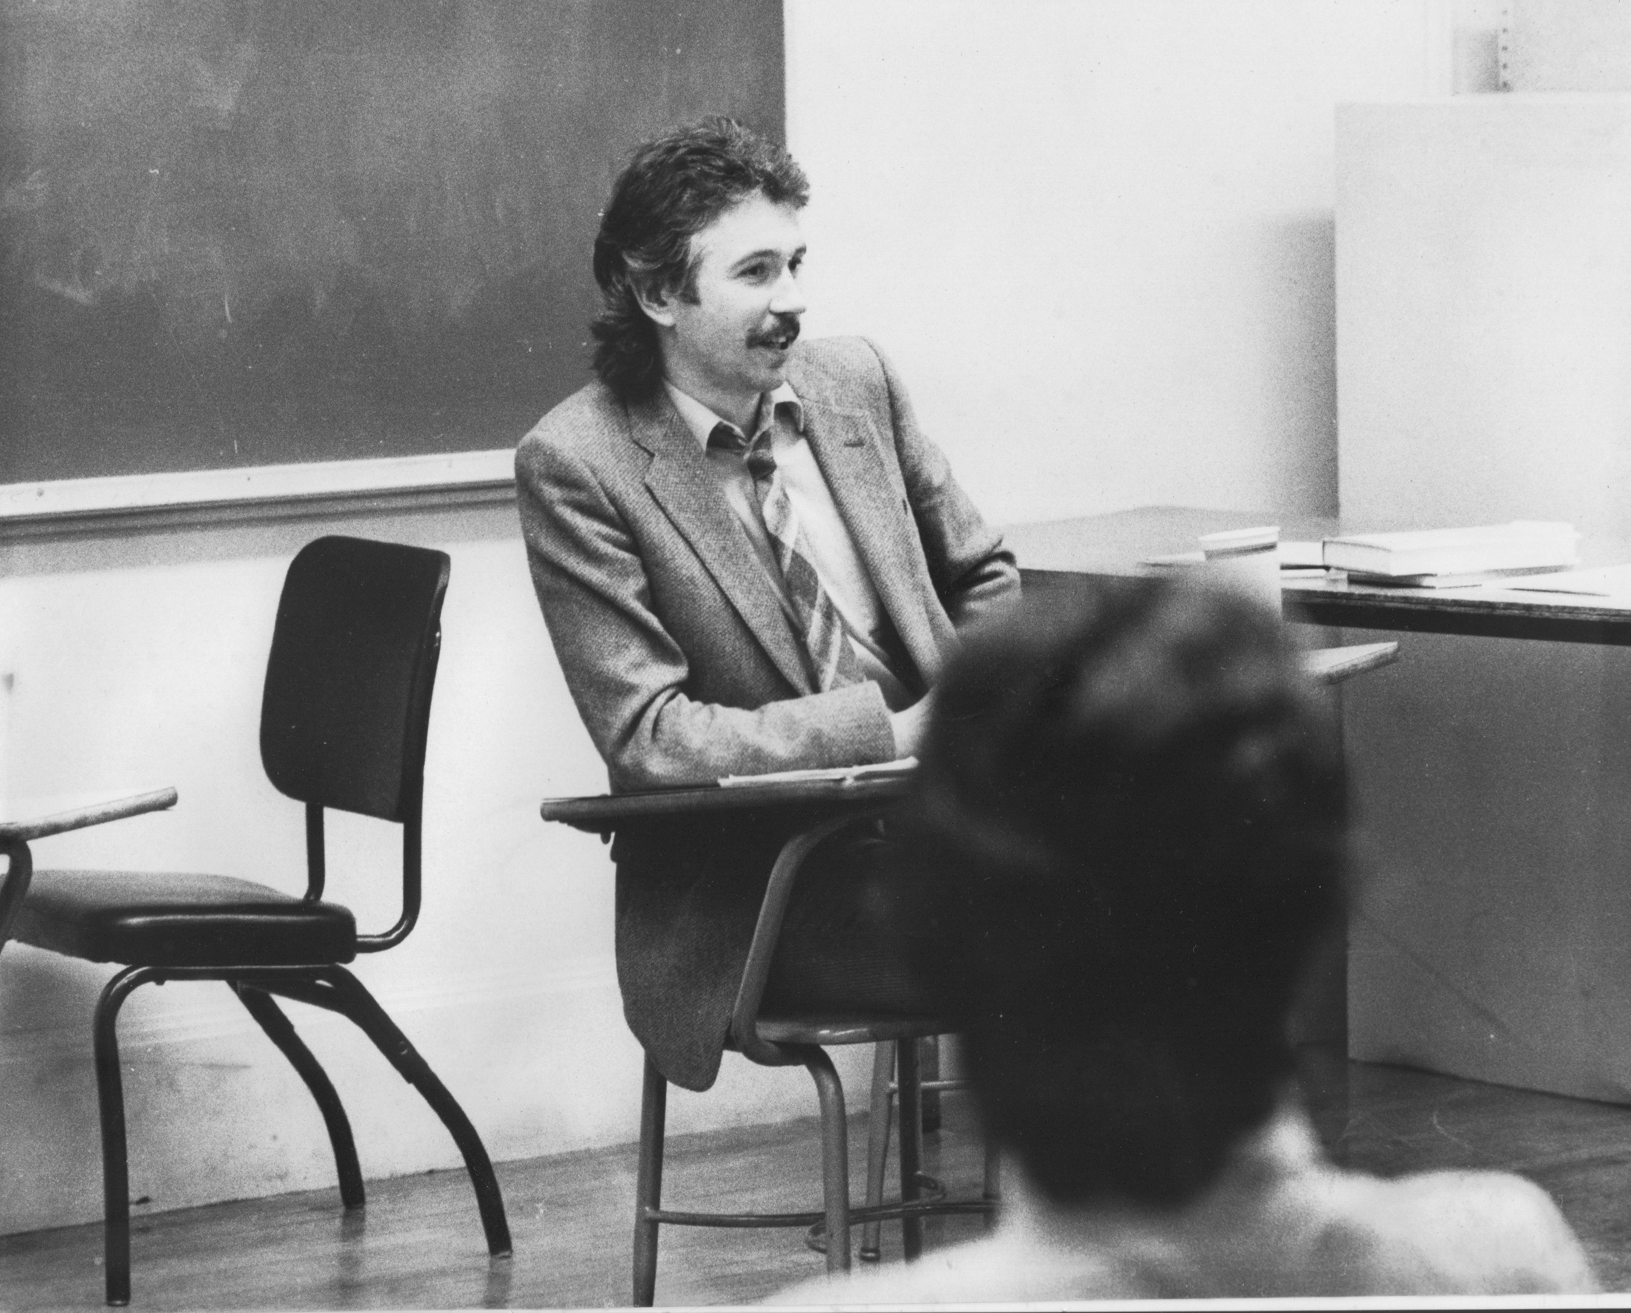
Who I am as a teacher is influenced by who I am as a learner….
History of academic mediocrity –failed high school leaving exams, university places cancelled, graduated in bottom half of my class, turned down for graduate study, failed my master’s degree exam Broadening student-centered assessment measures
Discussions as Performance Events – good discussion is speaking a lot, sounding smart, quoting sources correctly, being “noticed”
Establishing quiet ways of participating & normalizing periods of structured silence
Watching my doctoral supervisor – giving me ‘bad’ inconvenient news in a way that I knew was in my own best interests
Ethical use of teacher power
Relational underpinnings to critical thinking
An authoritative ally

Slide 4
Misconceptions
Discussion is inherently democratic – in fact, some groups shut down certain members & isolate them & their views
Discussion is spontaneous & open – counterfeit discussion: it looks like discussion but is really a fake currency of manipulation
Discussion is suited to every pedagogic purpose – No: it’s best suited to uncovering & developing complexity, opening people up to alternatives, causing people to question their assumptions
Discussion binds and coheres groups – sometimes it splinters & divides them into unbridgeably different clusters

Slide 5
An ‘Icebreaker’ I use – “I AM FROM”
Particularly helpful in discussions around contentious issues
Suited to groups where people are mistrustful
Designed to build good relationships
Demonstrate common ground
METHODOLOGY
Students choose 3 or 4 sentence prompts to complete the phrase “I AM FROM…”
The sound of…. The values of…. The touch of….
The smell of…. The family of…. The faith of….
The taste of…. The feeling of…. The place of….

Slide 6
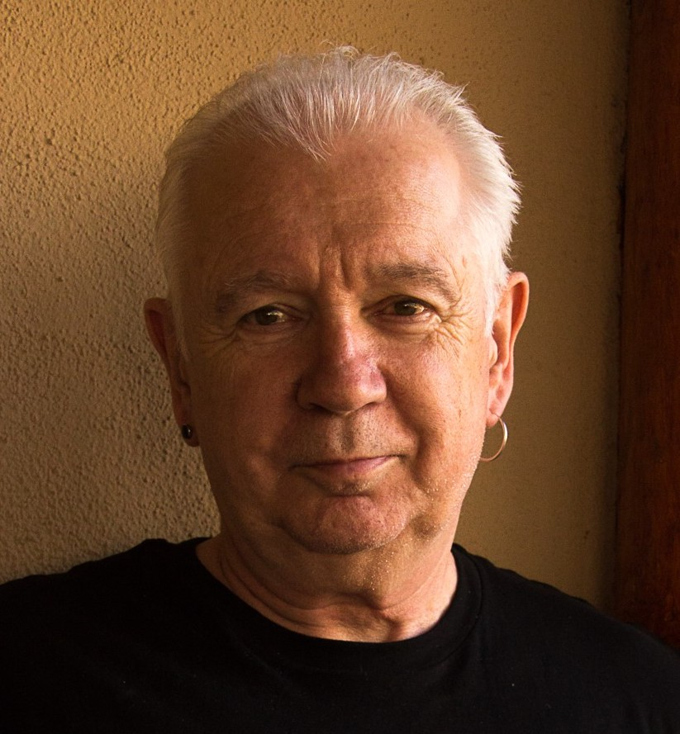

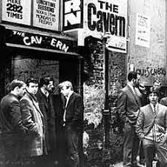

Slide 7
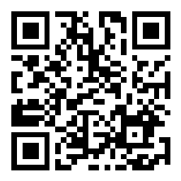
A SOCIAL MEDIA TOOL
Go to sli.do
Enter Code: 1303695
(Or, use the QR Code opposite)
Reply to the question: What do you hope to achieve when you use discussion as a way of teaching?
Your responses are ANONYMOUS

Slide 8
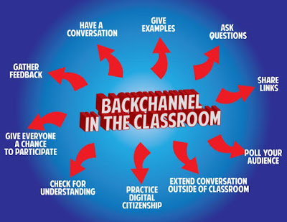
Pose a question at start of class to assess what knowledge, experience & preconceptions students bring
Pose quick questions during class to check for understanding, identify misconceptions
Invite students to raise questions or seek clarification anonymously
Interrupts the normal privileging of speech, extroverts, dominant language speakers – no one can dominate
Anonymity means students aren’t afraid to ask ‘dumb’ questions
As with all activities, open to sabotage
sli.do
backchannelchat.com
tweedback.de

Slide 9
The Importance of Modeling
Ending lectures with questions uppermost in your mind
Using your own learning autobiography to illustrate the growing depth of convictions, or important turning points for you
TEAM TEACHING
Point / Counterpoint
Dialectical conversation
Displaying curiosity
Disagreeing
Being open to alternative views

Slide 10

Setting Expectations…
Have students create their own norms for discussion based on their best & worst experiences as discussion participants
Avoid counterfeit discussions – that look like the real thing but that are fake currency
Announce protocols that… (1) involve everyone participating, (2) require careful listening & (3) incorporate regular structured silence for thinking & reflection
Publish criteria for grading participation early
Make sure those criteria include silent contributions

Slide 11
Grading for Participation
Post a question, comment or make a suggestion online that takes us in a promising or provocative new direction
Post a resource (a reading, web link, video) not covered in the syllabus but that adds valuable new information/perspectives
Make a comment indicating how you found someone’s ideas interesting or useful. Be specific about what was so helpful
Alert us to a question posed that is not being answered
Make a comment that explicitly underscores the link between two people's contributions
Grading for Participation
Contribute something that builds on, or springs from, what someone else has said. Be explicit about how you do this
Make a summary observation that acknowledges several people's contributions & touches on a recurring theme
Provide an example that clarifies or illustrates someone’s point
Ask a question or make a comment that encourages someone to elaborate on something they’ve already said
Find a way to express appreciation for the enlightenment you have gained from the discussion. Be specific about what helped you understand something better
Challenge an idea without challenging a person

Slide 12

QUESTION
When a discussion is going well, what does it LOOK, SOUND or FEEL like?
(1) Declare a 1-2 minute silent period for people to think about their response to the question & make written or mental notes
(2) Go alphabetically around the group and have each person give their response to the question(s) they’ve just been thinking about. Each person tries to keep their comments to a minute or so. No interruptions of each other please.
(3) Once everyone has spoken move into open conversation – anyone can speak at any time & there is no order of contribution. However, try to speak ONLY about what someone ELSE said in the opening round of comments.
A Classroom Tool – the Circle of Voices Protocol

