Slide 1
2022-SPRING SEMESTER LAUNCH Saturday, January 8, 2022 Ed.D in Education & Professional Practice What Constitutes Allyship?
Stephen Brookfield
Distinguished Scholar, Antioch University
http://www.stephenbrookfield.com

Slide 2
How to access this power point…
Go to my home page: http://www.stephenbrookfield.com/
Click on the “Resources” link (top left, next to ‘Home’
Scroll down to power points & pdf’s http://www.stephenbrookfield.com/powerpoints-pdfs
This power point is the 1st one listed – What Constitutes Allyship?
Feel free to steal anything from my home page – it’s open access for free download

Slide 3
The (White) Elephant in the Room Another White man leading something on race – doesn’t this underscore the power of Whiteness?
The problem of race is the problem of unchallenged white supremacy – its idea & practice
At the heart of racism is the fact that many White folks such as Stephen Brookfield have not examined what it means to have a White racial identity
White students & colleagues need to see us typically & unremarkably center racial dynamics as a factor in teaching & leadership – “equity pause” in meetings
Diversity, equity & inclusion (DEI) work often involves cross-racial conversations & alliances – facilitated by a team of colleagues of different racial identities

Slide 4
I am from…*
the sound…of seagulls crying over the north sea and merseybeat blasting at the Cavern club,
the smell…of fish & chips, factory waste and coal burning fires,
the taste…of grease, sour milk tea and dust at the back of my throat
the idea…of community pride & the triumph of humor over pretentiousness
* Adapted from the poem Where I’m From by George Ella Lyon

Slide 5
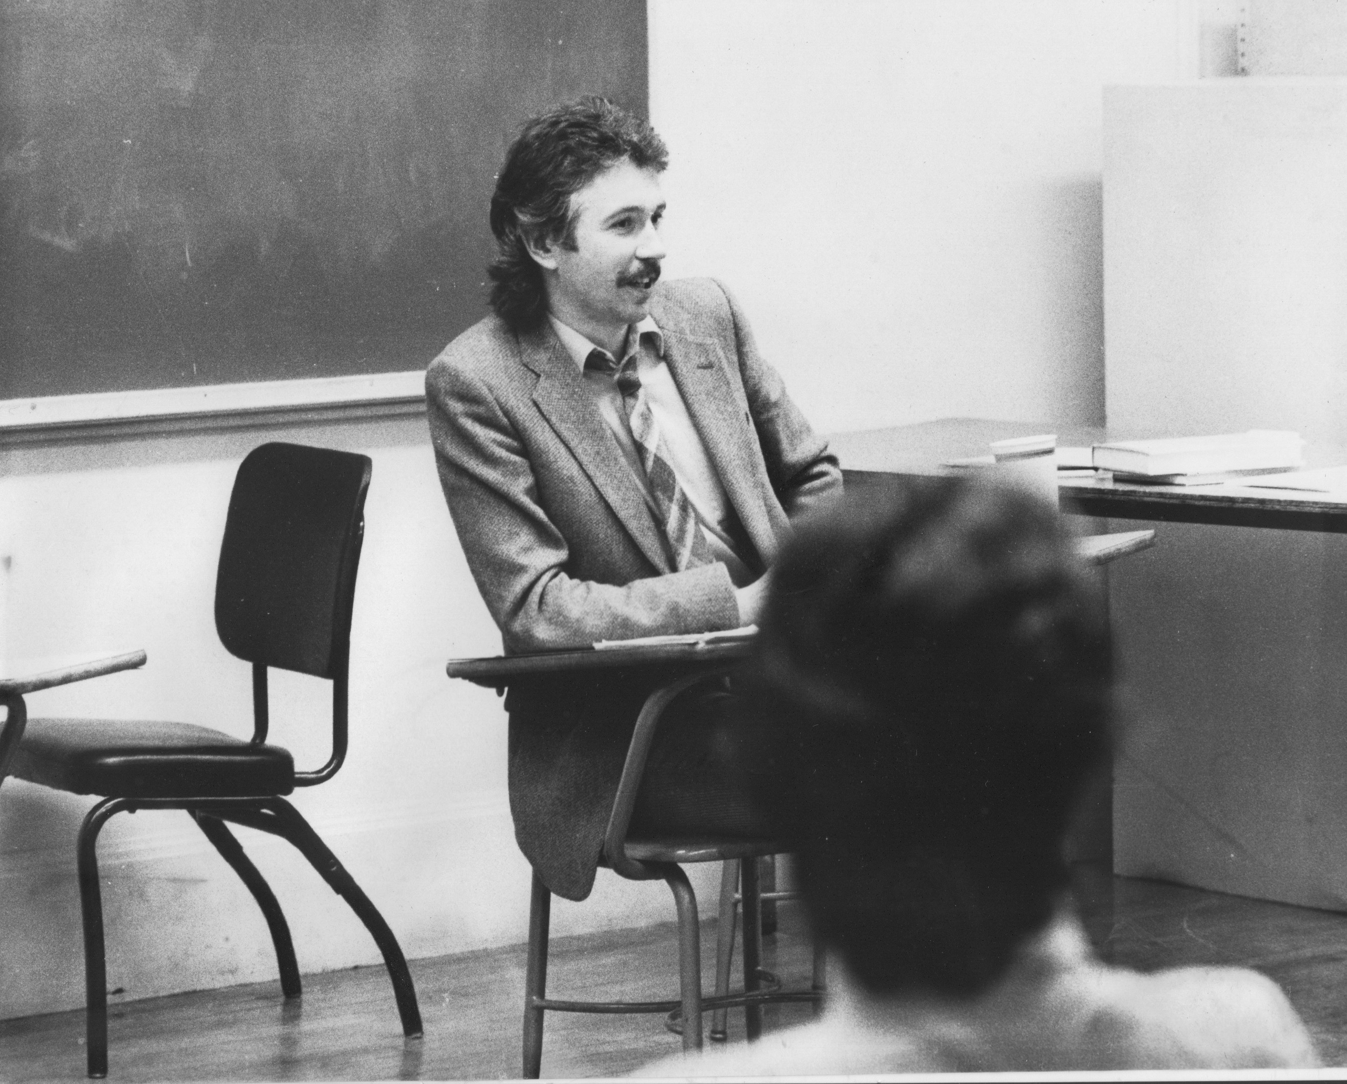
Situating Myself as a Teacher
History of academic mediocrity –failed high school leaving exams, university places cancelled, College of Technology, graduated in bottom half of my class, turned down for graduate study, failed my master’s degree exam
Broadening student-centered assessment measures Watching my doctoral supervisor – giving me ‘bad’ inconvenient news in a way that I knew was in my own best interests
Ethical use of teacher power
Relational underpinnings to critical thinking
Balancing credibility & authenticity

Slide 6
Situating Myself Racially
Born into a White family in Liverpool, England grew up in the UK Did not speak to anyone who wasn’t White until I was 18 Spent over half my life regarding myself as a “Good White Person”* who has escaped racism with a color-blind perspective Will never lose the White supremacist conditioning I’ve received - blackness as dangerous & volatile Will always feel “unqualified” to talk about racism - & then remind myself I’m an expert on how white supremacy is learned Believe that Whites like me need to develop an antiracist identity** *Shannon Sullivan. 2014. Good White People (SUNY Press) ** Stephen Brookfield & Mary Hess. 2021. Becoming a White Antiracist (Stylus)

Slide 7
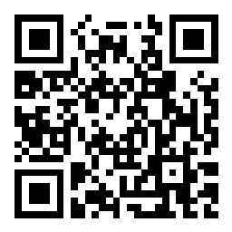
Let’s try a social media tool
Go to sli.do
Enter Code: 877750
Or use the QR code opposite (if you’re using a smart phone)
Give your response to the following question….
What is an act of racial allyship that you've witnessed or heard/read about?

Slide 8
Allyship is Conferred not Announced An ally works at the direction of the movement/group leaders – eg. White protesters at front & sides of protest Allies work within their own racial groups on addressing the racism/white supremacy that’s present in those groups Allies use any privilege or cultural capital they have to identify & challenge racism/white supremacy Allyship does NOT expect or seek any recognition or acknowledgment of effort
You don’t become an ally by declaring you’re one
Given that different agendas & stakeholders exist in any movement, this sometimes means choosing which groups you will be directed by
How do we learn & internalize white supremacy? How do we rationalize our own enactment of it? What Eurocentric paradigms of education & assessment go unchallenged as the universal norm? Privileging text, solo knowledge production
If you’re from the dominant racial group you are the first to raise issues of race, racism & white supremacy – you will not face the same accusations of having a racial agenda, playing the race card or advancing a sectional interest

Slide 9
Common Traps & Dangers
Announcing one’s status as an ally
False & inauthentic presentation of your own identity – clothing, slang, gestures
Always looking to BIPOC to tell you want to do
Looking for approval from BIPOC because of your actions – the ‘good ally’ medal
Speaking on behalf of a group to advocate for & represent their needs

Slide 10
Common Traps & Dangers
Preaching at & disdaining members of your own racial group who are supposedly less ‘enlightened’ than you
Opposing racial affinity conversations as holding a movement back (there are times your presence is a distraction to ‘real talk’)
Resolving to stay silent in multiracial discussions so as to ‘give voice’ to others
Becoming discouraged, & believing you’ve ‘failed’, when you’re called out on your own racism

Slide 11
Resources (Alphabetically)
Brookfield, S.D. & Hess, M.E. 2021. Becoming a white antiracist: A practical guide for educators, leaders, and activists. Sterling, VA: Stylus. ISBN: 978-1620368596
Crass, C. 2013. Towards collective Liberation: Anti-racist organizing, feminist praxis and movement building strategy. St. Louis, MO: Chalice Press. ISBN: 978-1-60486-654-4
Delgado, R. & Stefancic, J. 2017. Critical race theory: An introduction. New York: New York University Press. ISBN: 978-1479802760
Kendi, I.X. 2019. How to be an antiracist. New York: One World Books. ISBN: 9780525509288
Saad, L.F. 2020. Me and white supremacy: Combat racism, change the world, and become a good ancestor. Naperville, IL: Sourcebooks. ISBN: 978-17228238869
Solomon, A. & Rankin, K. 2019. How we fight white supremacy: A field guide to black resistance. New York: Bold Type Books. ISBN: 9781568588490
Yancy, G. 2018. Backlash: What happens when we talk honestly about racism in America. Lanham, MD: Rowman & Littlefield. ISBN: 978-1-5381-0405-7
Zalamin, A. 2019. Antiracism: An introduction. New York: New York University Press. ISBN: 9781479849284

